Slide 1
MSU’s Academic Advancement Network
Elizabeth H. Simmons
Associate Provost for Faculty and Academic Staff Development Dean, Lyman Briggs College
University Distinguished Professor of Physics
11 October 2016

Slide 2
11 October 2016

Slide 3
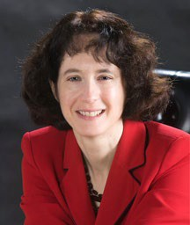
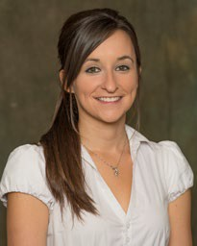
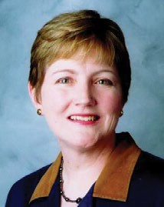
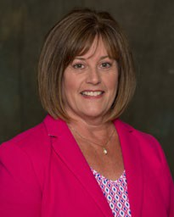
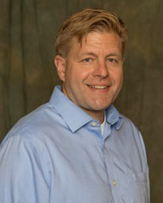
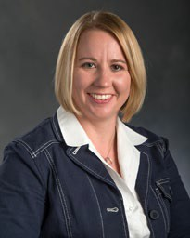
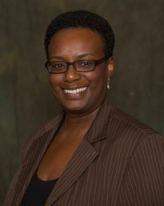
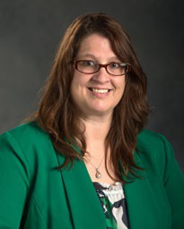
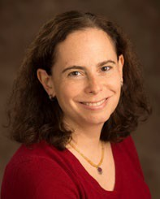
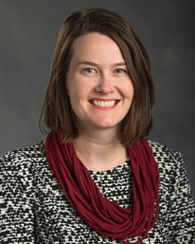
The Academic Advancement Network team:
Elizabeth Simmons
AAN Coordinator
Ann Austin
Academic Career Paths Node
Jeff Grabill
Teaching and Learning Node
Beronda Montgomery
Research and Scholarship Node
Juli Wade
Leadership Development Node
Jill Bryant
Project Events
Beth Leete
Administration
Cindi Leverich
Leadership Development
Patti Stewart
Instructional Development
Blythe White
Communications

Slide 4
AAN Offers:
Open-access workshops on teaching, scholarship, leadership, and academic career paths.
Targeted events for academics or administrators at key career stages (new roles, approaching promotion)
Leadership conversations with President Simon (Sept. 23) and Provost Youatt (Oct. 31) each semester
Individualized confidential consultations on
Developing new capacities as an educator
Building the organizational strength of your unit

Slide 5
AAN Offers:
Online materials on all aspects of academic careers and leadership (aan.msu.edu)
Small groups and learning communities where academics work with peers on building skills or improving campus life
Selective cohort programs for intensive study of the scholarship of teaching and learning (Lilly Fellows, Adams Academy) or foundations of academic leadership (Big Ten ALP Fellows).

Slide 6
How can AAN collaborate with you?

