Slide 1
MSU’s Academic Advancement Network
Elizabeth H. Simmons
Associate Provost for Faculty and Academic Staff Development Dean, Lyman Briggs College
University Distinguished Professor of Physics

Slide 2
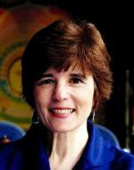
Origin of the Academic Advancement Network:
For many years, academic advancement at MSU was led by the Office of Faculty
and Organizational Development (F&OD), headed by Dr. Deborah DeZure.
As of 2016, F&OD has evolved into the new Academic Advancement Network, dedicated to advancing academic careers through inclusive, collaborative, and experiential learning. Resources are available at aan.msu.edu

Slide 4
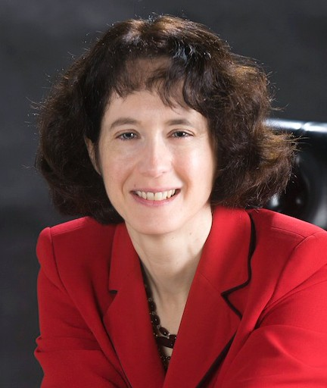
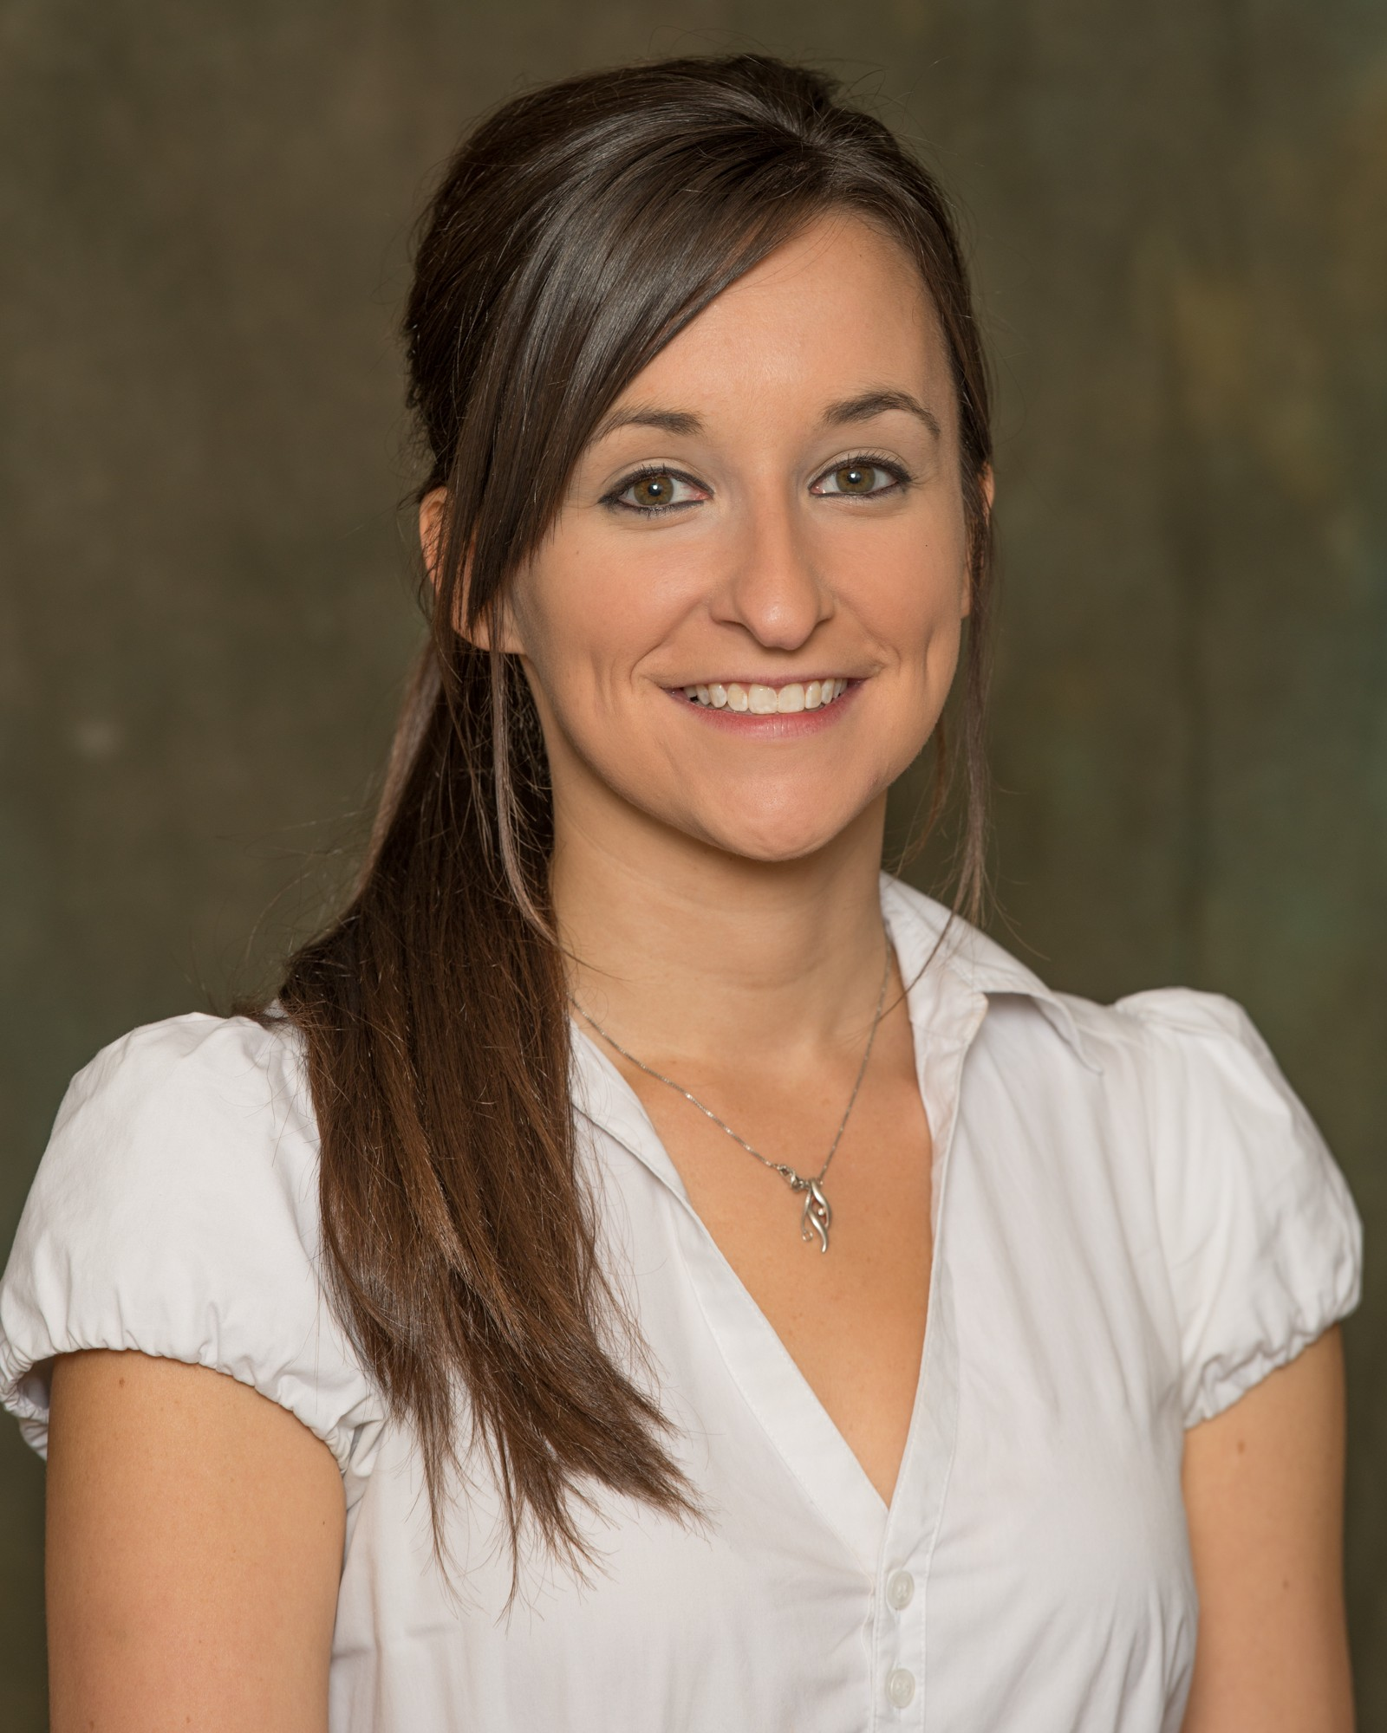
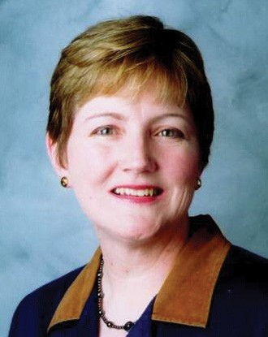
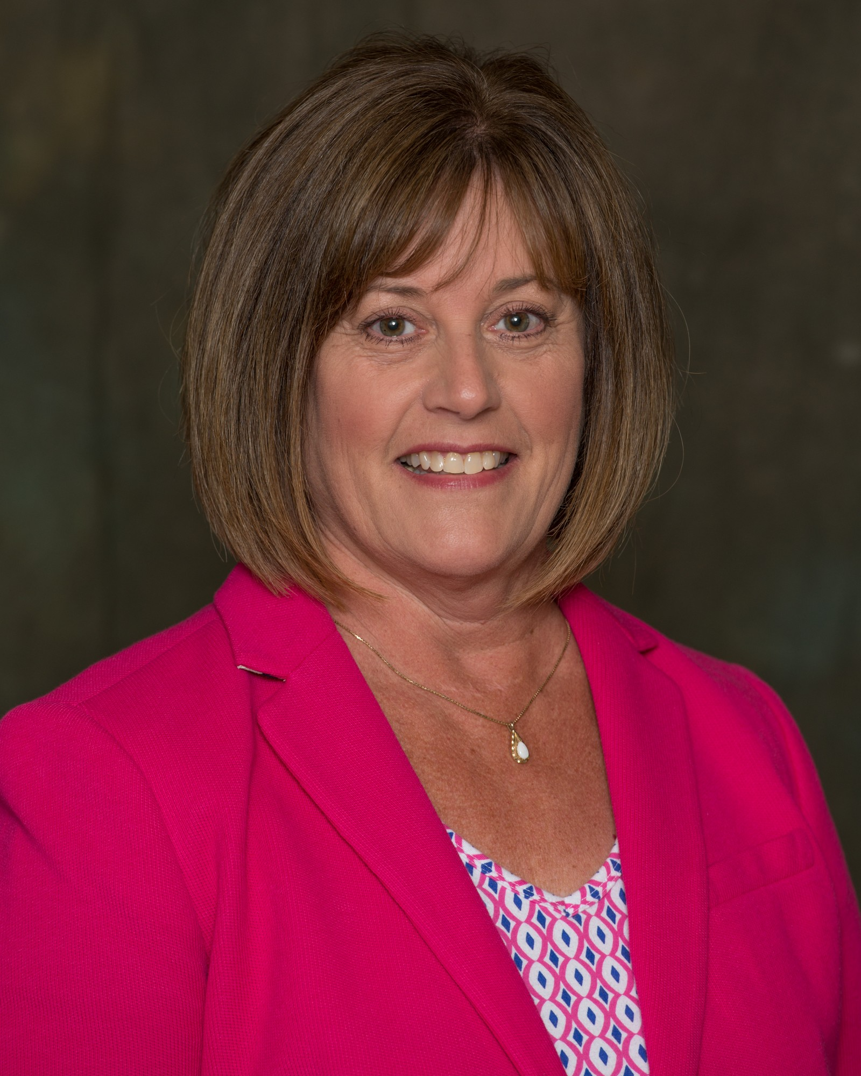
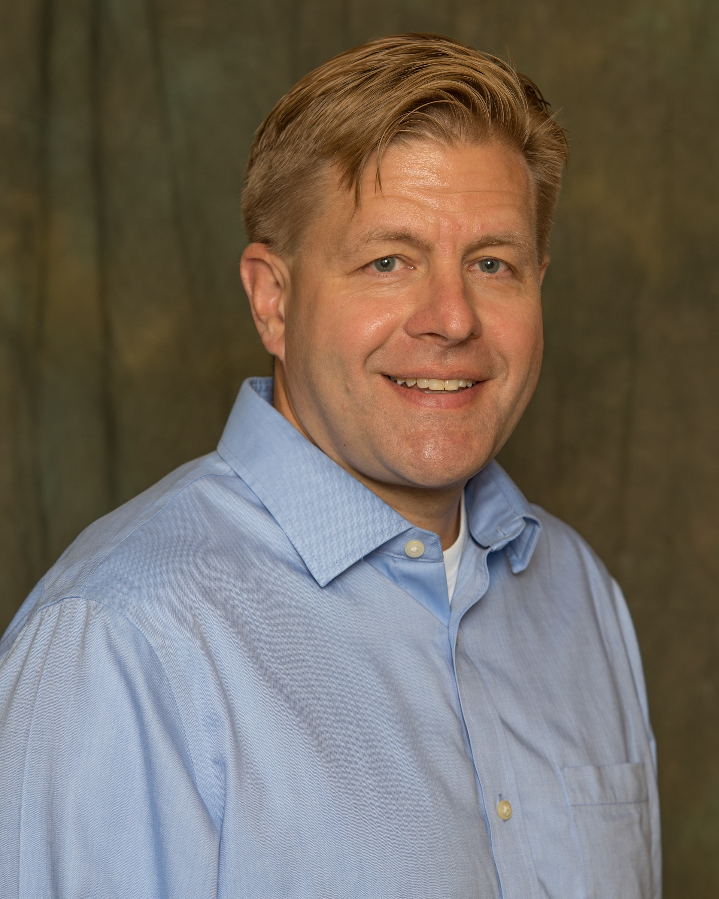
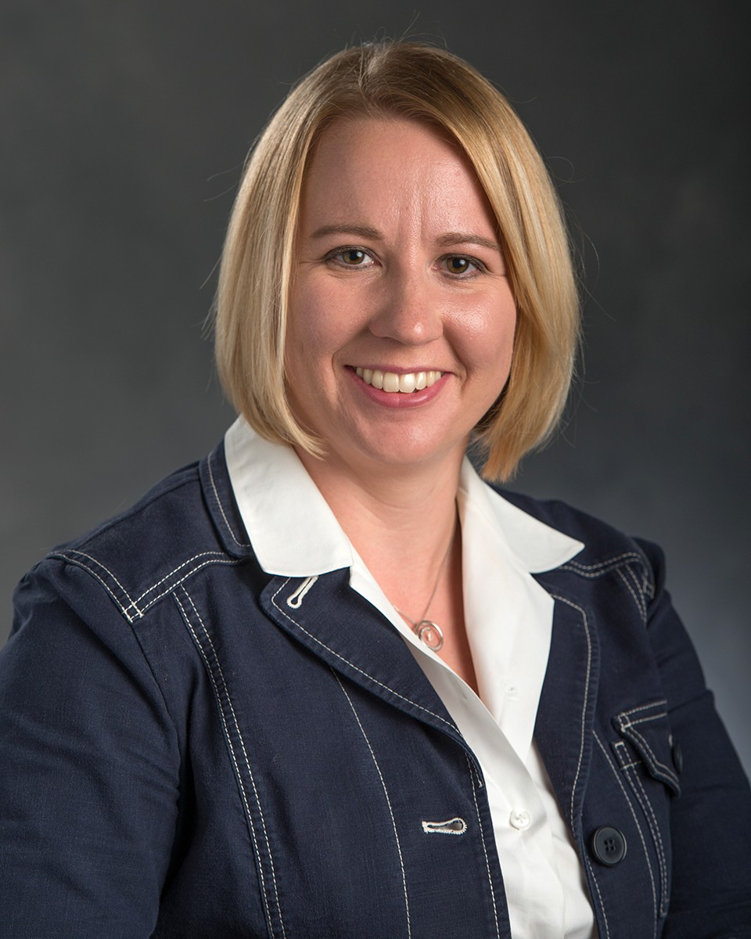
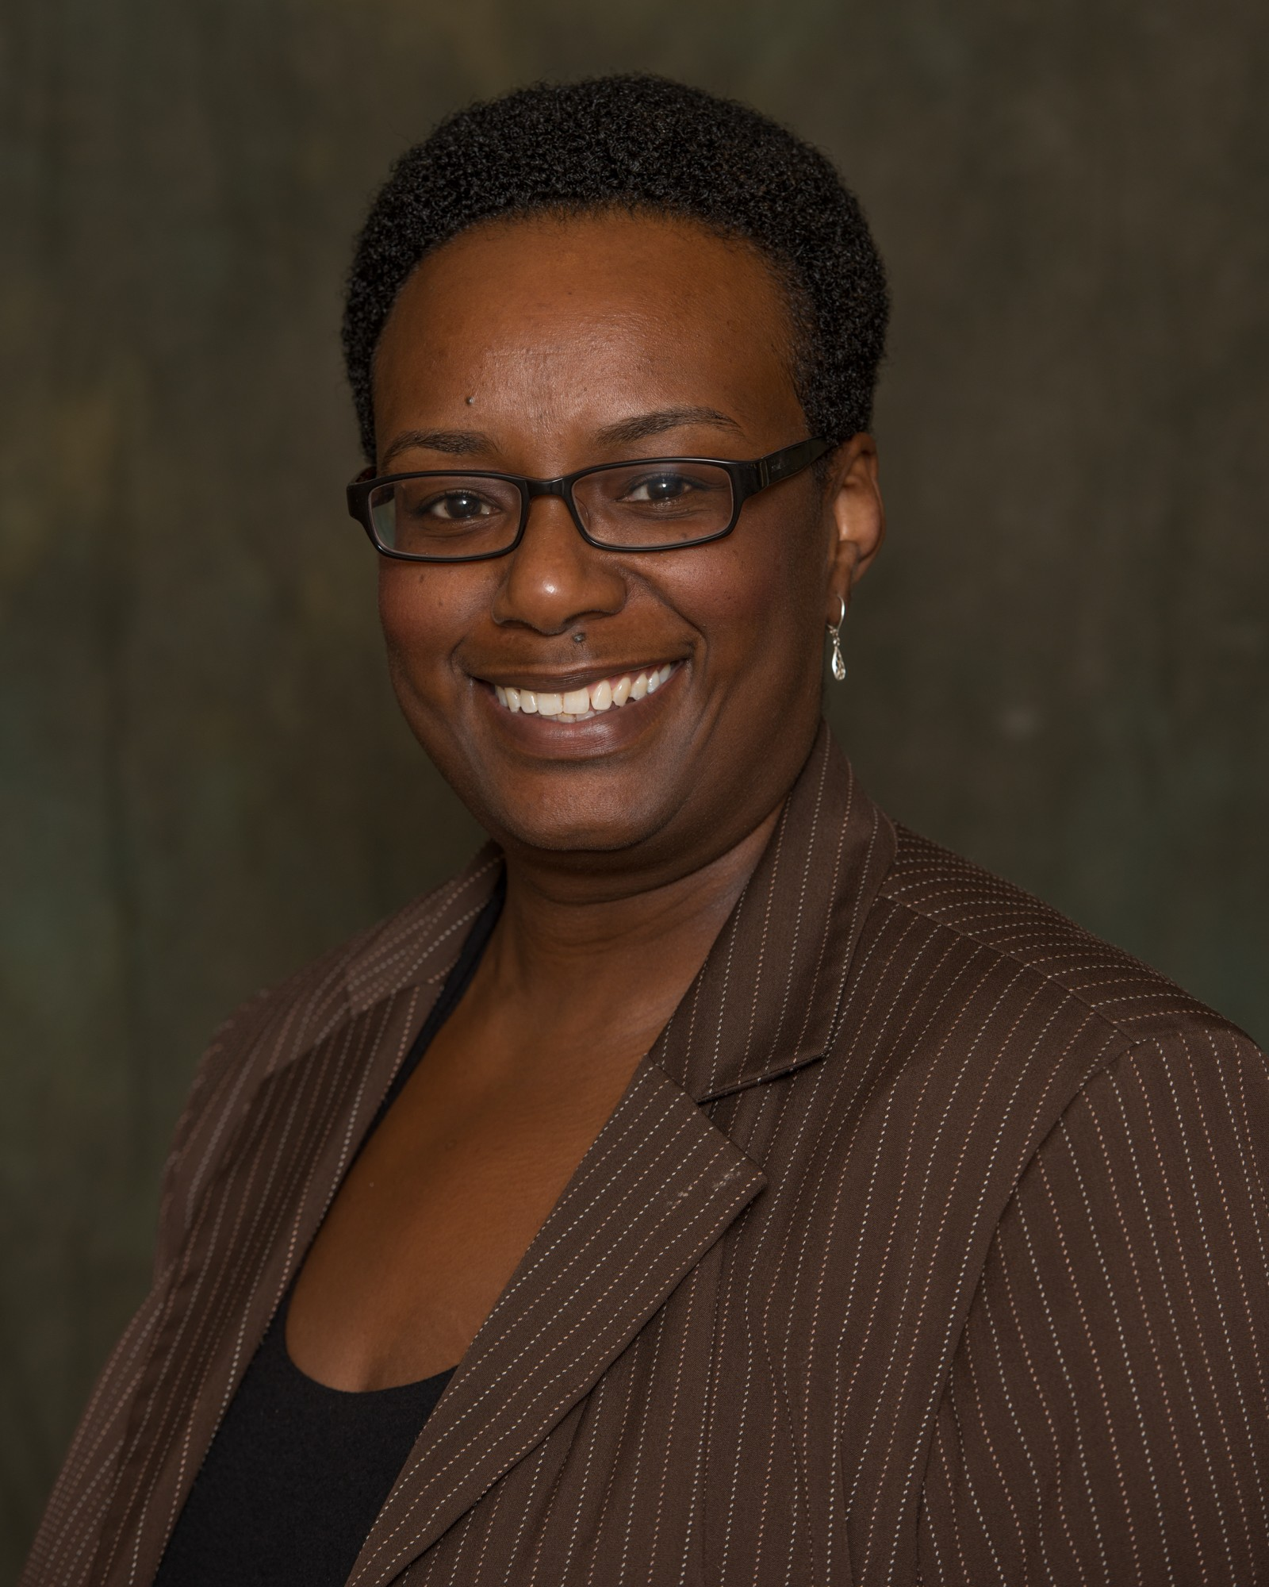
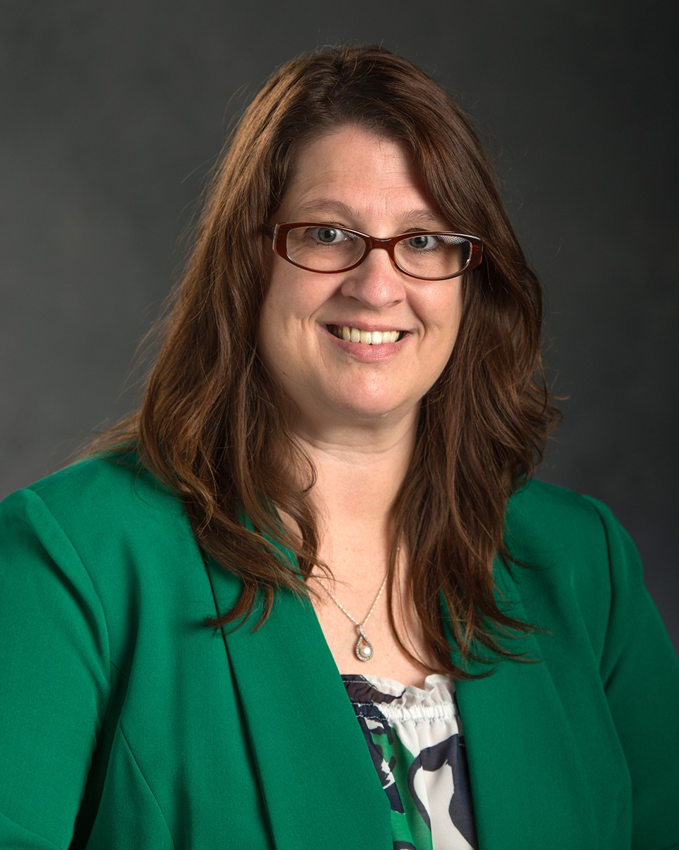
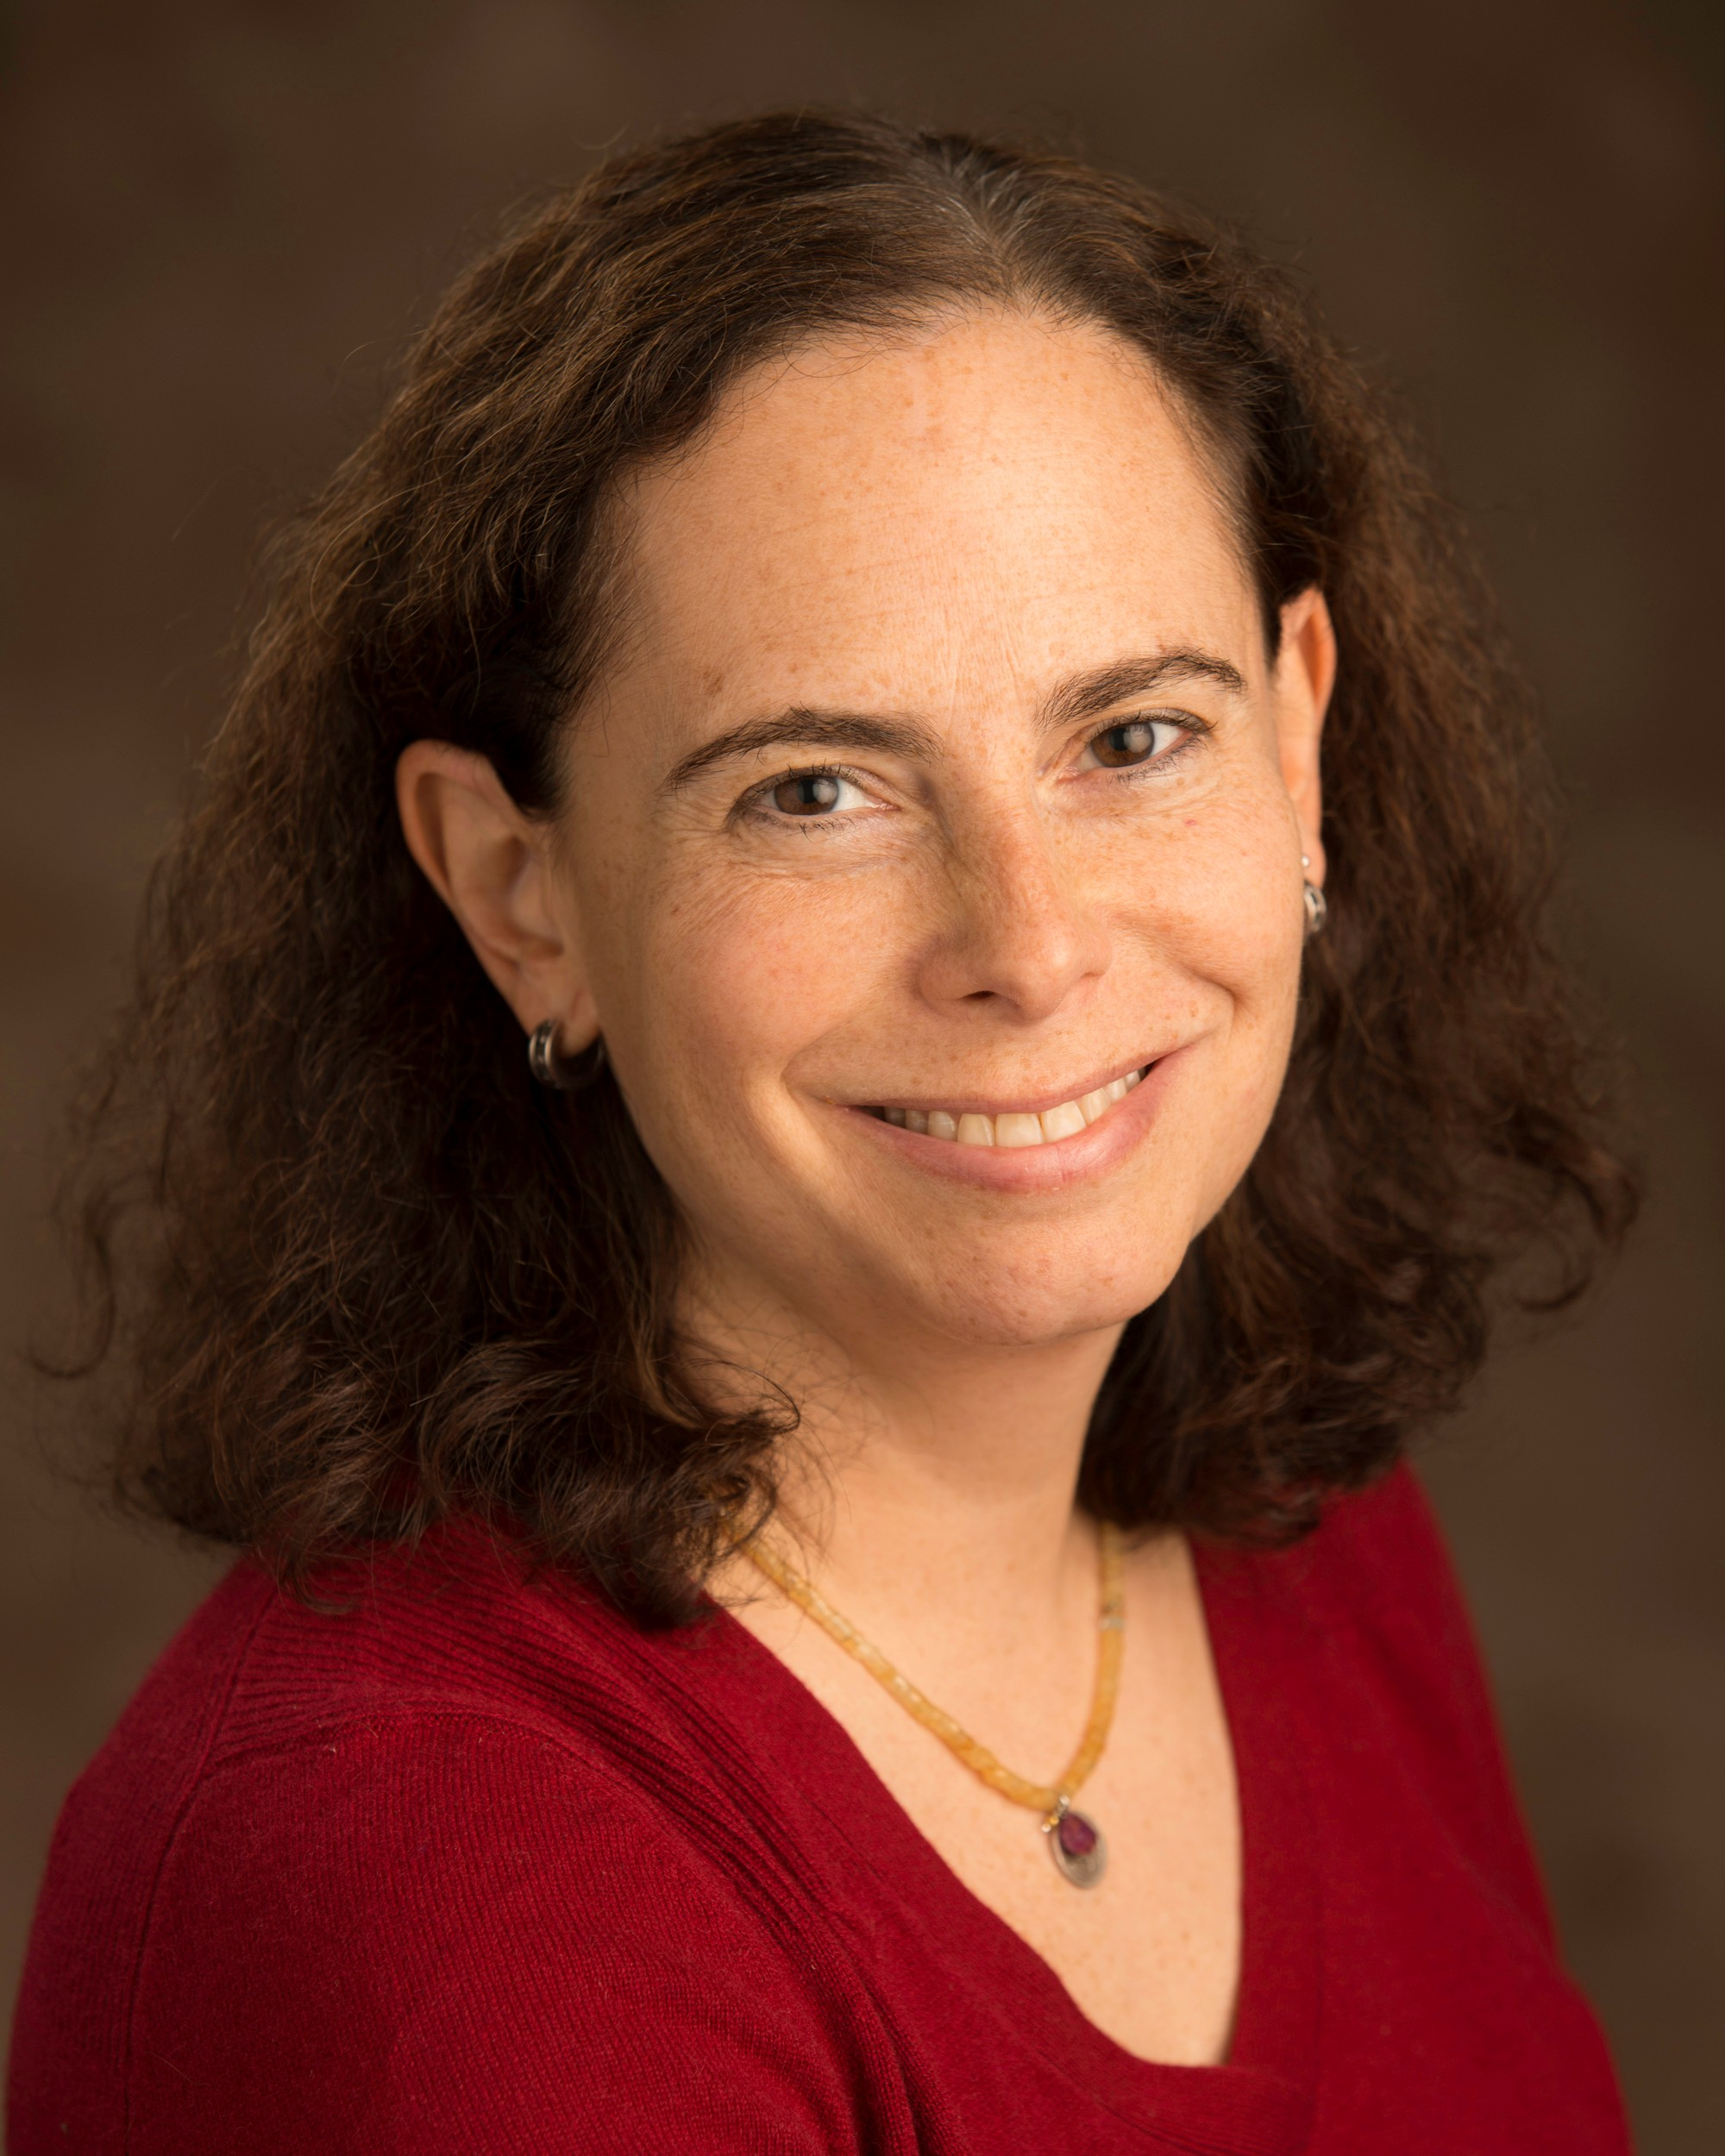
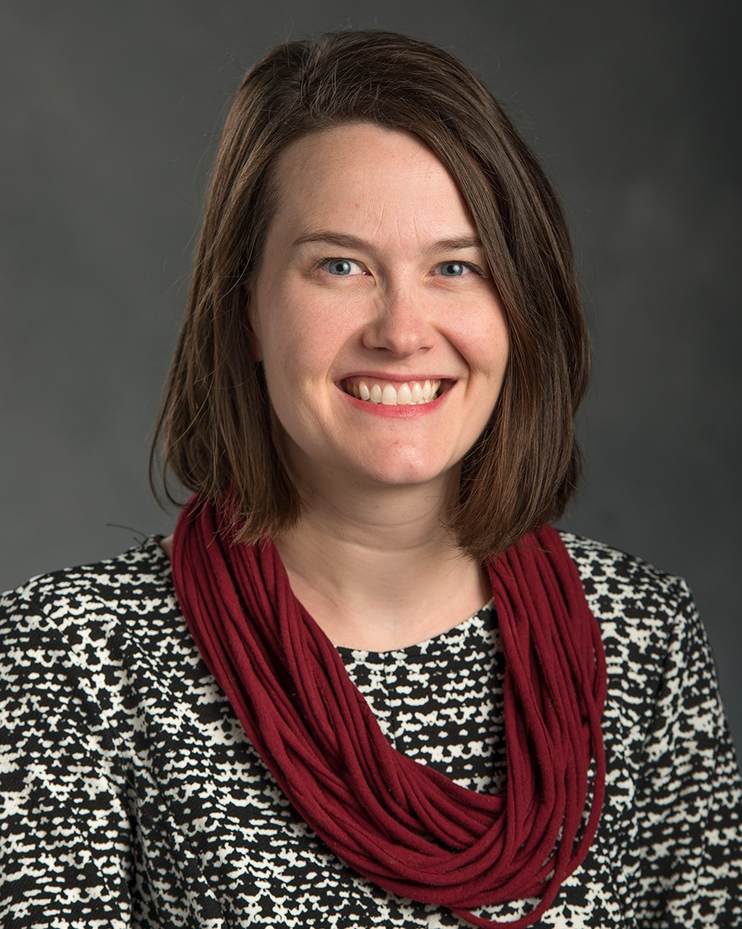
The Academic Advancement Network team:
Elizabeth Simmons
AAN Coordinator
Ann Austin
Academic Career Paths Node
Jeff Grabill
Teaching and Learning Node
Beronda Montgomery
Research and Scholarship Node
Juli Wade
Leadership Development Node
Jill Bryant
Project Events
Beth Leete
Administration
Cindi Leverich
Leadership Development
Patti Stewart
Instructional Development
Blythe White
Communications

Slide 5
AAN Classics:
Orientations for academics and administrators
Open-access workshops on teaching, scholarship, leadership, and academic career paths, offered in collaboration with other campus units.
Targeted events for academics or administrators at key career stages (new roles, approaching promotion)
Conversations with President/Provost each semester
Individualized confidential consultations

Slide 6
More AAN Classics:
Online materials on all aspects of academic careers and leadership (aan.msu.edu)
Small groups and learning communities where academics work with peers on building skills or improving campus life
Selective cohort programs for intensive study of the scholarship of teaching and learning (Lilly Fellows, Adams Academy) or foundations of academic leadership (Big Ten ALP Fellows).

Slide 7
AAN Coming Attractions:
Co-sponsored symposium on late-career issues
Survive & Thrive session at ASAC Forum
Mentoring workshops for chairs and new academics
Small groups (new chairs, LGBTQ learning community…)
Spring Teaching/Learning Conference co-offered with the Hub, ITS, Libraries
Participatory design of AAN’s new sets of workshops on Teaching Essentials, on launching new academics, and on assisting mid-career academics

Slide 8
How can AAN collaborate with you?

