Slide 1
Budgets based on MSU’s own numbers
2020-2021 Budget | Projected | Actual | Notes
State Funding | Loss of $43 million | No loss | In September 2020, the legislature adopted a budget that protected higher ed funding.
Tuition loss | Loss of $63 million | Loss of $56 million | MSU gained $7 million over projections
Federal funding for MSU as an institution | 0 | $87 million | CRRSA and ARP Acts
Federal funding for MSU students | 0 | $55 million | CRRSA and ARP Acts (MSU is essentially a pass through for these funds)
MSU imposed 10-month salary cuts of 1-8%; an 18-month, 50% cut in retirement match; and at least a 36-month gap between merit raises for all non-union academic management, faculty, and academic staff. Note: Only 7% of Tier 1 public universities cut fringe benefits during the pandemic.
Faculty have lost an estimated $90M in salary and benefits from FY21 and FY22
MSU received $137M more money than projected in its FY21 budget ($87M in federal aid, retention of a projected $43M cut that never happened, and $7M more in tuition than expected)
MSU has about $1.8B in unrestricted balances, an increase of $474M over last year (according to the 2020-2021 MSU Annual Financial Report)
MSU had both its best fundraising year ever and a record endowment return of 42% which stands at $3.9B (according to the report to University Council)
MSU had the highest endowment growth in the Big 10 and is 2nd among all public universities over the past 5 years. Over the same five years, faculty salaries grew less than at any other Big 10 school.
2020-2022 Concessions (Estimated)
Salary (10 months) | $15 million | Sliding salary reductions averaging 2.3%
Retirement (18 months) | $45 million | 50% cut in match
Merit Pay Elimination (FY21,22) | $30 million | Estimated at 4% of faculty salaries, based on a ~2% merit pay elimination over two fiscal years

Slide 2
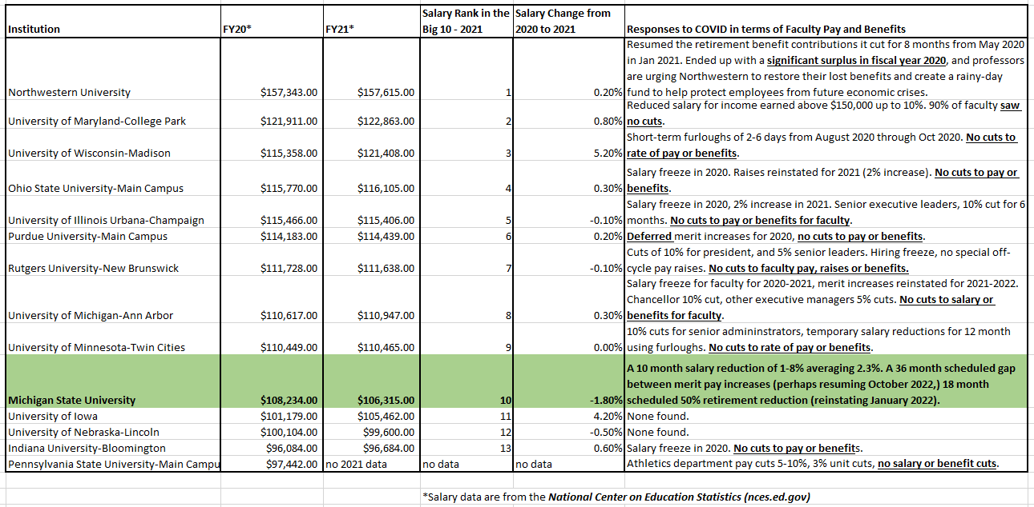
Big 10 Universities: Compensation and response to COVID.

Slide 3
MSU administration is rightfully concerned about the prudent use of reserves. They have a responsibility to the future of the university and its ability to thrive.
What about their responsibility to the faculty and academic staff. What about their need to thrive?

Slide 4
How much will you have lost in your 403b by the time you retire?
The following examples use average salaries of Assistant, Associate and Full Professors at MSU with a 7% annual return from the National Center on Education Statistics (NCES) .
NCES data does not include specialists or librarians, but these examples will be illustrative of the impact of retirement cuts for librarians and affected academic staff
Want to calculate the impact on your own retirement account with different numbers? We used the Compound Interest Calculator at Nerdwallet.com for the following slides

Slide 5
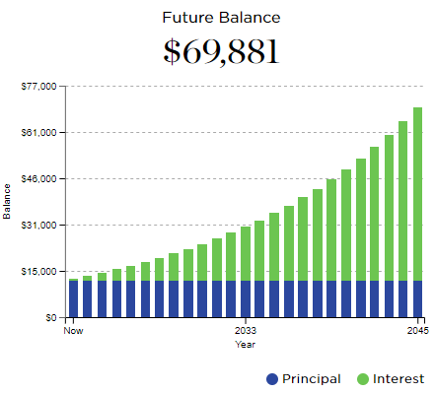
Loss of 5% retirement match for 18 months
Professor, MSU salary of $151,939*
*Average MSU professor salary from the National Center on Education Statistics (nces.ed.gov)

Slide 6
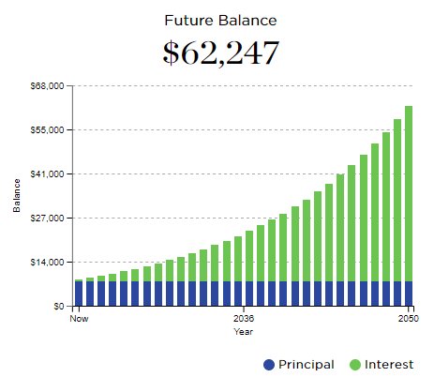
Loss of 5% retirement match for 18 months
Associate Professor, MSU salary of $101,654*
*Average MSU assoc professor salary from the National Center on Education Statistics (nces.ed.gov)

Slide 7
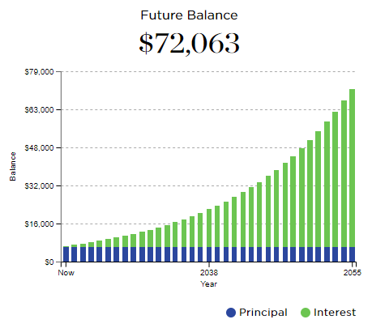
Loss of 5% retirement match for 18 months
Assistant Professor, MSU salary of $82,938*
*Average MSU asst professor salary from the National Center on Education Statistics (nces.ed.gov)

Slide 8
How much did you lose in lifetime earning due to missing one 2% merit pay increase?
Lifetime income from a single 2% merit raise*
Professor with 20 earning years left: $73,815
Associate professor with 30 earning years left: $82,475
Assistant professor with 35 earning years left: $82,941
* Using average salaries of Assistant, Associate and Full Professors at MSU from the National Center on Education Statistics (NCES)

Slide 9
Increased Turnover of Faculty and Academic Staff: Cost of actions during the pandemic?
Oct 2018- Sep 2019
459 total (259 men, 200 women, 126 minority)
Self identified: 25 Black, 75 Asian, 18 Hispanic
Oct 2019- Sep 2020
375 total (213 men, 162 women, 120 minority)
Self identified: 22 Black, 70 Asian, 22 Hispanic
Oct 2020- Sep 2021
488 total (275 men, 213 women, 159 minority)
Self identified: 35 Black, 90 Asian, 30 Hispanic
Change from Sep 2020 to Sep 2021
30% increase (29%↑ men, 31%↑ women, 33%↑ minority)
Self identified: 59%↑ Black, 29% ↑ Asian, 36% ↑ Hispanic

Slide 10
Sign the petition in support of the retroactive restoration
https://www.ipetitions.com/petition/restore-the-cuts-to-faculty-and-academic-staff-pay

