Slide 1


University Outreach and Engagement (UOE)
Kwesi Brookins, Ph.D. (he/sisi)
Associate Provost for University Outreach and Engagement Professor, Ecological-Community Psychology kwesib@msu.edu
engage.msu.edu
Faculty Senate
March 21, 2023
Kellogg Center | Lansing | Detroit | Flint

Slide 2
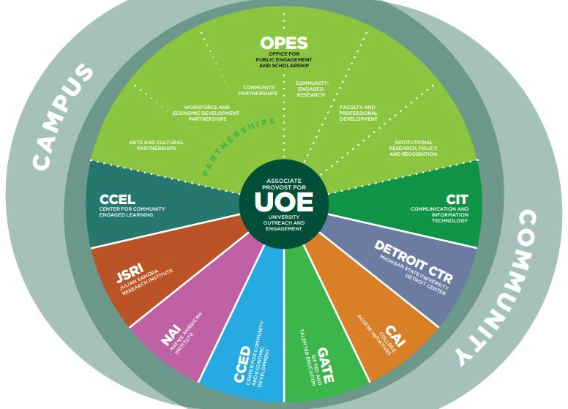
Overview What We do Our Impact Our Future

Slide 3
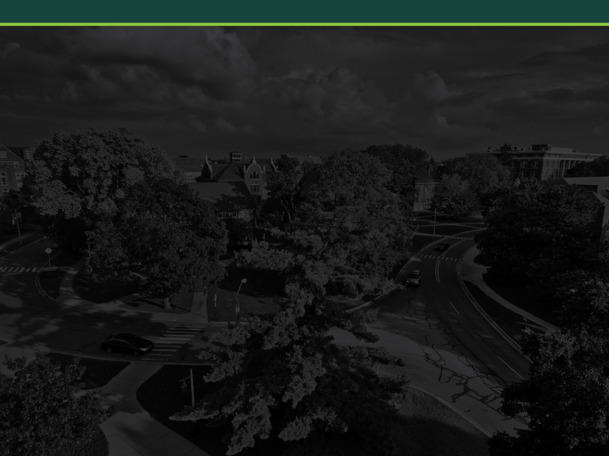
UOE Mission
Facilitate the engaged scholarship of MSU faculty, staff, and students in partnership with communities to create societal impact.
Support Advocate
Innovate Connect
Foster

Slide 4







Scholarship and Research Intentionality and Reciprocity
Activity Research, creative activity, teaching, engagement & service
Outputs
Impact
outreach and engagement

Slide 5
MSU Outreach and Engagement
Student community-engaged learning
Funding proposals
Faculty and academic staff engaged scholarship

Slide 6

Center for Community-Engaged Learning (CCEL)
Academic Programs
Faculty CEL Workshop Series and Consultations Faculty CEL Learning Communities
Classroom/Course CEL Orientations, Supports, and Reflection
Co-curricular Programs
MSU Community Engagement Scholars Spartan Volunteer Service Awards Student Volunteer Programs
Days of Service
Support for Service-focused RSOs Pre-professional Student Service
America Reads/Counts Student Tutors
Co-directs democratic engagement at MSU and the MSUvote Initiative

Slide 7
1. Student Community-Engaged Learning Experiences have increased
40000 36,933
32,223 32,241 32,348
COVID
Student Registrations
30000 27,475
27,154
26,127
20,205
20000
10000
0
2015 2016 2017 2018 2019 2020 2021 2022
Academic community-engaged learning Beyond the classroom
Note: From Center for Community Engaged Learning Index.

Slide 8
Pre-College Initiatives
College Access Initiatives
Awarded 5-year $1.5M Upward Bound grant
In 2022, CAI programs served 2,569 middle- and high- school students through mentoring, tutoring, skill-building, and other college prep activities
Gifted and Talented Education
In 2022, served 295 students with advanced academic programming.
Initiatives underway to improve pipeline to Honors College and to identify gifted students in Detroit Public Schools.
Created new dual enrollment system.

Slide 9
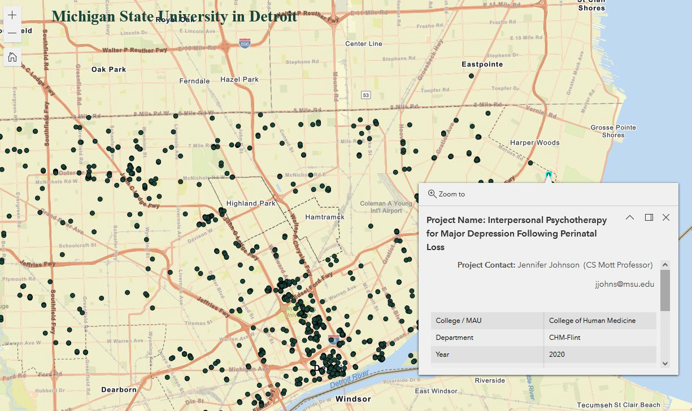
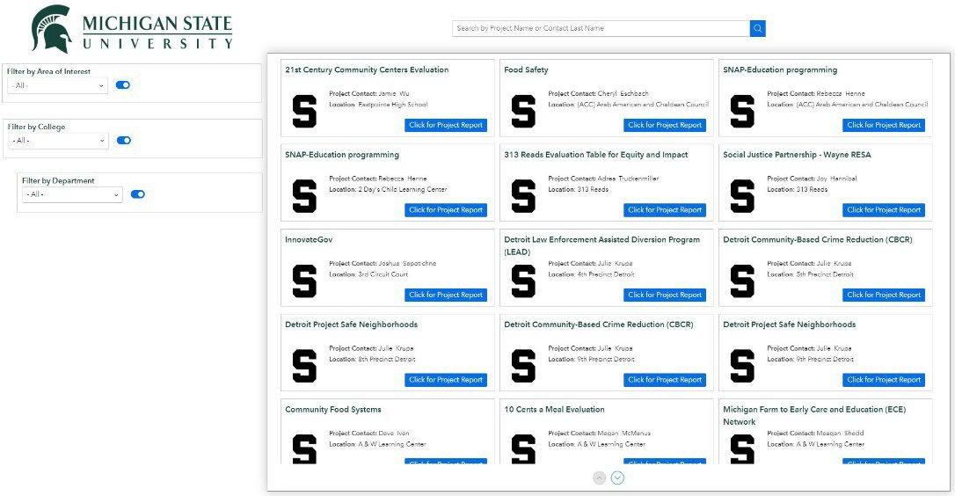
Supporting Institutional Research on Community Engagement Scholarship
Collecting data about faculty and academic staff outreach and engagement since 2004
Data used for many purposes
Recent changes to shorten the survey have improved numbers of responses
Current efforts focus on developing self-serve access to data through maps and a searchable catalog

Slide 10
3a. Faculty and Academic Staff Engaged Scholarship
Engaged research
Engaged creative activities
Engaged teaching and learning
Engaged service
Engaged commercialized activities
$10 million investment FTE
898 (53% of respondents) FAS reported engaged scholarship, describing 1,216 outreach and engagement projects
Estimated reach: 309K in-person, 2.6M remote
81% of projects were reported as having created intellectual property and scholarly/public products
48% reported that their outreach and engagement work impacted their scholarly or teaching practices
Note: 2021 Outreach and Engagement Survey, sent to 5,434 FAS, 32% response rate.

Slide 11
Capacity-Building for Engaged Scholarship
Faculty and Professional Development
In 2022, served 2,693 FAS from all colleges to build capacity for engaged scholarship and broader impacts – a 45% increase from 2021
MSU hosts National Engaged Scholarship Conference in 2023
Graduate Certification in Community Engagement
Since 2009
446 graduate and professional students
90 have passed portfolio defense
Reported to be important in job search

Slide 12
2a. Funding: The percent of proposals that includes outreach and engagement has been fairly steady.
30%
23%
24%
23%
20%
20%
19%
10%
0%
2018 2019 2020 2021 2022
Note: Out of 12,201 records in Kuali Coeus with Funded/Not Funded status, 2018-2022. OE indicated by “Public Service.”

Slide 13
2b. Funding: The percent of proposals with outreach and engagement that are funded mirrors the submissions.
30%
20%
22%
23%
23%
20%
18%
10%
0%
2018 2019 2020 2021 2022
Note: Out of 12,201 records in Kuali Coeus with Funded/Not Funded status, 2018-2022. OE indicated by “Public Service.”

Slide 14
2c. Funding: Funding associated with proposals that are primarily “public service” has increased.
$140
A few big center grants
$132.5
$120
$100
$80
$60
$ in Millions
$40
$45.7
$37.8
$20
$0
$28.5 | $27.4
2018 | 2019 | 2020 | 2021 | 2022
Note: 1,874 records in Kuali Coeus with Funded status and Public Service, 2018-2022.

Slide 15
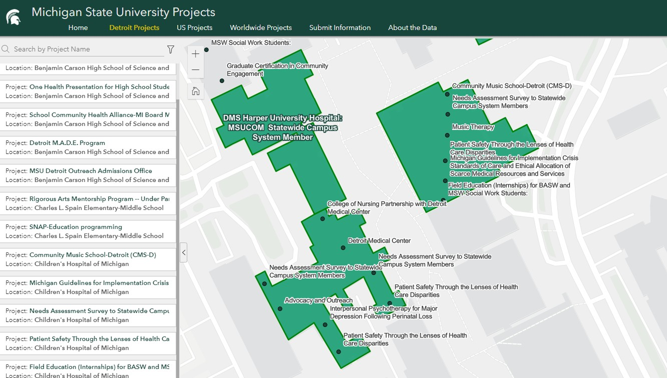
3b. MSU Faculty and Academic Staff in the Community (Engagement Platform – Detroit)

Slide 16
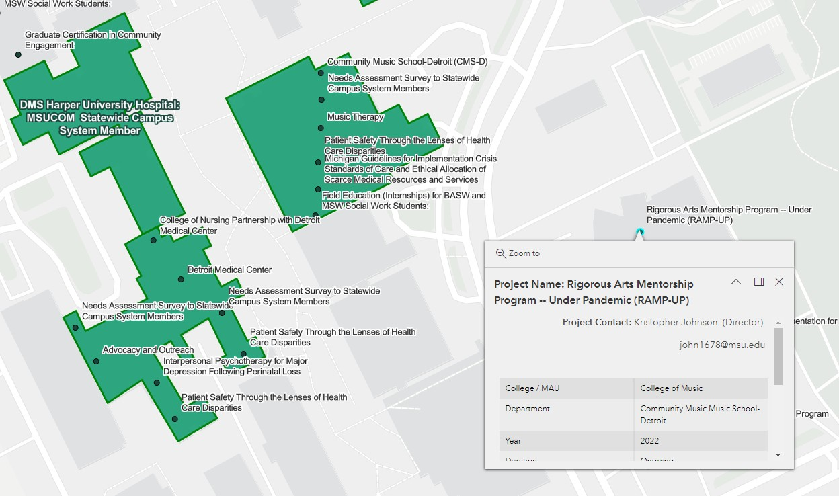
3b. MSU Faculty and Academic Staff in the Community

Slide 17
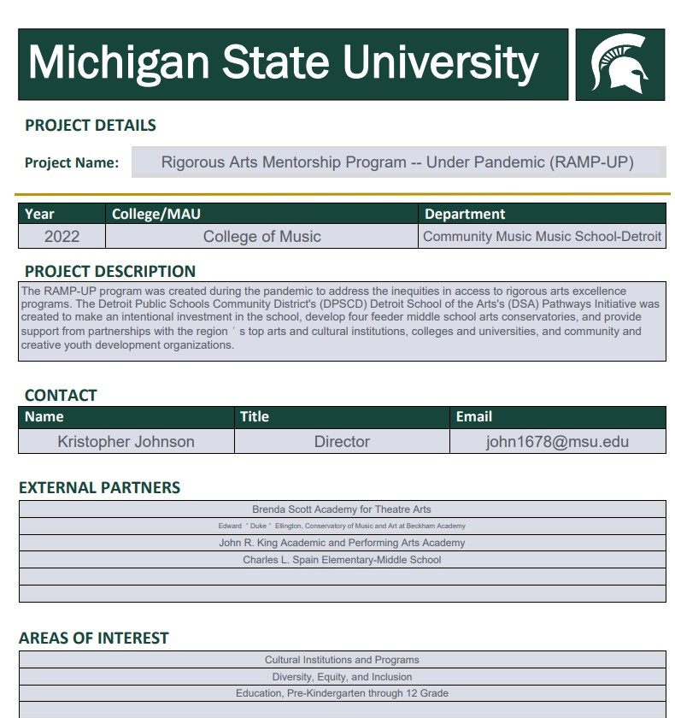
3b. MSU Faculty and Academic Staff in the Community

Slide 18
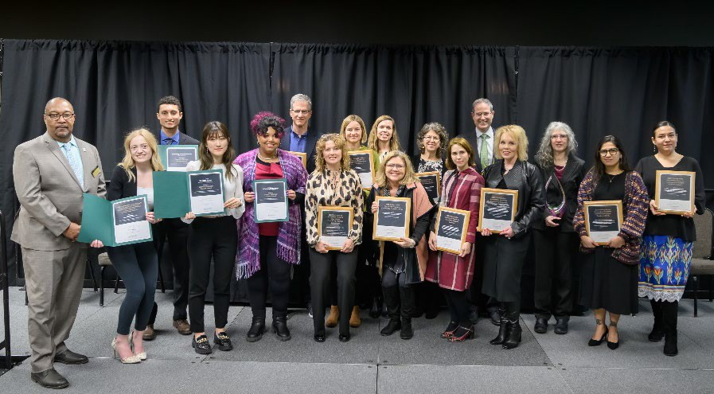
Recognizing Excellence in Community Engagement
Awards and recognitions
Community Engagement Scholarship Award
Distinguished Partnership Awards (research, creative activity, teaching, service, and international)
Institutional Champion Award for Community Engagement Scholarship
Community Engagement Scholarship Lifetime Achievement Award
Graduate Student Award for Community Engagement Scholarship
Graduate Student Award for Science Communication and Outreach
Spartan Volunteer Service Awards
Others in development
Supporting MSU nominations for national/international awards
Michigan State University Outreach and Engagement Awards Ceremony (in March)

Slide 19
Awards and Partnerships
Awards
In 2023: 13 awards and commendations for engaged scholarship
Since 2006: 18 Community Engagement Scholarship Awards
Since 2017:
  28 Distinguished Partnership Awards: faculty/academic staff and community partners
  2 Institutional Champion Awards
  6 Lifetime Achievement Awards
Since 2021: 15 Graduate student awards and commendations
Partnerships
197 individual organizations/institutions listed across UOE units
  85 community partners
  96 MSU partners
  15 higher education partners outside MSU
Forming 229 partnerships – 62 orgs were partners with more than one UOE unit

Slide 20
Institutional Recognition and Support for Engaged Scholarship
Institutional Recognitions
APLU Innovations in Economic Prosperity Designation, with MSU Innovation Center – submit May 2023
Carnegie Classification for Community Engagement – submit 2025; convening committee shortly.
Research Impact
Supported 12 NSF grant proposals
Consulted on 50+ projects to provide partnerships, design recommendations, activity ideas, and evaluation guidance
Received $50K grant to participate in Toolkit Project to support investigator broader impact (Advancing Research Impacts in Society – ARIS)

Slide 21
Institutional Initiatives of Note
External Engagement and DEI
Faculty and professional development for scholarly engagement with marginalized communities equitably and inclusively
Need to document college and department plans for external engagement with diverse and/or underserved
Engaged Scholarship in RPT
  Supports for evaluating engaged scholarship in tenure- stream and fixed-term faculty and academic specialists
  Academic strategic planning proposal moving forward
  Nationally, working on innovation and entrepreneurship and HIBAR (highly integrative basic and responsive research)

Slide 22
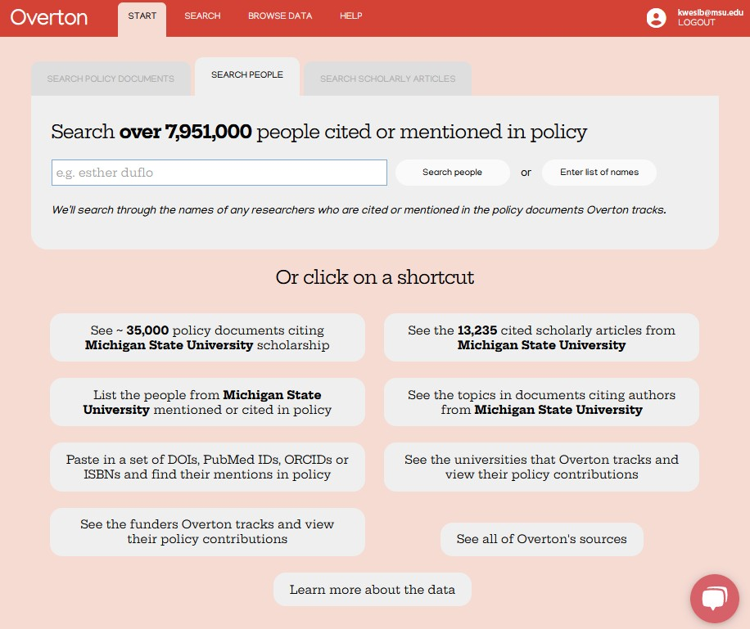
Supporting Institutional Research on Community Engagement Scholarship
Identifying impact of faculty research on public policy
Licensed Overton for MSU (https://www.overton.io)
o World’s largest searchable index of policy documents, guidelines, think tank publications, and working papers (7,309,611)

Slide 23
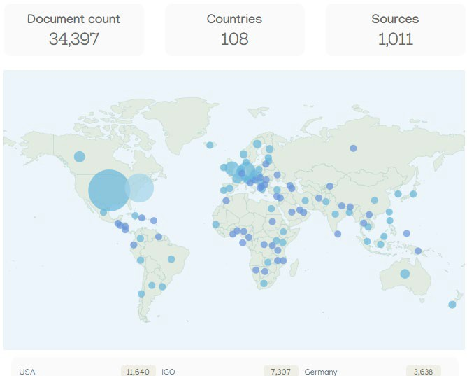
3c. Faculty Research in Policy Documents
Source: Overton.io

Slide 24
Research and Engagement: Centers and Institutes

Slide 25

Julian Samora Research Institute (JSRI)
Michigan Food and Farming Systems (MIFFS) Partnership
Spanish Language Workshops
  Introduction to Farm Management
  Pest Management
  Food safety for farmers and farmworkers
Technical assistance on agricultural production (e.g., hoops and greenhouses, sustainable agriculture, etc)
Expansion to new markets and networks to facilitate the flow of information about production, marketing, insurance, work opportunities and training programs
Expanded national networks of farmers,( i.e., National Latino Farmers and Ranchers Initiative.

Slide 26
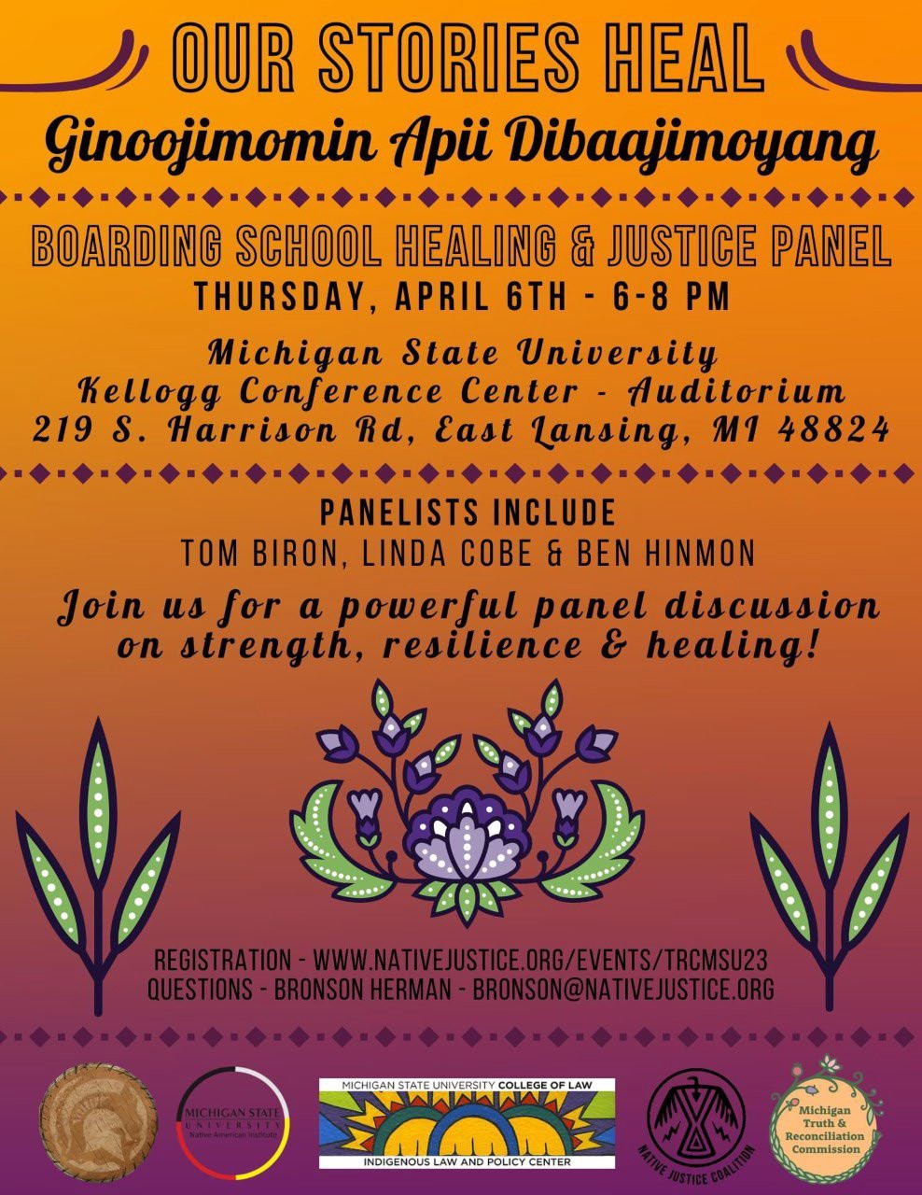
Native American Institute
Strategic Listening Sessions across Michigan Communities and Partners:
Anishinaabe Database Access Initiative
MSU Libraries
State of Michigan Civil Rights Office
Little Traverse Bay Band of Odawa and Chippewa Indians
Department of Repatriation Archives and Records
Inter-University Collaborations

Slide 27

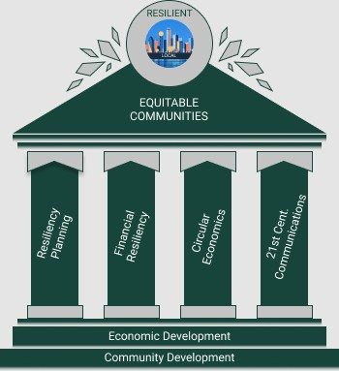
Center for Community and Economic Development (CCED)
Creating, applying, and disseminating valued knowledge through responsive engagement, strategic partnerships, and collaborative learning.
Economic Development Administration (EDA) University Center for Regional Economic Innovation
Comprehensive Economic Recovery Initiative (CERI)
CCED Flint
Community Partnerships

Slide 28
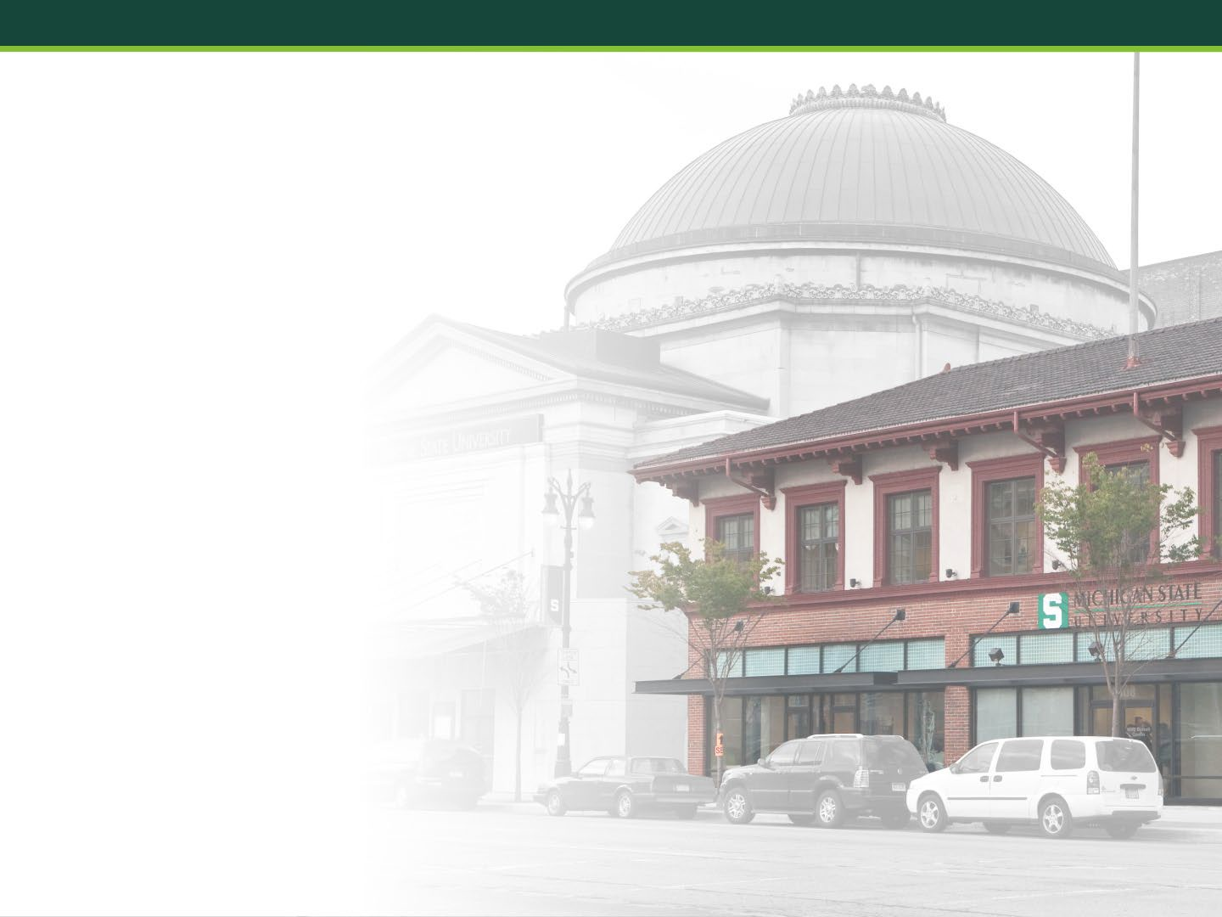
MSU Detroit Center
Research and meeting space for campus and community partners
Hosts the College of Music’s Community Music School, Admissions, College of Education classes
Hope Village Collaboration
Urban Learning and Leadership Collaborative

Slide 29

The Future of University Outreach and Engagement
Strategic Planning
Cross-Institutional and Transdisciplinary Initiatives
Anchor Alliances

Slide 30

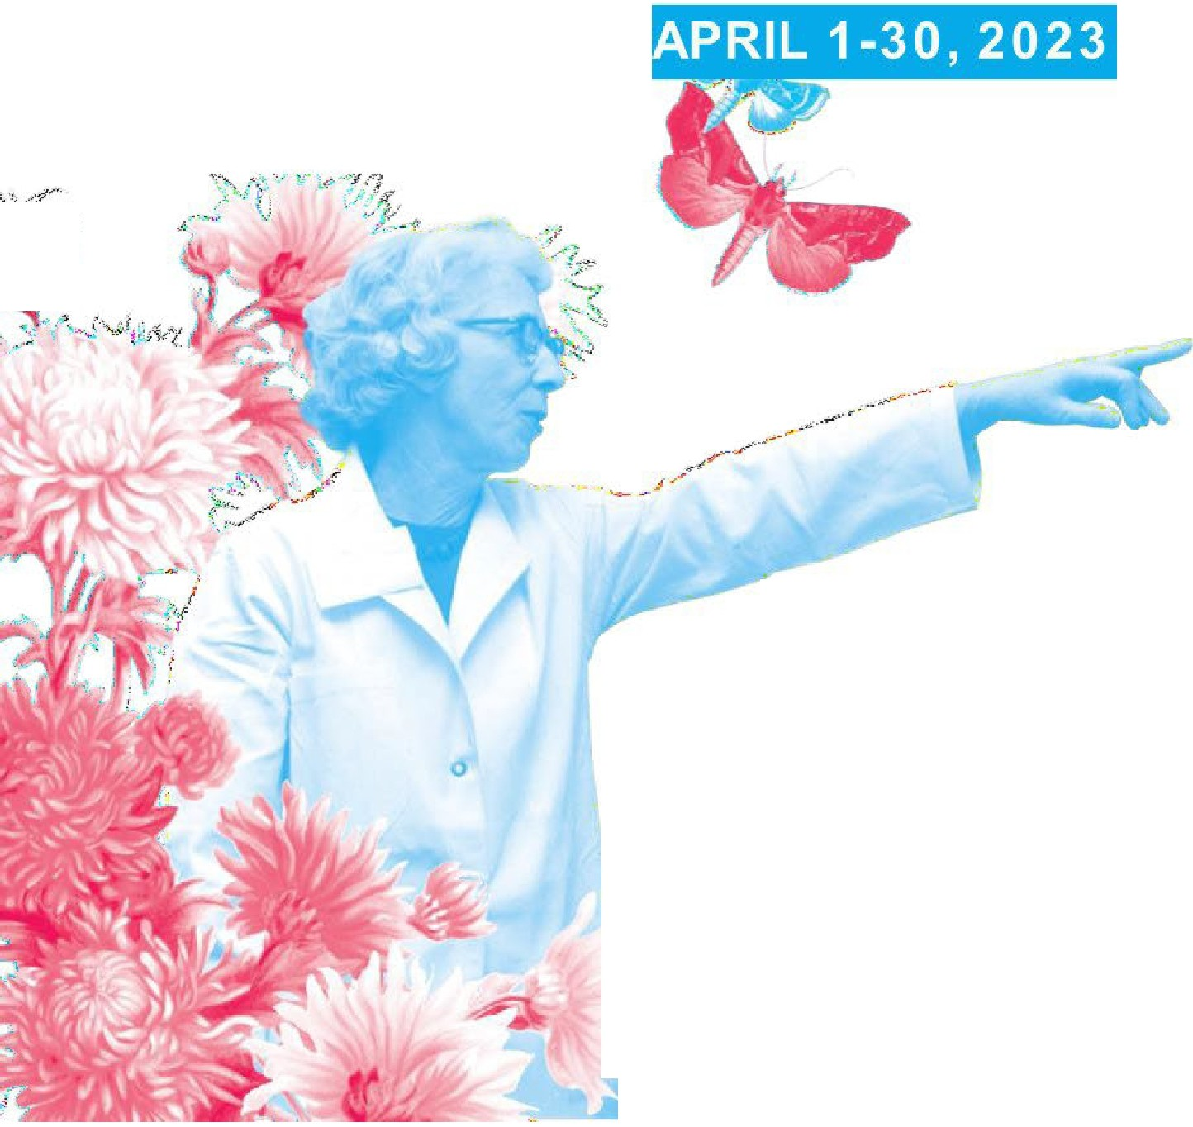
SCIENCE FESTIVAL
MICHIGAN STATE UNIVERSITY
OUR IMPACT
10 years of STEAM
, ··/'/
i
10 years of FREE pub lic STEAM celeb rat io ns
Over 1,600 free programs and events
800+ free digital resources shared wit h familie s
Over 150 ,0 0 0 fest ival at t endees
Mo re than 20,000 K-12 stu den t part ic ipan ts
91% of visitors learn something new
"This Festival has really evo lved in a posit ive way since the first one, which I also
attended . My 7-year-old grandd aug hter was excited from start to finish!"
-Festiva l attende e
ij_-1 ..
;.,. ..,.-' ;
.......-⁻---^{¼},.
e:_ - : :
sciencefestivaI.msu.ed u
' _{.,-}-,
·--

Slide 31
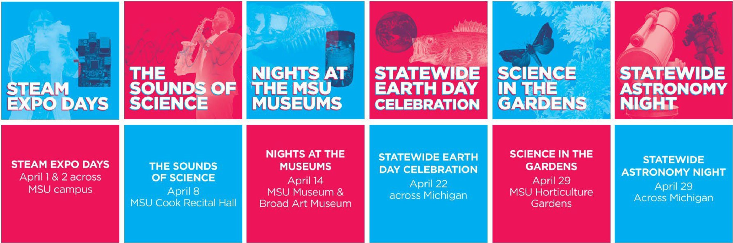
OVER 200 FREE EVENTS!
VISIT SCIENCEFESTIVAL.MSU.EDU TO VIEW THE FULL SCHEDULE

Slide 32
In Summary
Support
Advocate
Foster
Innovate
Connect
Impact

Slide 33

Contact Information
Kwesi Brookins
University Outreach and Engagement
Michigan State University
93 Kellogg Center
517-355-0140
kwesib@ms.edu
© Michigan State University Board of Trustees

