Slide 1
An Introduction to Robert’s Rules of Order
Secretary for Academic Governance Tyler Silvestri Deputy Secretary for Academic Governance Taylor Thrush

Slide 2
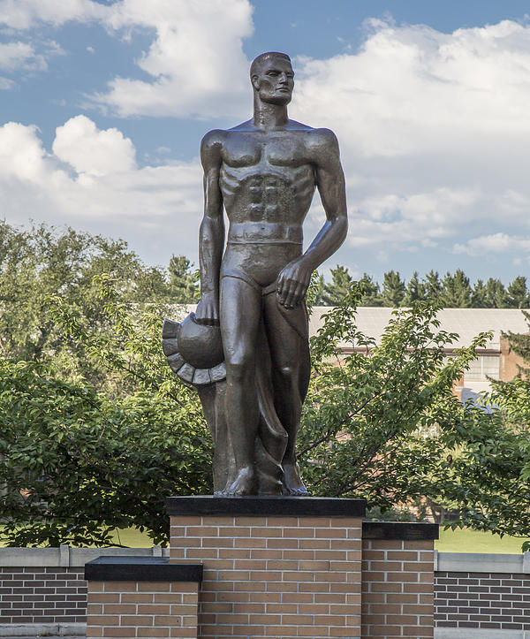
“It is important to specify the manner and process by which the faculty and students develop and communicate their views to the President and the Board. These Bylaws for Academic Governance are designed to provide an effective system for the participation of faculty and students in the development of policy on academic matters.”
Preamble of Bylaws for Academic Governance

Slide 3
Basic Meeting
Basic Principles
All members have equal rights, privileges, and obligations
No person can speak until recognized by the chairperson
Personal remarks are out of order
Only one question/motion at a time may be considered
One person may have the floor at a time

Slide 4
Standard Order of Business
Quorum
Half of the voting membership plus one.
Call to Order
Reading and Approval of the Minutes
Reports
Unfinished Business
New Business
Members: 32
Quorum: 17
Members: 185
Quorum: 94

Slide 5
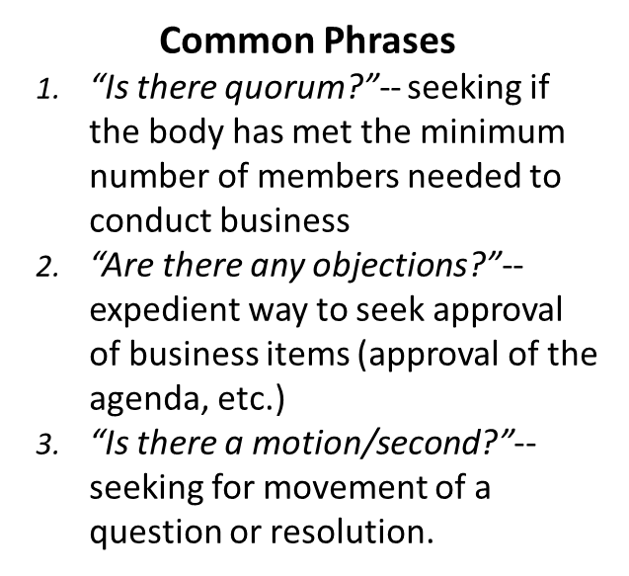
Parliamentary Procedure Basics

Slide 6
Chairperson’s Role
Start once quorum is verified
Stay neutral at all times
Keep the meeting moving
People are called on in the order they raise their hands unless:
The person has already spoken and someone else who hasn’t spoken has their hand raised
If the chairperson knows people with differing views have their hands raised, they alternate

Slide 7
The Fundamentals
Motion
Second
Discussion
Possible Amendment
Motion
Second
Discussion
Vote on the amendment
Continue discussing as amended
Vote

Slide 8
Parliamentary Procedure Basics
Making a motion
“I move to…” or “So moved.”
Seconding
“I second the motion” or “Second.”
Voting
Unanimous consent or majority vote
Discussion
Time to ask questions, make comments, or make amendments

Slide 9
Examples
Incorrect Motion:
Chair: We move now to Item 7.4 on the agenda, “Proposed Resolution on ID Cards.”
Green: *Raises hand* Mr. Chair?
Chair: Dr. Green, you have the floor.
Green: Since the dawn of humankind, people have wanted ID cards with statues on them, not buildings. Moreover, I do not like the Beaumont Tower very much at all. It has the wrong roman numeral for “4” on it. Plus, the Sparty statue is more widely known. For that reason, I move that Faculty Senate adopt a resolution reading, “It is the opinion of Faculty Senate that the picture on MSU ID cards should be changed from the Beaumont Tower to a picture of the Sparty statue.”
Correct Motion:
Chair: We move now to Item 7.4 on the agenda, “Proposed Resolution on ID Cards.”
Green: *Raises hand* Mr. Chair?
Chair: Dr. Green, you have the floor.
Green: I move that Faculty Senate adopt a resolution reading, “It is the opinion of Faculty Senate that the picture on MSU ID cards should be changed from the Beaumont Tower to a picture of the Sparty statue.”
Blue: Second!
Chair: It is moved and seconded that Faculty Senate adopt a resolution reading, “It is the opinion of Faculty Senate that the picture on MSU ID cards should be changed from the Beaumont Tower to a picture of the Sparty statue.” Is there any discussion?

Slide 10
Debate/Discussion
The person who made the motion has a one-time preference for speaking first.
Each person can speak twice for no more than ten minutes each time
To be given the floor simply raise your hand
The chair does not have to call on people in order
Keep debate Germain to the motion at hand.
Debate issues not personalities
Address the debate to the chair

Slide 11
Unanimous Consent (“Without Objection”)
Any of the steps on the right can be skipped with, “Is there any objection to doing [x]?”
Yes: Don’t skip the step and continue as usual.
No: Skip the step and any preceding it (depending on the wording of the proposal).
Motion
Second
Discussion
Possible Amendment
Motion
Second
Discussion
Vote on the amendment
Continue discussing as amended
Vote

Slide 12
Friendly Amendments
NO!

Slide 13
Friendly Amendments

Slide 14
Calling the Question
A motion to end voting
Not debatable
Requires a 2/3 vote

Slide 15
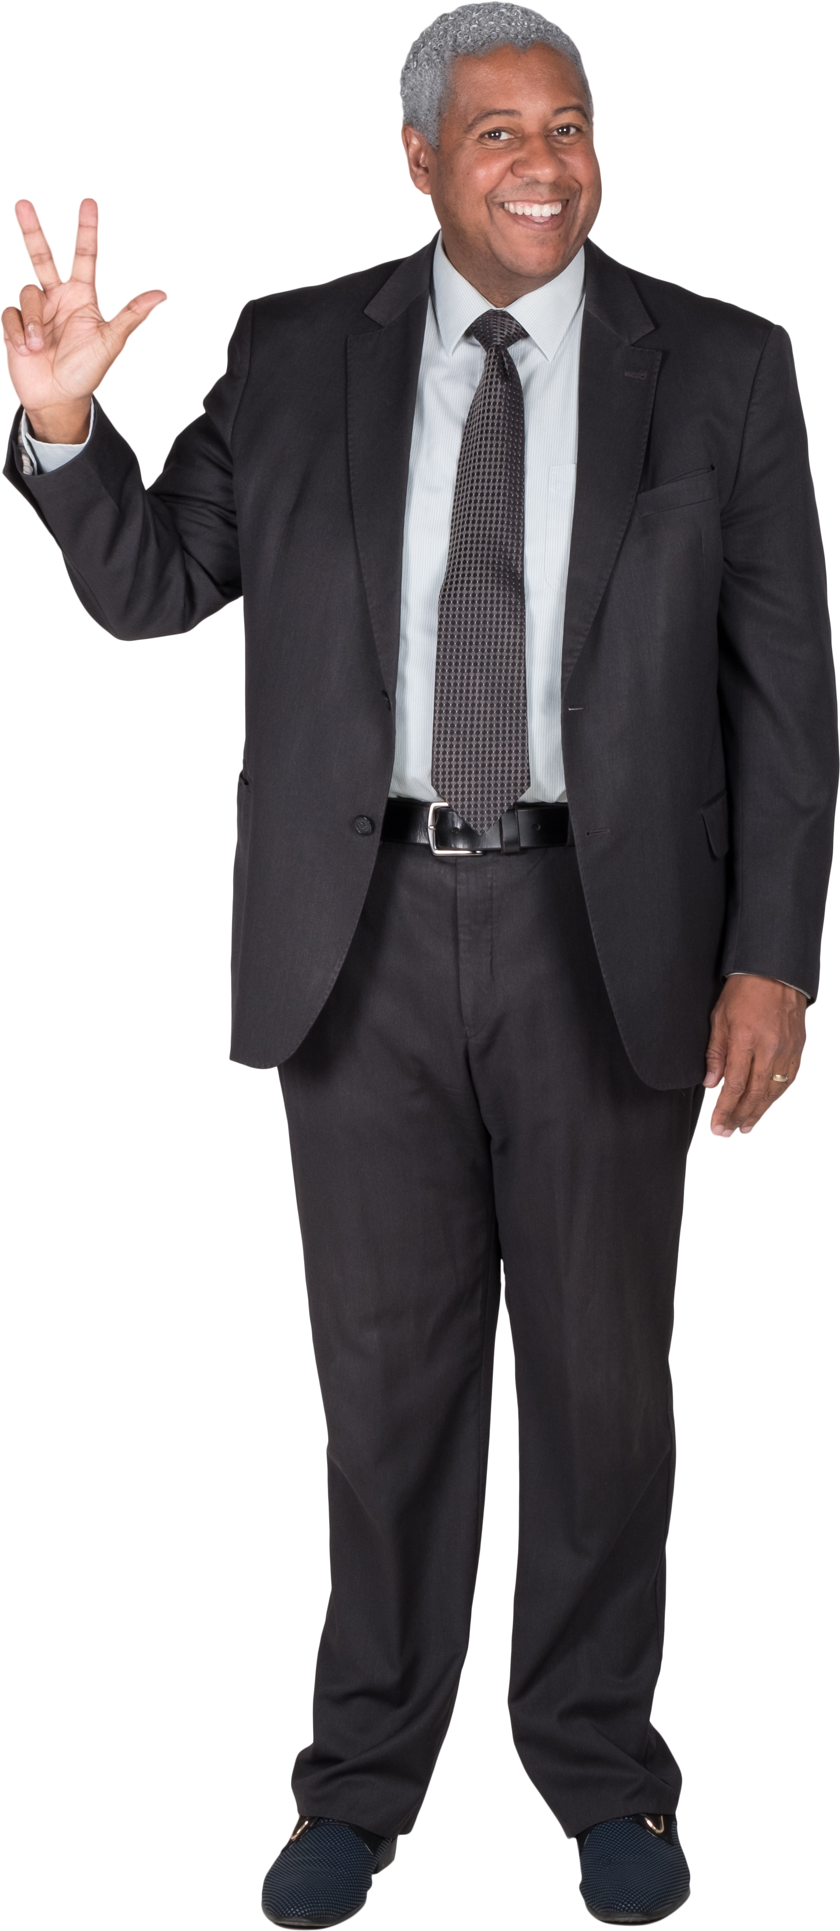
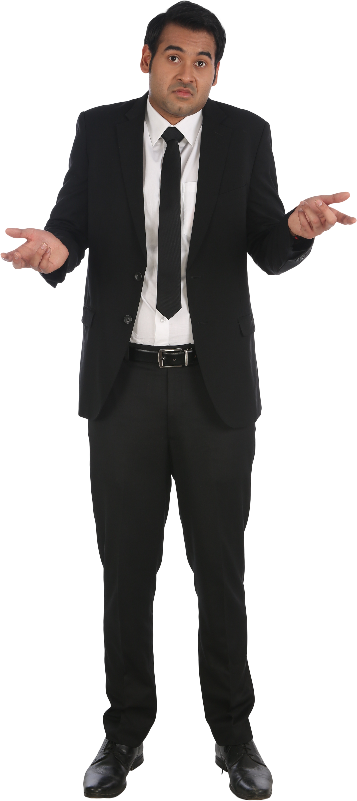
Abstentions
I abstain
Yes
Yes
Yes
No
No

Slide 16
Points of Order
Simply call out “Point of order!”
The chair will recognize you.
Explain the rule you believe is being violated
The chair will rule
You can appeal the chair’s ruling with a majority vote

Slide 17
Questions?

Slide 18
Contacting Secretary Silvestri
acadgov@msu.edu for most things
silves19@msu.edu for confidential things
thrusht1@msu.edu for the deputy secretary

