Slide 1


Research Security Update
Doug Gage, VP Research and Innovation
MSU Faculty Senate
December 19, 2023

Slide 2



Research Security Overview
Michigan State University (MSU) is committed to global engagement and international collaboration
Research security continues to be a high priority for federal funding agencies
The Office of Research and Innovation will support our scholars by providing resources, consulting, and training to meet new federal regulations, while also maintaining our research growth and excellence trajectory.

Slide 3
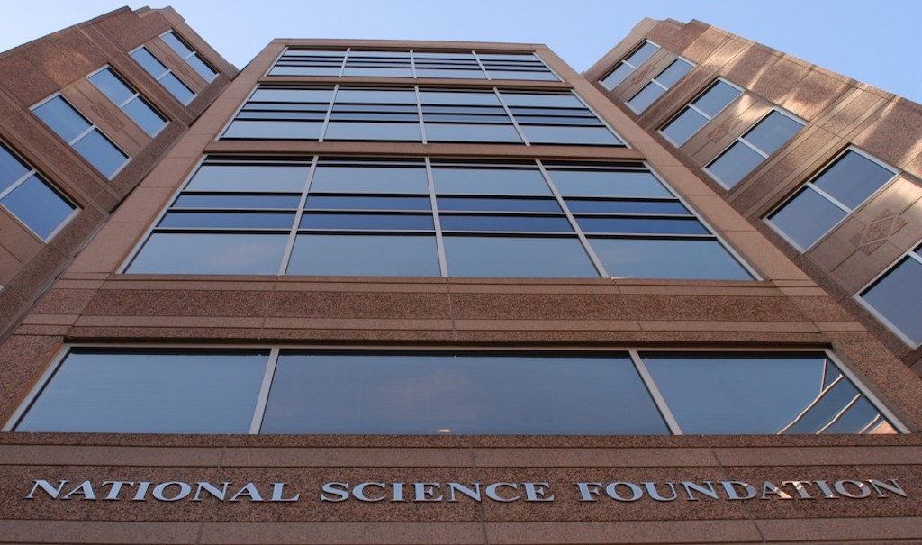
Upcoming Research Security Regulations
MSU is required to comply with multiple federal regulations for sponsored research
Most federal funding sources now have research security as a requirement to receive funding
Some regulations to keep in mind are:
  National Security Presidential Memorandum 33 (NSPM-33)
  Federal Acquisition Regulation (FAR) 52.204-27
  Department Of Energy Order 486.1

Slide 4




Research Security Regulations
Krista Campeau, Director of Export Control and Trade Sanctions, is our Point of Contact for the program
A Research Security Committee has been established to address the new requirements
The Research Committee represents many areas across the university including MSU Global Health from the travel perspective, research regulatory support, contracts and grants administration, and many key professionals from MSU IT
MSU is developing a Research Security Program that will address new requirements outlined in the Guidance for Implementing National Security Presidential Memorandum 33 (NSPM-33) and other federal regulations.
A new website “portal” hosts important information from various units in one place research.msu.edu/security

Slide 5

Research Security
NSPM-33
National Security Policy Memorandum (NSPM) 33 requires that research institutions receiving federal support in excess of $50 million per year must establish and operate a Research Security Program
Required elements of a Research Security Program:
  Cybersecurity
  International Travel Security
  Disclosure Requirements
  Export Control and Research Security Training
  Designated Research Security point of contact

Slide 6

Research Security
Cybersecurity
Develop a Research Cybersecurity Certification Program to ensure that the basic controls of NSPM-33 are being met
Establish a Regulated Research Enclave (RRE) to support research that involves Controlled Unclassified Information (CUI)
Create a Loaner Laptop Program to provide safe, clean devices for faculty traveling to Countries of Concern
Cybersecurity Awareness Training

Slide 7

Impacts on Efficiency, Trust, Reproducibility
Successful attacks can impede research by making data and instruments unavailable
Data integrity is at risk now. If the data cannot be trusted, the public’s trust in science itself is undermined
Malicious modification of research infrastructure may make it difficult to reproduce results
Example: A mysterious “cyber incident” at a National Science Foundation (NSF) center coordinating international astronomy efforts knocked out of commission major telescopes in Hawaii and Chile, including MSU’s SOAR.
https://www.science.org/content/article/cyberattack-shutters-major-nsf-funded-telescopes-more-2-weeks
Acknowledgements: Mike Corn, UCSD – content shared with permission

Slide 8
Research Security
International Travel
Research organizations must maintain international travel policies that include:
  Pre-registration of MSU related or sponsored international travel by faculty and staff
  Disclosure and authorization in advance of international travel
  Security briefings and assistance with electronic device security (laptops, etc.)
MSU has convened a working group to address these requirements and will be leveraging the Global Travel Registry and Concur

Slide 9

Research Security
Disclosure Requirements
Funding agencies will be requiring disclosure of information related to Conflict of Interest (COI) and Conflict of Commitment (COC) from participants with federally funded research
New requirements for disclosure of international engagements (under development by agencies)
New requirements for disclosure of "Malign Foreign Government Talent Programs"

Slide 10
Research Security
Disclosure Requirements
Key Resources for following faculty disclosure requirements
  Resources for Faculty Disclosures (including contacts)
  Current and Pending / Other Support
  Biographical Sketch
  Resources for reporting activity to federal government (Fall 2023 summary)

Slide 11

Research Security
Training
Research organizations must provide training to relevant personnel
Required training must include:
    research security threat awareness insider threat training
    export control training for research that is subject to the Export Control Regulations
    process training for restricted entity list
    coordination with Responsible and Ethical Conduct of Research (RECR) training

Slide 12


Coming Next Semester
MSU workshops and webinars on federal agency disclosure requirements
Talent program question will be added to annual disclosure
Research Security training
Visit the Research Security website for updates

Slide 13
THANK YOU

