Slide 1
MSU UC Should not Support ESG Investment Framework Resolution
R. Mark Worden
Faculty Senate/University Council Member worden@msu.edu

Slide 2
Social Conscious (ESG) investment framework
Resolution brought to University Council (UC) by ad-hoc committee USIWG
University Sustainable Investment Working Group (USIWG)
USIWG submitted report* with recommendations to MSU Trustees
USIWG made oral presentation to UC on 10/18/22
Promoted Environmental, Social Governance (ESG) investment framework
Named ASU and UC Berkeley as peer universities implementing ESG
Recommended that MSU Trustees invest MSU Endowment using ESG framework
USIWG’s resolution seeks UC’s support for implementing ESG framework
* https://tinyurl.com/2qd3ampj

Slide 3
Reasons not to approve USIWG’s ESG resolution
Social conscious investment frameworks like ESG have many disadvantages
Are non-fiduciary*: investment decisions may not be in best interests of investors
Investment objectives are subjective, ill-defined, and politically motivated
Reduce diversity of investment options
Often have higher management fees
Have delivered lower return on investment (ROI) than conventional investments
Are used to force unwanted sociopolitical policies on companies and individuals
Many states have divested from ESG frameworks for the reasons listed above
* https://www.investopedia.com/terms/f/fiduciary.asp

Slide 4
Online evidence of ESG’s disadvantages
Former BlackRock senior executive Terrence Keeley’s criticisms of ESG:^{1,2}
“Despite tens of trillions of ESG investments, investors haven’t done very well nor
generated much good.”
ESG managers force unwanted social policies on companies they invest in³
Many states have divested from asset managers over ESG initiatives:⁴
Missouri, West Virginia, Louisiana, Texas, Kentucky, Oklahoma, Florida, South Carolina, Arizona, Idaho, Utah, Wyoming, Arkansas and North Dakota
19 state AGs asked SEC to investigate BlackRock over ESG practices⁵
A corporate “Post-ESG Era” is emerging in opposition to ESG⁶
Consumers Research just launched new organization to combat ESG⁷
Consumer’s Defense, a 501(c) organization to protect investments from abuse

Slide 5
Example of low ROI by ESG Endowment Fund
California’s Endowment Fund (CalPERS) that funds UC Berkeley
“CalPERS Announces Preliminary Net Investment Return of -6.1% for the 2021-22 Fiscal Year”⁸
Public equity (stock) component of CalPERS investment gave ROI of -13.1%
Year ending June, 2022
Energy Select Sector SPDR Fund gave ROI of +32.7% over same period⁹
XLE (a basket of energy stocks)
$54.69 (June 27, 2021)
$72.58 (June 26, 2022)
ESG framework restricts energy investments, reducing CalPERS ROI

Slide 6
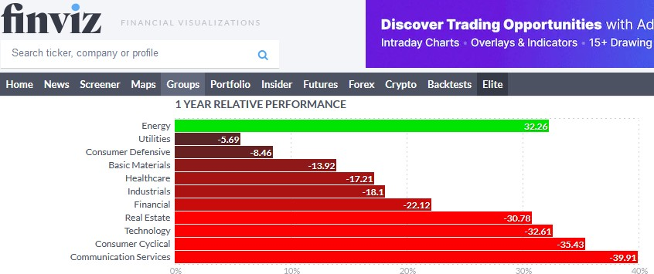
Energy was the best stock sector by far in 2022
Energy best one-year ROI: +32.3% Utilities second best ROI: -5.7%
ROI for ESG investments suffered due to divestment of energy
Energy
(+32.3%)
Source: https://finviz.com/groups.ashx (Nov. 2022)

Slide 7
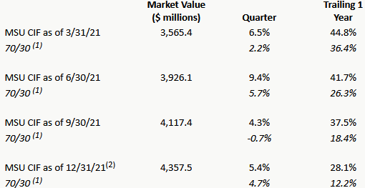
ROI of MSU’s Endowment Fund (CIF) has been high
MSU’s endowment’s net ROI was 28.1% for year ending 12/31/21¹⁰
MSU Endowment
Benchmark

Slide 8
UC not authorized or qualified to manage endowment
MSU’s Bylaws authorize Trustees to manage its Endowment Fund¹¹
UC criticized MSU Trustees for micromanaging university operations
MSU administrators are better qualified to manage university operations
Trustees lack the training & experience needed to make optimal decisions
UC would be criticized for micromanaging Trustees’ investment decisions
Trustees’ investment managers are better qualified to manage MSU’s endowment
UC members lack the training & experience needed to make optimal decisions

Slide 9
Benefits of MSU Endowment Fund’s high ROI
Example benefits from high MSU Endowment ROI
Faculty and staff salaries (e.g., raises, endowed chairs)
Student scholarships
Academic programs
New research, teaching, and service initiatives
Implementing ESG investment framework would jeopardize these benefits

Slide 10
Excerpts from USIWG report*
Make changes to MSU Endowment’s investment advisors
“The Board should consider appointing additional advisors who have strong experience in ESG”
Impose ESG policies on companies in which MSU invests:
“The BOT should adopt a proxy vote policy that reflects a commitment to the principles of DEI and SRI/ESG practices and instruct that all proxies shall vote in a manner most likely to preserve or enhance the value of Diversity, Equity and Inclusion and Environmental, Social and Governance principles.”
“The Board is more concerned with the financial value of the endowment rather than the environmental and social benefits produced from its
investments.”
Solicit investment advice from “broader MSU community”
“We also encourage the board to seek the advice and guidance of the broader MSU community and articulate the statement of investment objectives.”
* https://tinyurl.com/2qd3ampj

Slide 11
Communicating political stance demotivates workers
Research findings from Vanessa Burbano, Columbia Prof. of Management*
Studied effect of employer communicating socio-political stance on employees
When employee disagrees with stance: result is significant demotivating effect
Lower quality of required work completed
Lower quantity of extra work completed for employer
When employee agrees with stance: no significant effect
Communicating political stance has net negative effect on worker productivity
Lower worker productivity would reduce stock price over time
Similar negative effect likely from proxy votes forcing ESG policy changes
* Burbano, V.C. (2021) The Demotivating Effects of Communicating a Social-Political Stance: Field Experimental Evidence from an Online Labor Market Platform. Management Science 67(2): ​1004-1025.

Slide 12
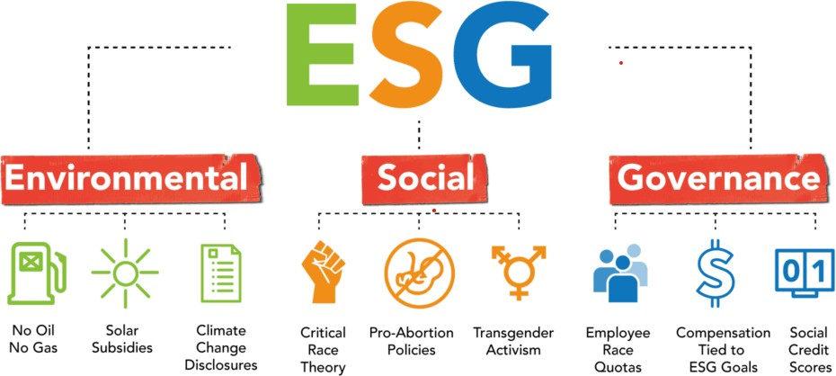
ESG political policies likely to demotivate workers

Slide 13
Conclusions
MSU’s Endowment provides broad financial benefits across the University
MSU’s Endowment has exhibited a high ROI without ESG restrictions
ESG restrictions reduce diversification and are likely to reduce ROI
ESG framework forces unwanted socio-political policies on others
Imposition of unwanted ESG policies is likely to demotivate employees
By demotivating employees, ESG can depress stock price and MSU’s ROI
MSU’s UC is not authorized or qualified to set MSU’s investment strategy
USIWG resolution seems counterproductive to MSU’s financial well-being

Slide 14
References
https://www.wsj.com/articles/esg-does-neither-much-good-nor-very-well-evidence- composite-scores-impact-reports-strategy-jay-clayton-rating-agents-11663006833
Kelley, Terrence (2022) “Sustainable: Moving Beyond ESG to Impact Investing”, Columbia
Business School Publishing, 0231556667 (ISBN13: 9780231556668)
https://www.foxbusiness.com/energy/oppose-esg-politics-free-markets-not-coercion
https://www.foxbusiness.com/politics/missouri-latest-state-divest-blackrock-esg- initiatives-woke-political-agenda
https://nypost.com/2022/08/16/blackrock-faces-scrutiny-from-19-state-ags-over-esg- investments/
https://www.foxnews.com/opinion/post-esg-era-corporations-investment-nears
https://consumersresearch.org/consumersfirst/
https://www.calpers.ca.gov/page/newsroom/calpers-news/2022/calpers-preliminary- investment-return-2021-22
https://finance.yahoo.com/chart/XLE
https://investments.msu.edu/endowment-performance.html
https://trustees.msu.edu/bylaws-ordinances-policies/policies/01-07-01.html

Slide 15
Appendix: Text of Draft Resolution
Whereas, The academic community at MSU shares and practices transparency in all that it does; and,
Whereas, MSU has a longstanding history of using investments to support important societal values, for example the divestment in firms supporting South Africa during apartheid; and,
Whereas, MSU supports the Board of Trustees’ interest in promoting a program of sustainable stewardship that supports the three E’s of sustainability: Environment, Economics, and Equity; therefore be it,
Resolved, That the MSU Board of Trustees develop and adopt a social conscience framework in its investment policy statement to be transmitted and employed by the investment firms that manage MSU’s endowment; and,
Resolved, That the MSU Board of Trustees expand the network of investment firms that it uses for managing MSU’s endowment to ensure a competitive approach to supporting the social conscience framework; and,
Resolved, That where reasonable, the Board of Trustees make Budget & Finance Committee meetings and Investment Advisory Subcommittee (IAS) meetings open to the public in order to demonstrate the Board’s commitment to transparency in all its deliberations.

Slide 16
What are the “Three E’s of Sustainability (EEE)”?
Definition of EEE acronym is ambiguous and open to interpretation
Acronym as defined in resolution: “The 3 E’s of Sustainability: Environment,
Economics, and Equity”
Acronym as defined elsewhere#: “The 3 E’s of Sustainability: Environmental,
Economic, and Ethical”
Acronym as defined elsewhere##: “The 3 E’s of Sustainability: Economy, Ecology and Equity”
5 different E’s in the three definitions of “The 3 E’s of Sustainability”
Environment(al), economy(ic), ecology, equity, ethical
# http://statesustainabilityindex.com/three-es-of-sustainability/
## https://sustainability-success.com/the-3-es-of-sustainability/

Slide 17
Is “EEE” an established investment framework?
“EEE Investment” framework has not been established in literature*
Only 14 Web of Science hits for “EEE investment*”
None of the 14 hits related to investments
“ESG Investment” is well established in literature*
1,128 Web of Science hits for “ESG investment*”
ESG mentioned 17 times in its report to the MSU Trustees**
USIWG’s report** recommended “ESG” investments, not “EEE” or 3 E’s
* https://www-webofscience-com.proxy1.cl.msu.edu/wos/alldb/basic-search
** https://tinyurl.com/2qd3ampj

Slide 18
Why was “ESG”: replaced by “3 E’s” in resolution?
USIWG report* used “ESG” 17 times, but it did not use “3 E’s” or “EEE”
USIWG presentation to UC 10/18/22 only used “ESG”, not “3 E’s” or “EEE”
Why was the nomenclature changed from “ESG” to “3 E’s” in resolution?
Possible answers:
Disadvantages of “ESG” have been widely publicized recently
People might not realize that “ESG” disadvantages also apply to “3 E’s” or “EEE”
* https://tinyurl.com/2qd3ampj

