Slide 1
Enhancing Free Speech at MSU
Sen. Mark Worden (worden@msu.edu)

Slide 2
MSU’s Trustees have posted a Statement on Free Speech*
Key excerpts:
“Fundamental to Michigan State University’s philosophy on campus dissent is a belief that the rights guaranteed in the First and Fourteenth amendments of the Constitution must be protected.”
“Each right of an individual places a reciprocal duty upon others: the duty to permit the individual to exercise the right.”
“Regulations shall respect the free expression of ideas and shall encourage the competition of ideas from diverse perspectives.”
“The robust exchange of ideas and perspectives can be indicative of a healthy intellectual environment.”
It is impermissible for an individual or group to deny free expression to others who are engaged in peaceable discourse or dissent.”
* https://trustees.msu.edu/about/statement-free-speech.html

Slide 3
Questions of potential interest University Council members
Should MSU embody to the principles in its Statement of Free Speech?
Who is responsible for safeguarding free speech on campus?
Is there evidence of serious free-speech violations on campus?
If so, how did MSU respond?
Have any external survey(s) assessed free speech at MSU?
If so, what did the survey(s) show?
What is the public’s perception of free speech at MSU?
Is that public perception helpful or damaging to MSU?
What could be done to strengthen free speech at MSU?

Slide 4
Should MSU embody the principles in its Statement of Free Speech?
Freedom of speech has long been considered a cornerstone of universities
Evidence shows that university policies, culture increasingly restrict free speech
Damages the universities’ reputations
Damages the education they provide their students
Several US Congressional hearings have documented this trend
https://edworkforce.house.gov/calendar/eventsingle.aspx?EventID=403038
https://docs.house.gov/meetings/JU/JU10/20180927/108458/HHRG-115-JU10-Wstate-WoodP-20180927.pdf
https://edworkforce.house.gov/uploadedfiles/3.29.23_owens_hewd_subcomittee_hearing_opening_statement.pdf

Slide 5
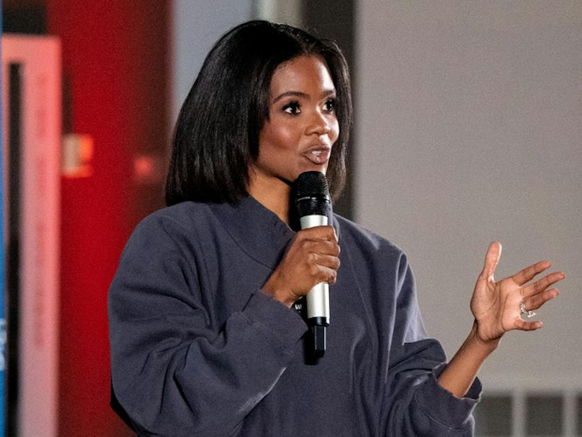
Is there evidence of serious free-speech violations on campus? *
A nationally known invited speaker was shouted down by about 20 “protesters” in a large MSU auditorium (Oct, 2022).
The student group that invited the speaker anticipated such problems and paid for MSU police to be present.
The police eventually removed the “protesters” so the talk could resume.
As attendees left the building, the “protesters” cursed them.
* https://statenews.com/article/2022/10/turning-point-msu-hosts-candace-owens-protesters-condemn-her-ideologies

Slide 6
Have any external survey(s) assessed free speech at MSU? *
2024 National College Free Speech Rankings
Conducted by Foundation for Individual Rights and Expression (FIRE)
Survey of 55,000 currently enrolled students at 250 colleges/universities
Comprehensive comparison of student experiences of on-campus free speech
MSU ranked in the bottom 36% nationally for free speech
MSU ranked lowest of four large Michigan universities
MTU, UM, WSU, and MSU
* https://rankings.thefire.org/rank/school/michigan-state-university

Slide 7
What is the public’s perception of free speech at MSU? *
MSU was derided nationally for claiming that common words were offensive (March, 2023)
“Gift”
“Bunny”
“America”
“Christmas tree”
* https://nypost.com/2023/03/30/gift-bunny-and-christmas-tree-are-offensive-words-on-campus/
https://www.thecollegefix.com/michigan-state-inclusive-language-guide-bunny-gift-america-are-offensive/

Slide 8
What could be done to strengthen free speech at MSU?
University Council (UC) could express support for free speech at MSU
UC could encourage efforts to assess and strengthen free speech at MSU
Proposal: Independent, Ad-Hoc Committee to study free speech at MSU
Membership:
Small, grass-roots group of faculty, staff, and students
Qualifications: Participants should want to strengthen free speech at MSU
Mission:
Collect information relevant to free speech at MSU
Study best practices for strengthening free speech in academia
Identify potential opportunities to strengthen free speech at MSU
Submit final report to UC for its consideration and possible resolutions

Slide 9
Example 1 of possible UC free-speech resolution *
Whereas, MSU’s Board of Trustees has posted a Statement on Free Speech stating that “Fundamental to MSU’s philosophy on campus dissent is a belief that the rights guaranteed in the First and Fourteenth amendments of the Constitution must be protected;” and,
Whereas, “The University has worked for decades to establish a community consensus on the scope of intellectually productive and constitutionally protected dissent, and to distinguish it from impermissible disruption;” and,
Whereas, “That consensus is embodied in several documents, which have received student, faculty, and administrative review and approval;” therefore be it,
Resolved, That MSU’s University Council supports the abovementioned MSU Board of Trustees’ Statement on Free Speech and calls on the MSU administration, faculty, staff, and students to honor and enforce the passages and principles expressed therein.
* Text shown in quotes was excerpted from MSU Trustees Statement on Free Speech:
https://trustees.msu.edu/about/statement-free-speech.html

Slide 10
Example 2 of UC free-speech resolution *
Whereas, MSU’s Board of Trustees has posted a Statement on Free Speech stating that “Fundamental to MSU’s philosophy on campus dissent is a belief that the rights guaranteed in the First and Fourteenth amendments of the Constitution must be protected;” and,
Whereas, evidence exists that recent violations of the passages and principles in the abovementioned Statement on Free Speech have restricted free speech at MSU; and,
Whereas, an ongoing pattern of free-speech violations at MSU could potentially damage MSU’s reputation and the quality of its students’ education; therefore be it,
Resolved, That MSU’s University Council (UC) supports constructive efforts to identify opportunities to strengthen free speech at MSU and report such opportunities to the UC.
* Text shown in quotes was excerpted from MSU Trustees Statement on Free Speech:
https://trustees.msu.edu/about/statement-free-speech.html

Slide 11
Thank You
Mark Worden
worden@msu.edu

