Slide 1
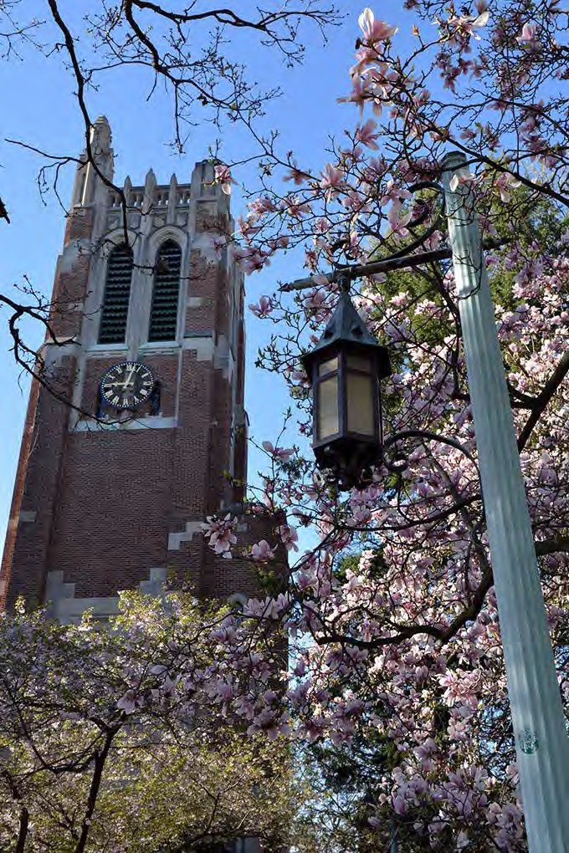
Campus Master Plan
Update 2016
masterplan.msu.edu troosts@msu.edu

Slide 2


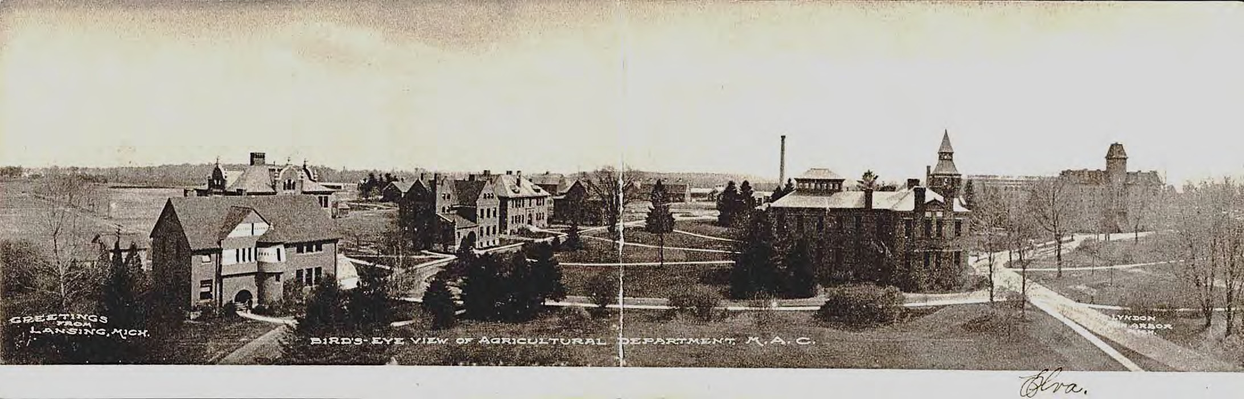
Purpose of the Campus Master Plan
Establishes a framework for the organizational character of the campus
Identifies opportunities to accommodate growth in response to programmatic needs
Optimizes the use of limited resources
Enhances safety by coordinating physical systems
Provides a tool for discussion and decision making

Slide 3


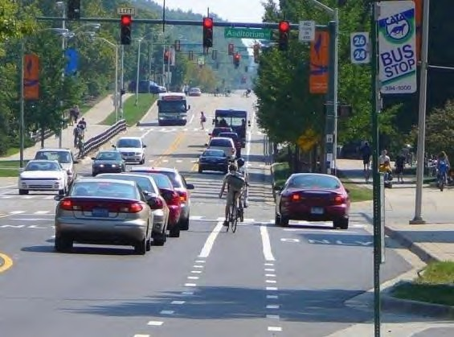
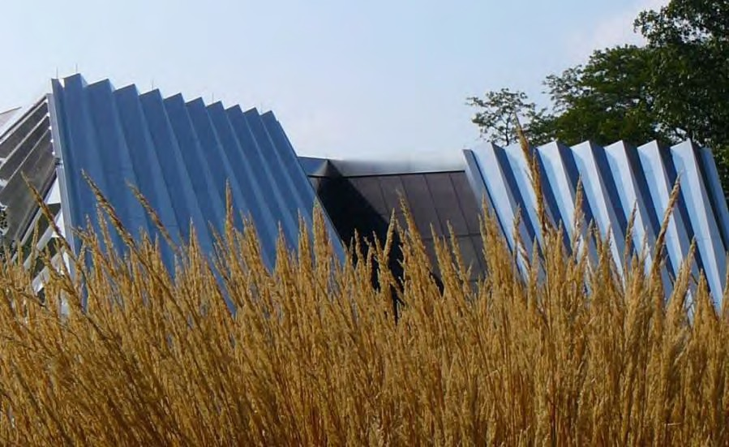
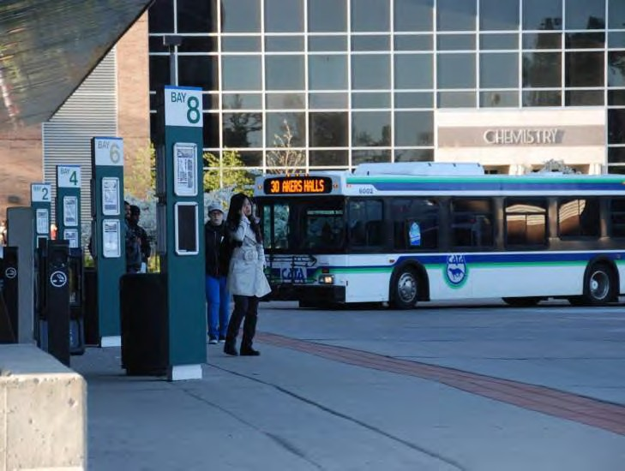
Master Plan Components
Planning Principles
  Overarching and timeless ideals
  Smart Growth
System Recommendations
  Buildings, circulation, open space, and infrastructure
University Zoning Ordinance
  Established by the BOT in April 1968 under President Hannah
  “…Preserving the campus environment of spaciousness and landscape beauty, promoting order and unity, and minimizing congestion.”

Slide 4


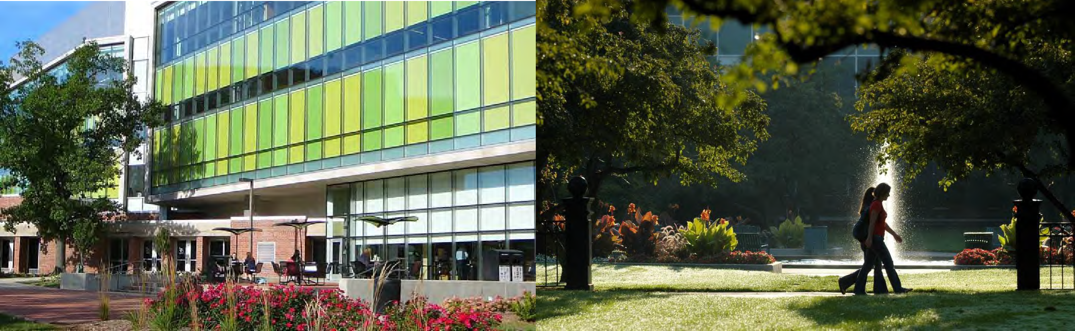
Smart Growth Principles
Highest and best use of land
Establish a compact campus composition with a mix of land uses
Provide a variety of transportation choices
Enhance non-motorized accessibility and create walkable neighborhoods and districts
Preserve critical environmental areas, open space, and farmland

Slide 5


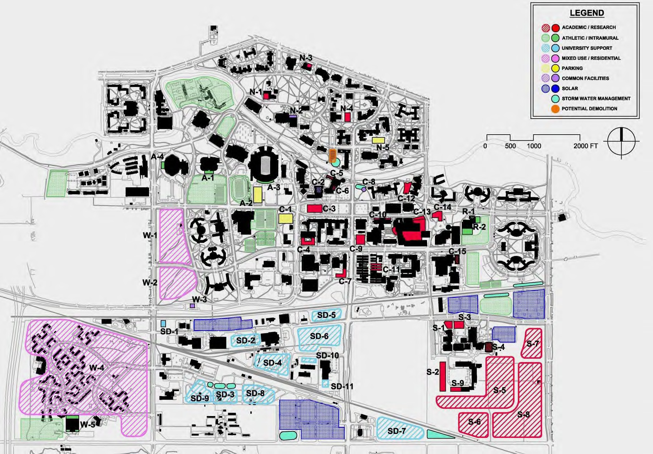
Future Development Opportunities
Approximately 9.8 MGSF

Slide 6


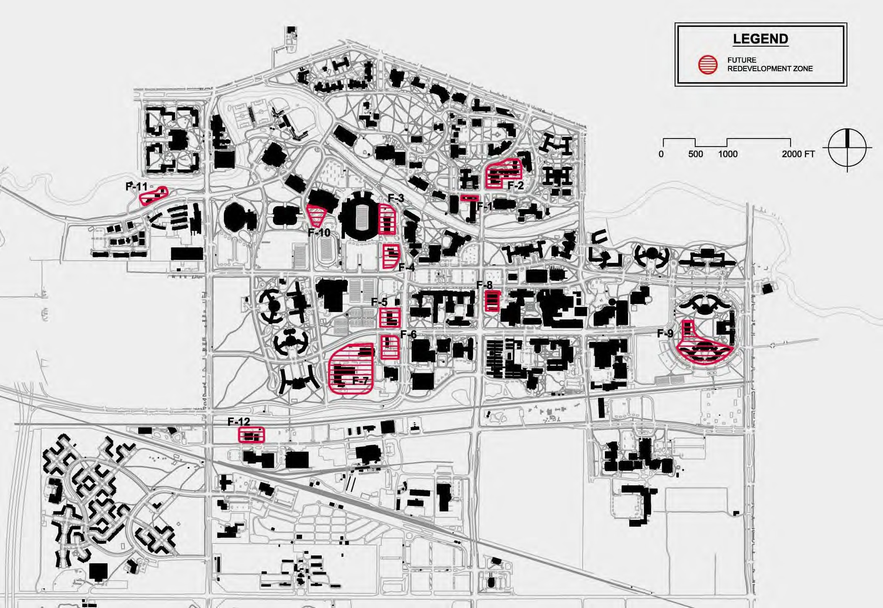
Future Redevelopment Considerations
Approximately 1.7 MGSF

Slide 7


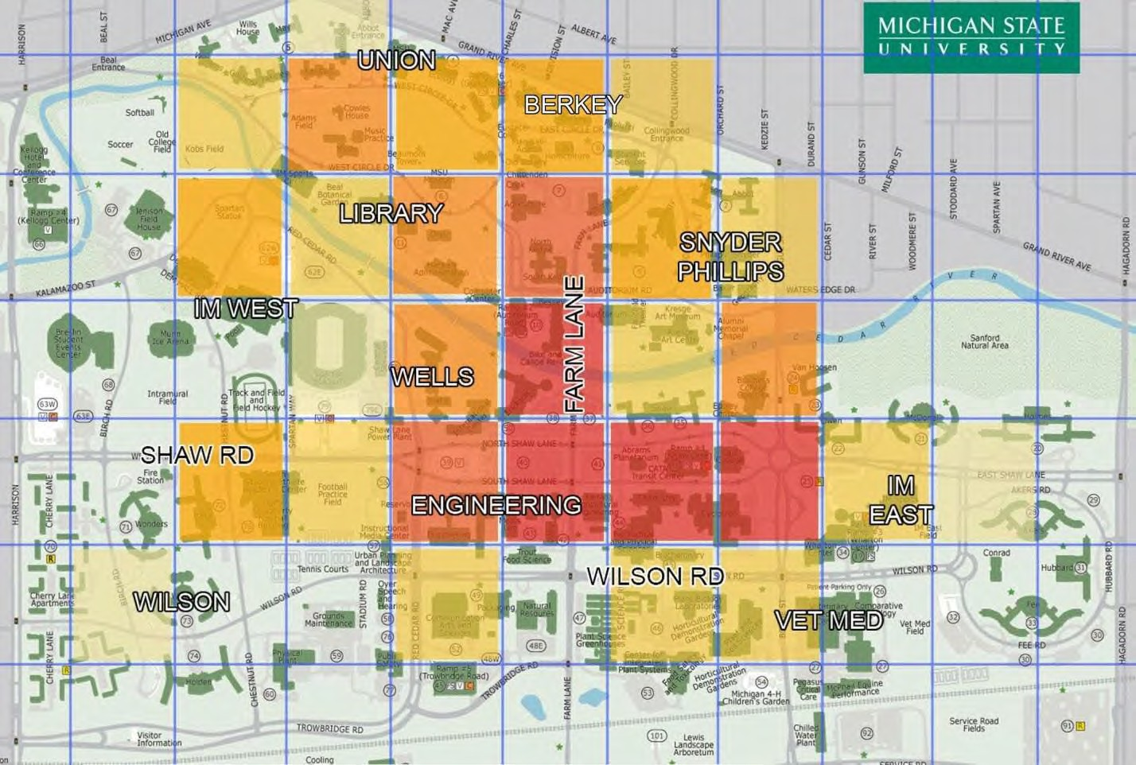
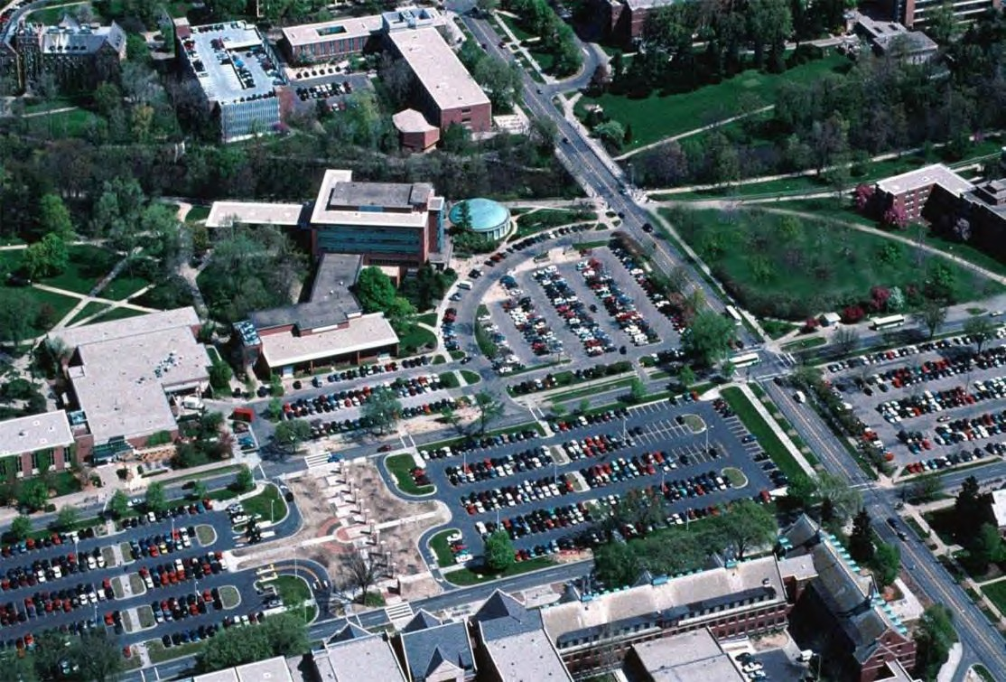
Circulation Safety
2011 Student Transportation Survey

Slide 8


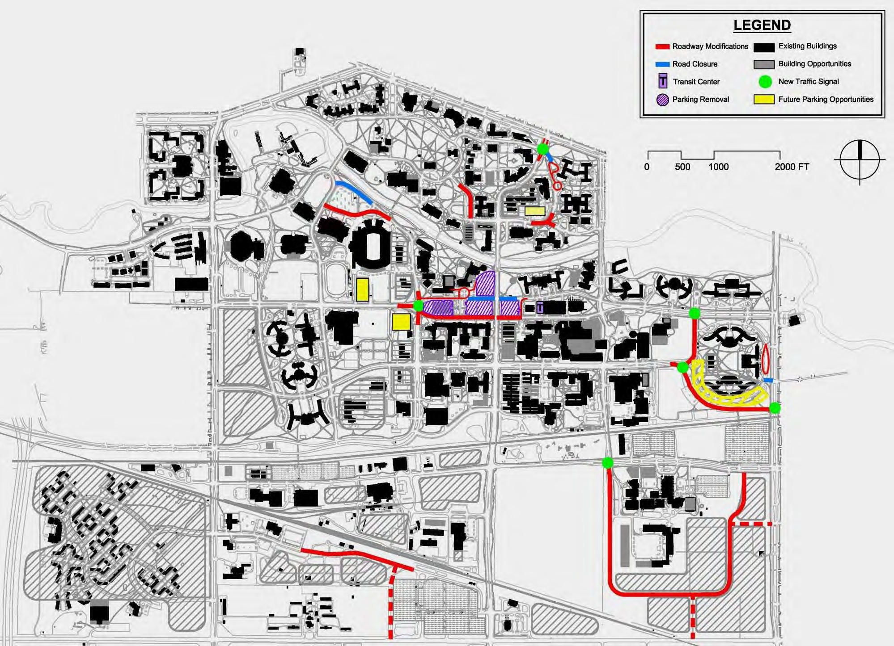
Vehicular Circulation Framework

Slide 9


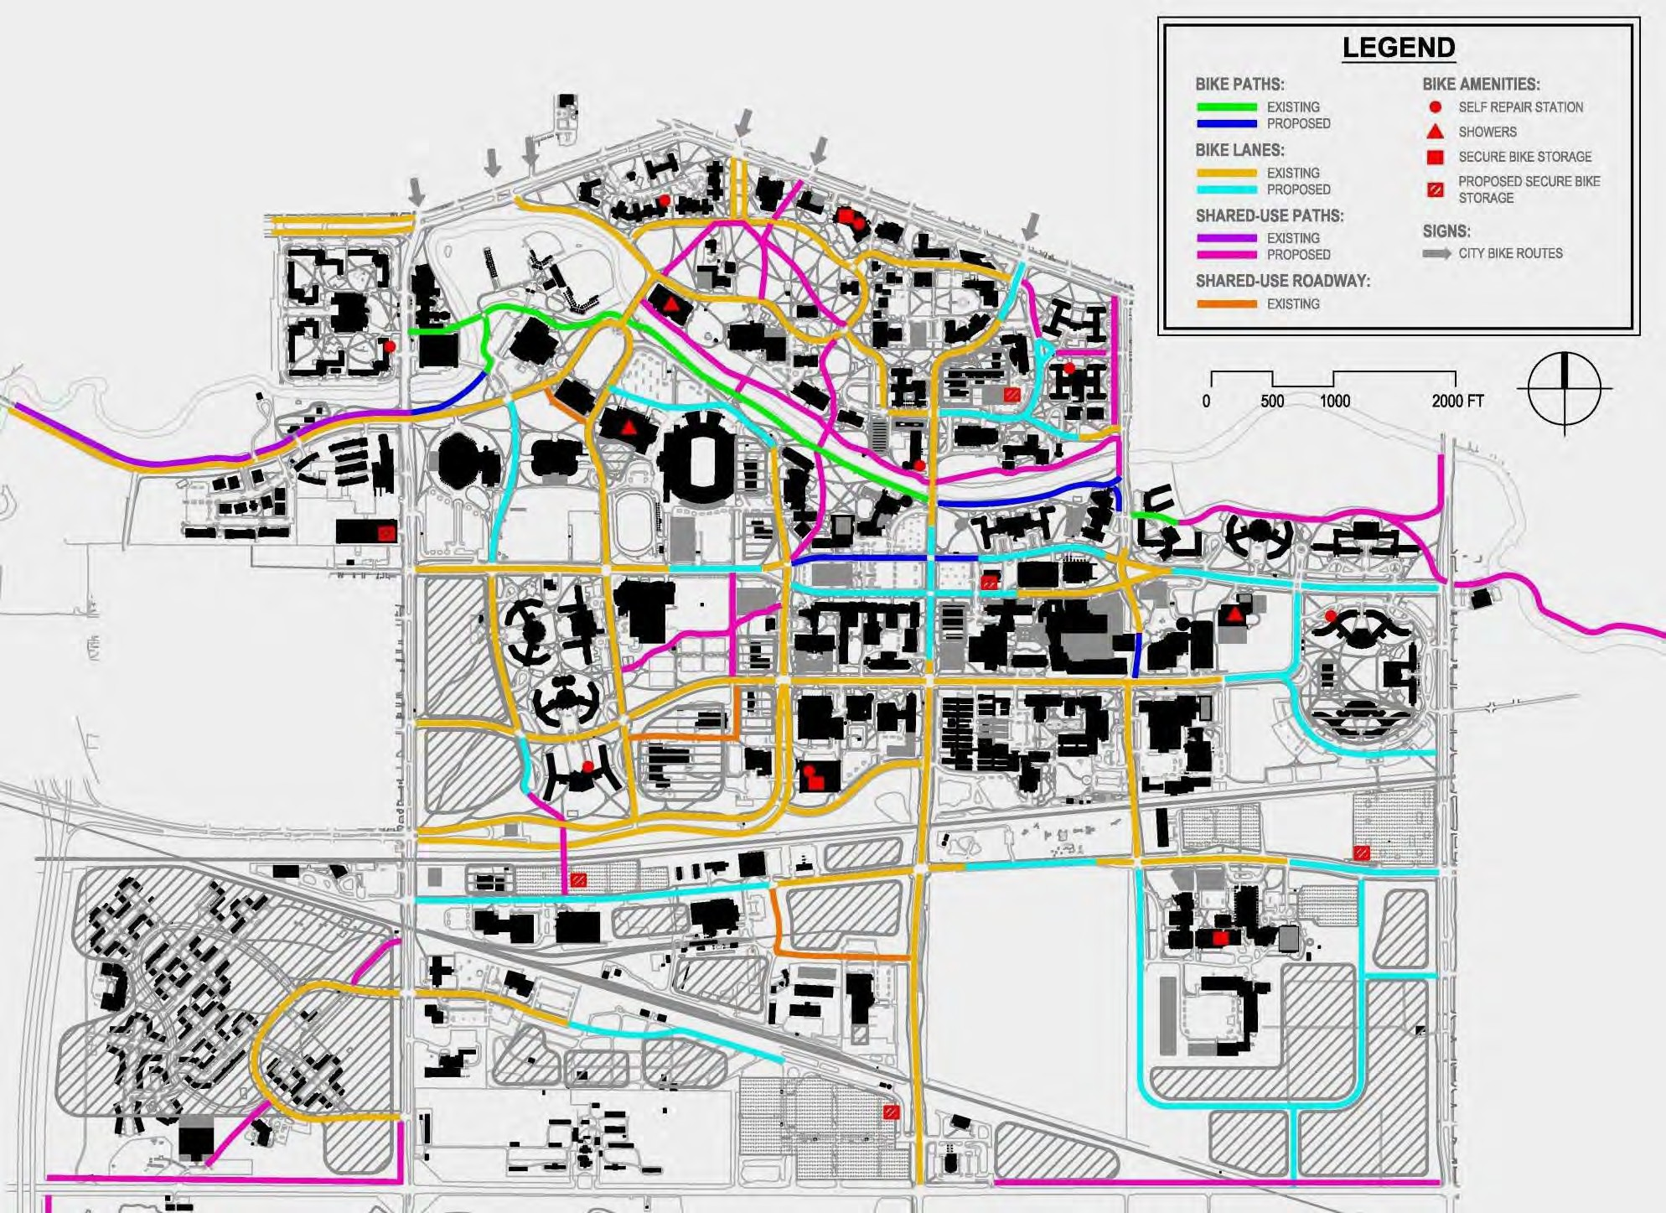
Bicycle Circulation Framework
68% of campus roads have bike lanes

Slide 10


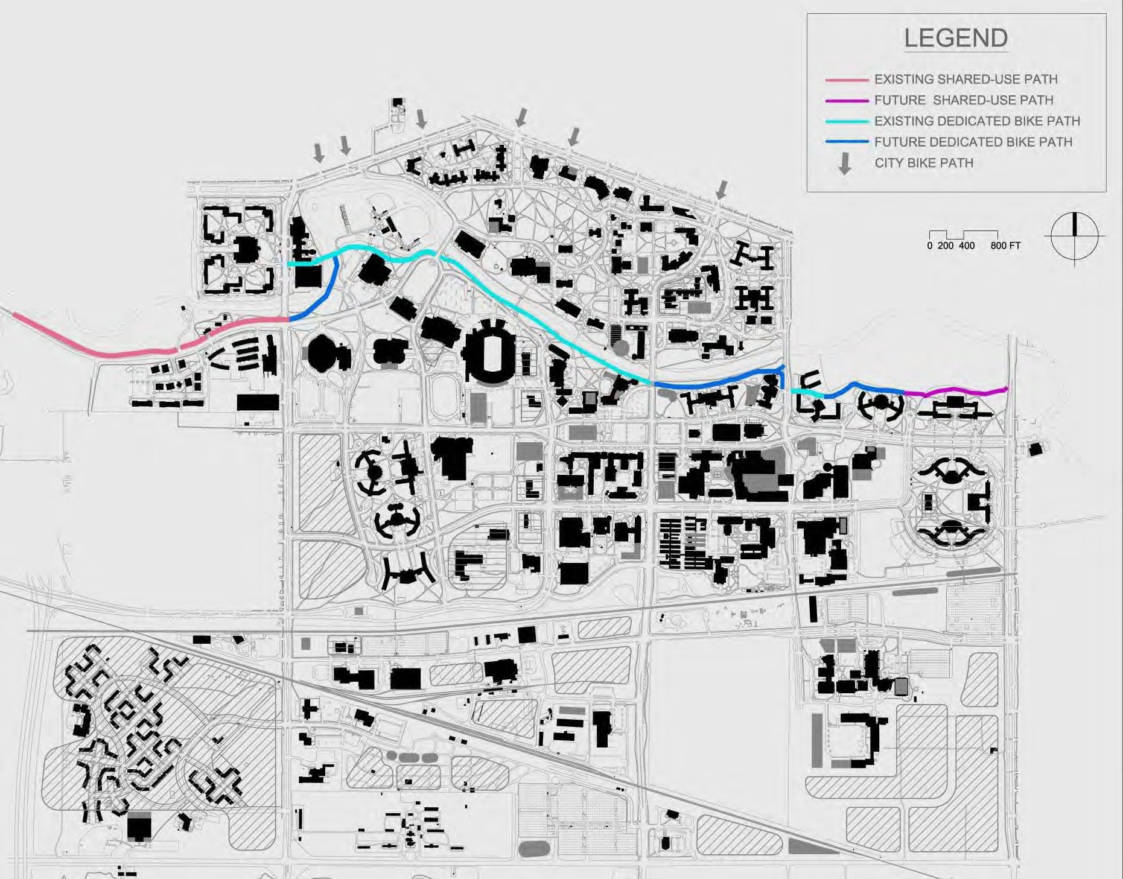
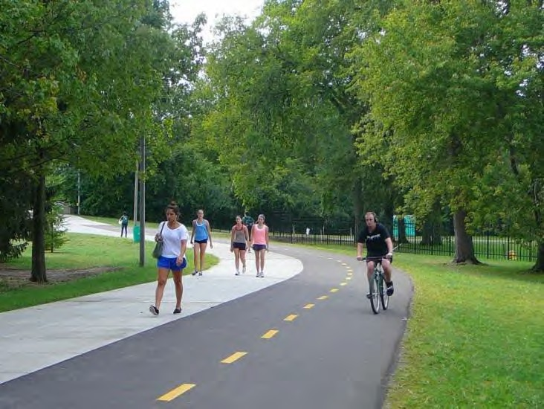
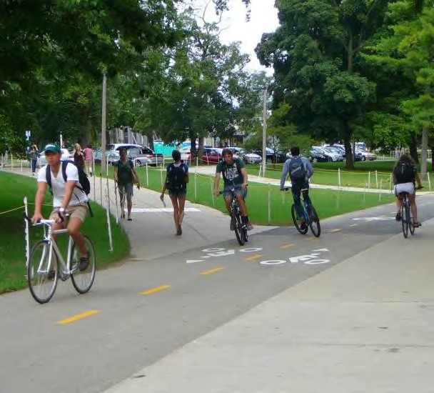
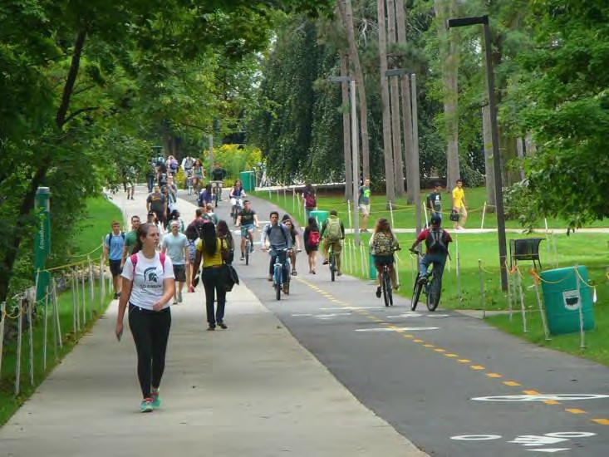
MSU River Trail

Slide 11


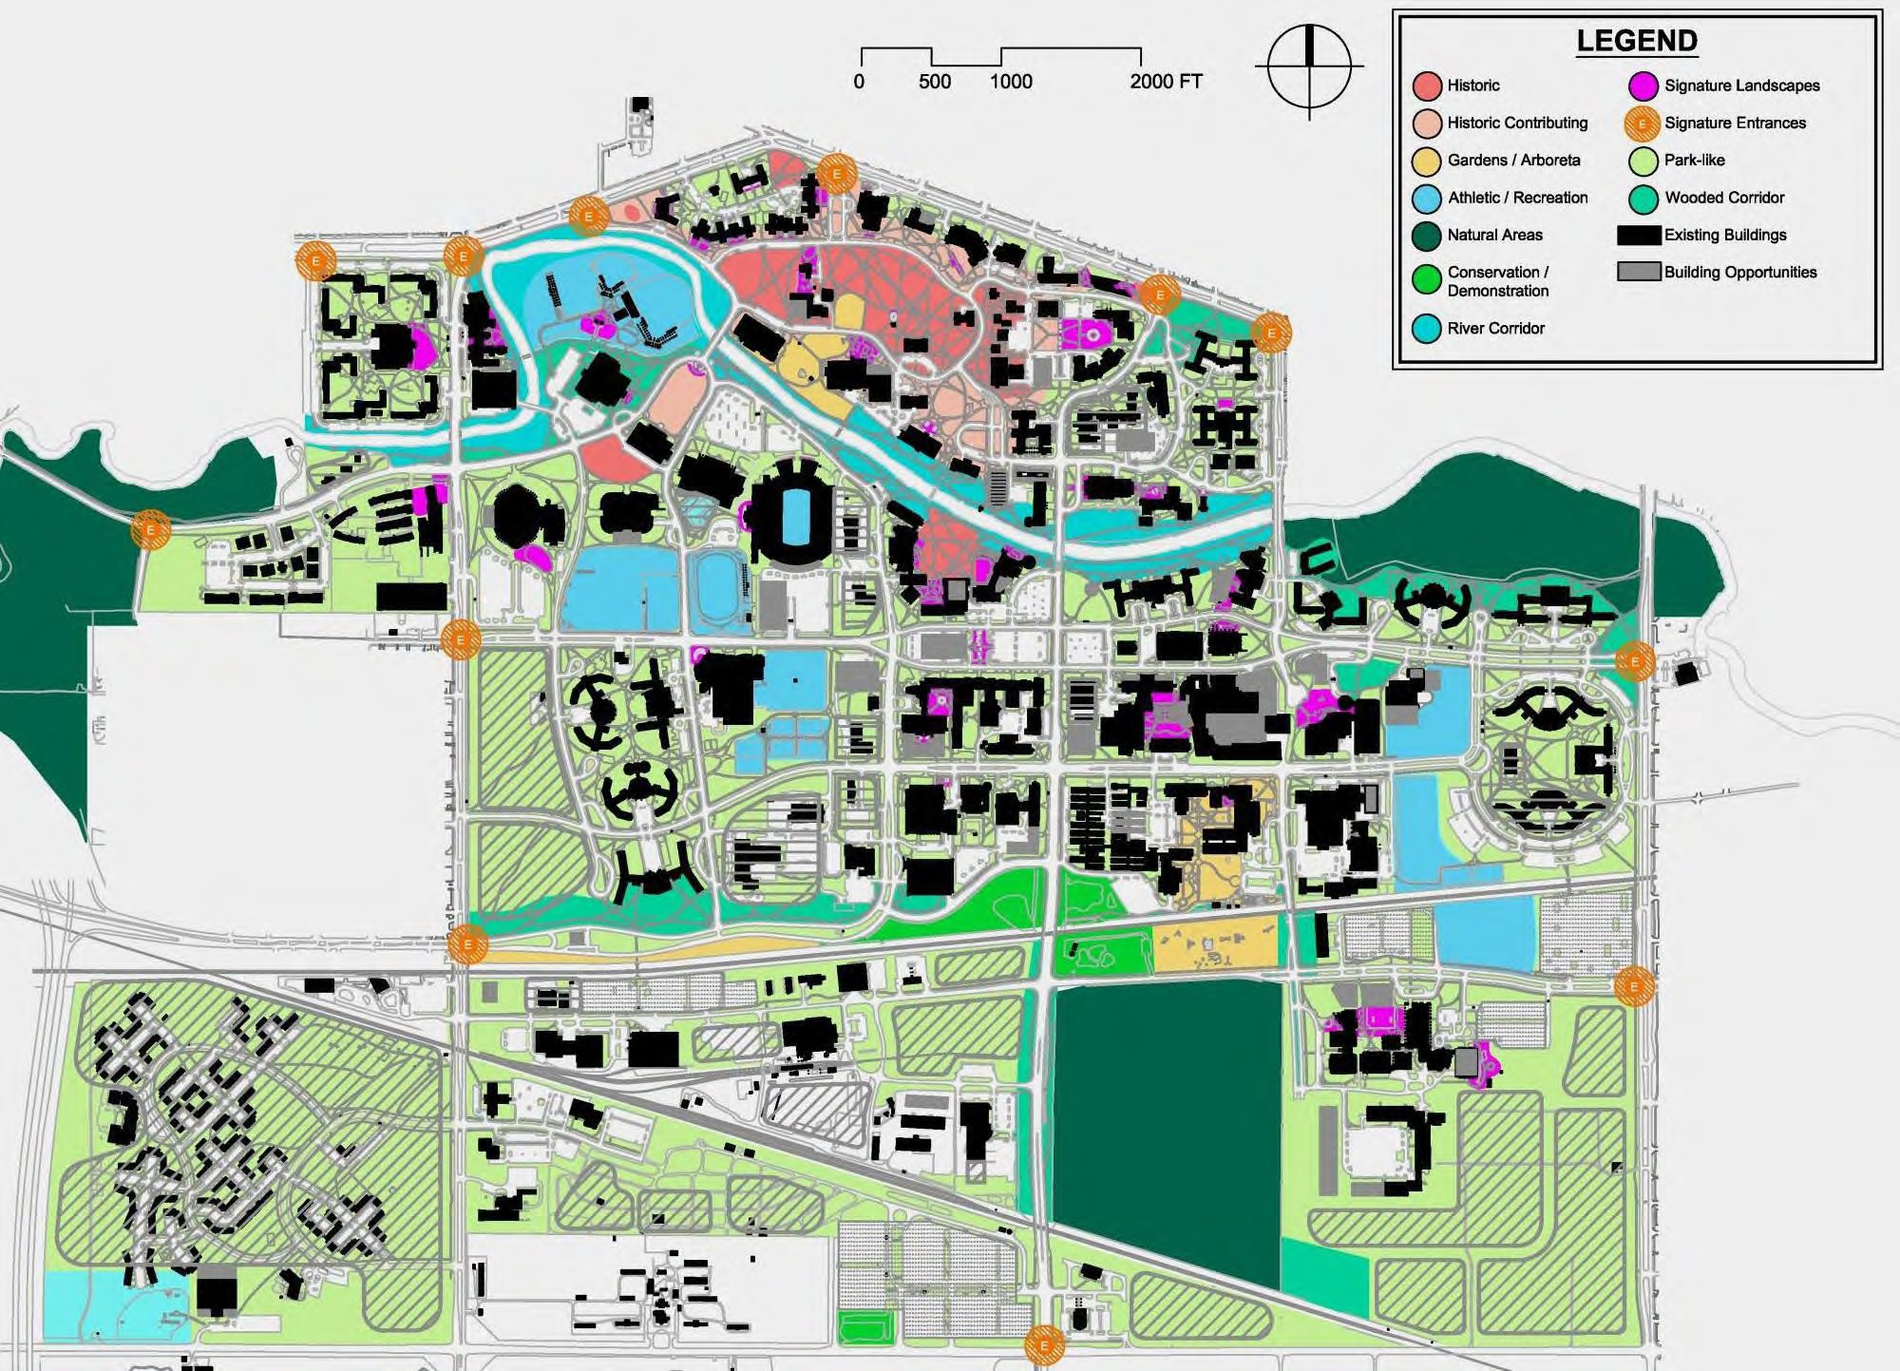
Open Space Framework

Slide 12


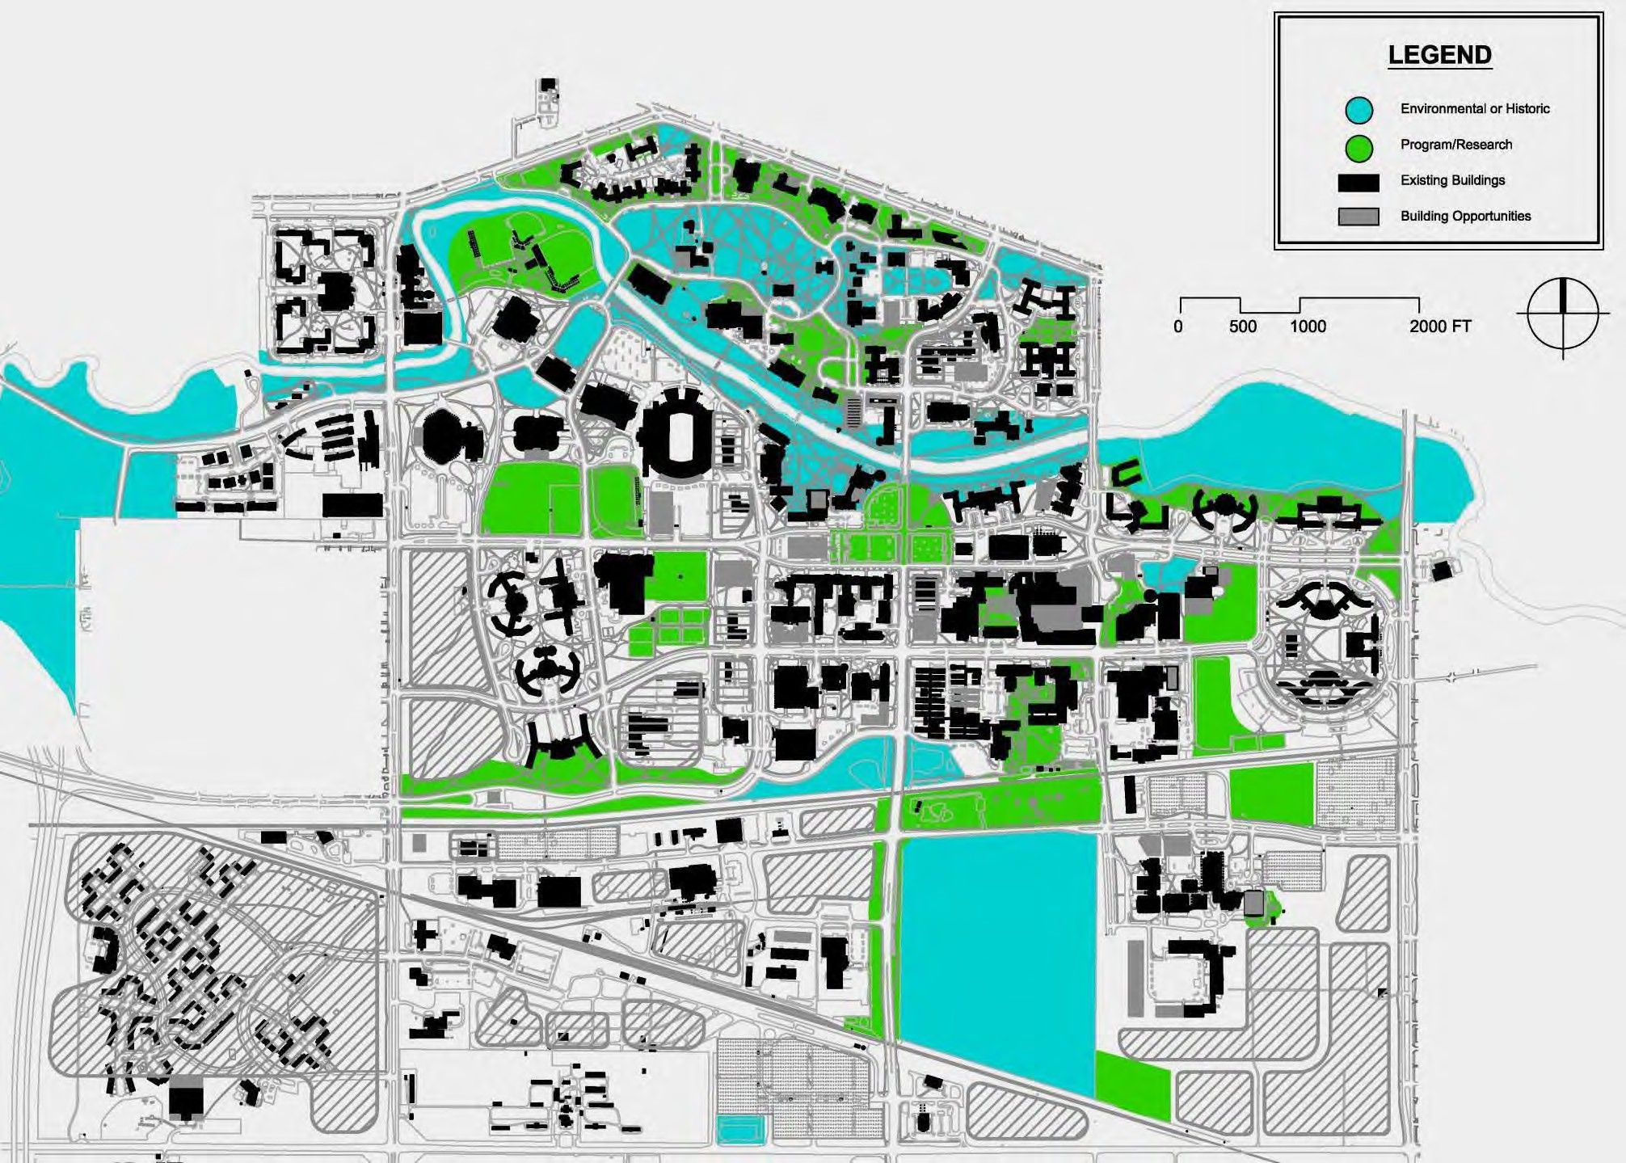
Protected Green Space

Slide 13




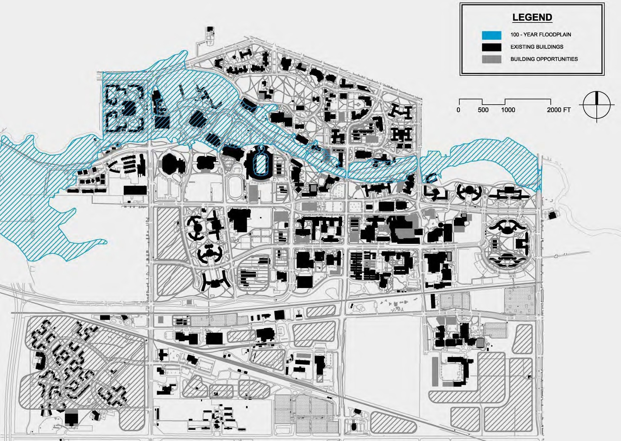
100 - Year Floodplain

Slide 14


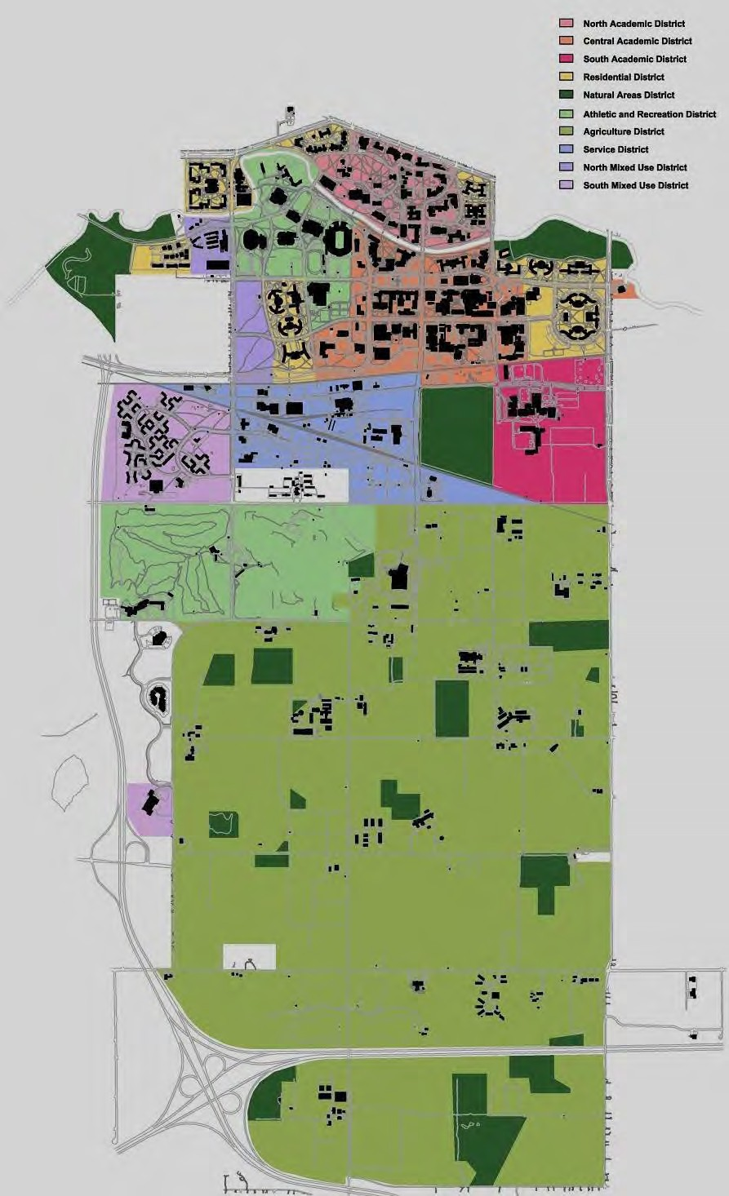
Zoning Districts

Slide 15
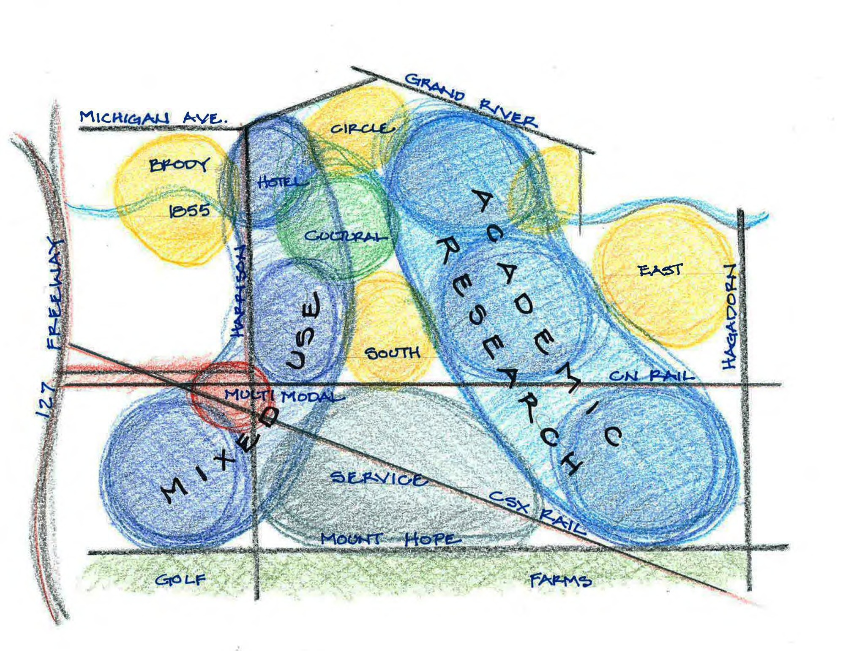
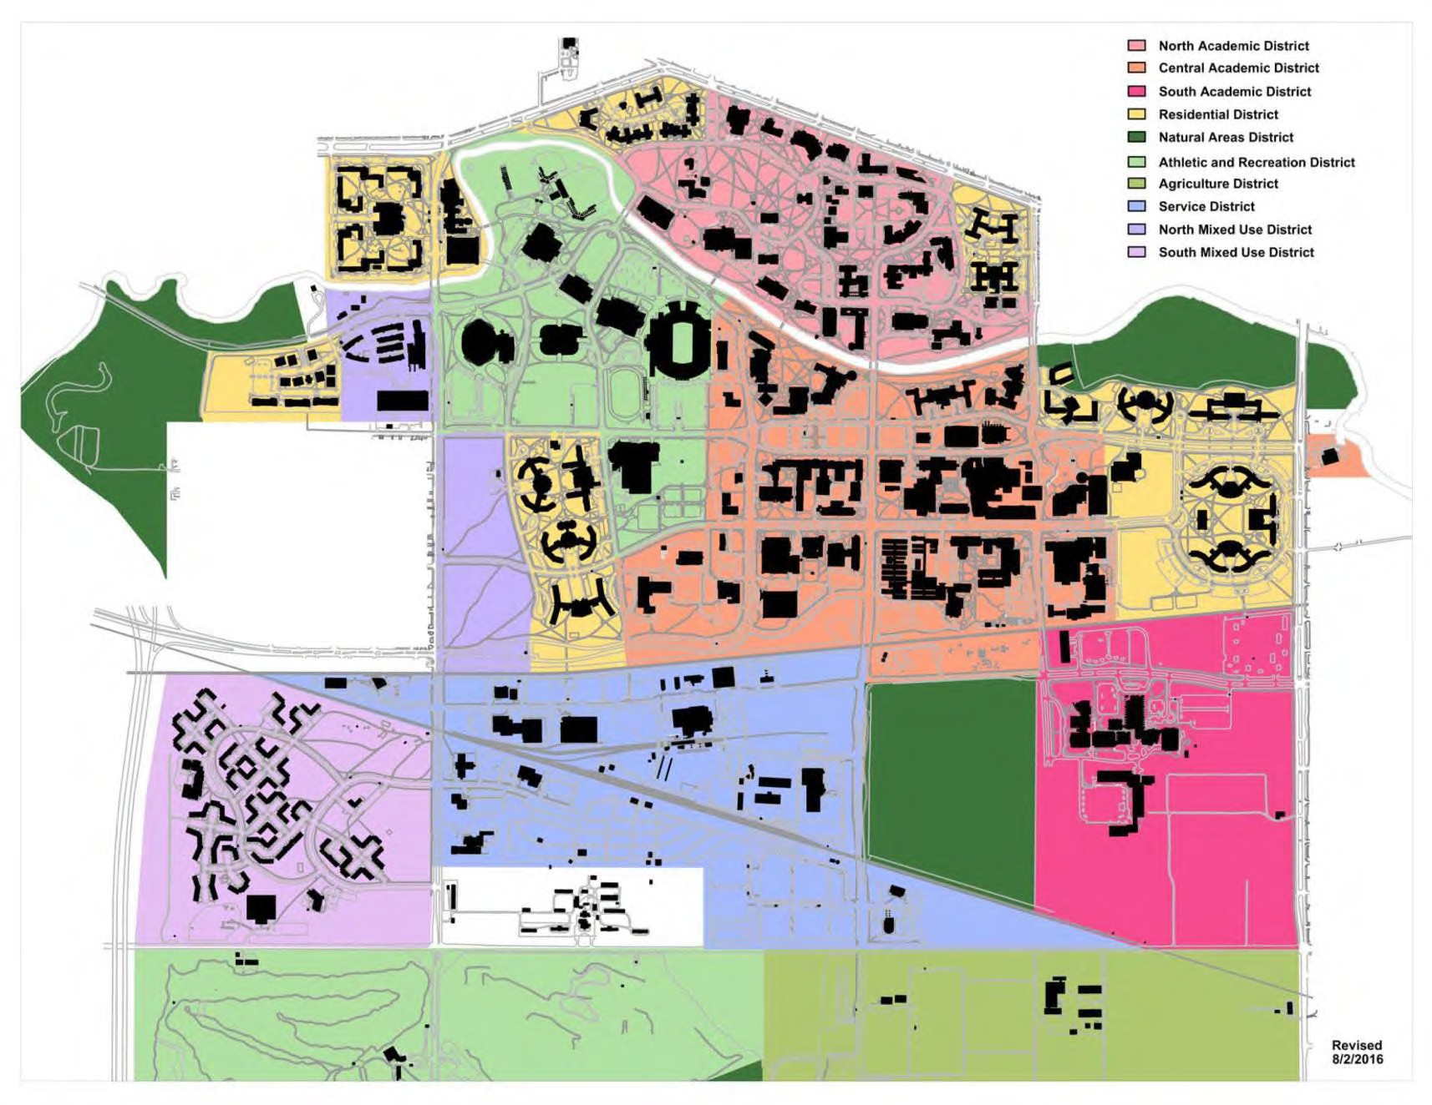

Slide 16
Campus Master Plan
Update 2016
masterplan.msu.edu troosts@msu.edu

