Slide 1

Our Commitment to International Students and Scholars

Slide 2





International Scholars
338
14.4%
International Undergrad
4,844
International Grad
2,082
Total International
7,264
14.4%
International Student and Scholar Community

Slide 3

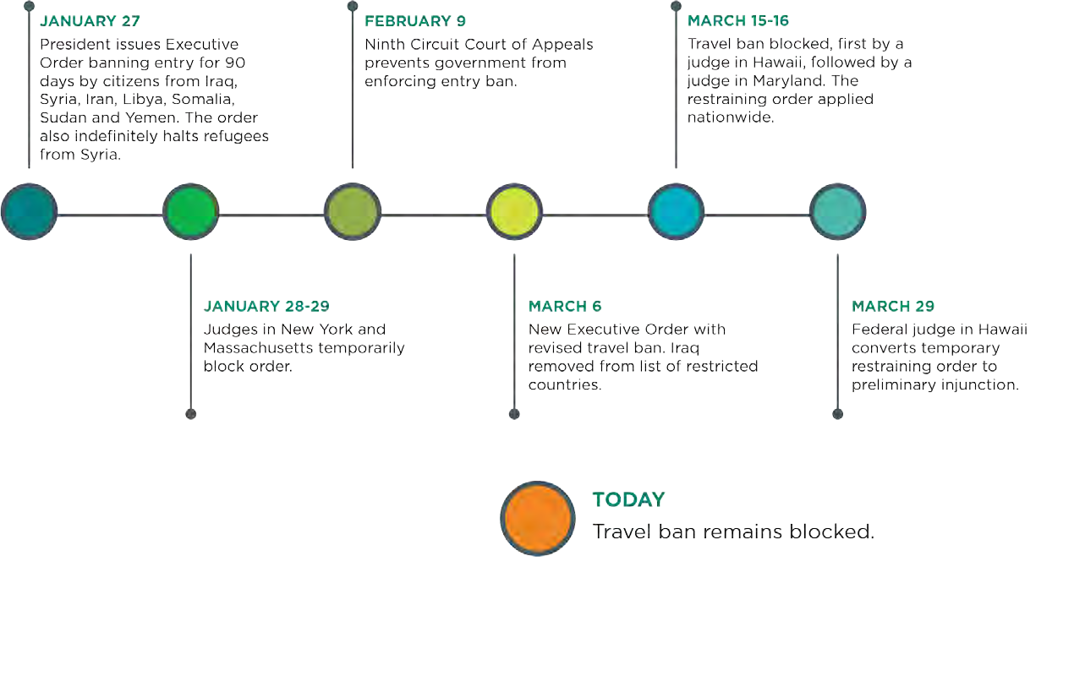
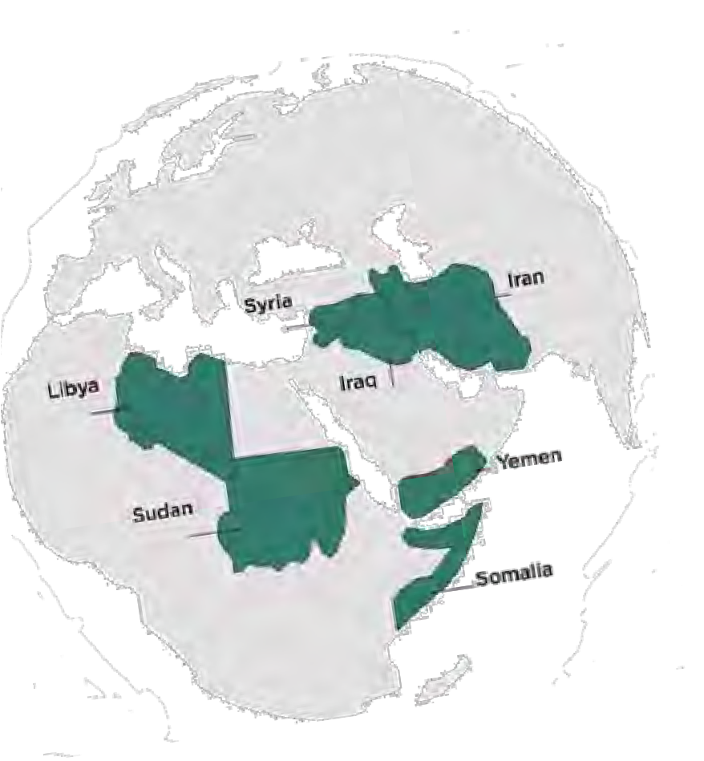
Immigration Executive Orders

Slide 4





Somalia 1
Sudan 1
Potential MSU
Impacts
Syria 4
Libya 12
122
Students & Scholars
Undergraduate: 10
Graduate: 94
Scholars: 18
Iran 104
DACA
10

Slide 5
Two University Committees
EXECUTIVE TASK FORCE
High-level administrators of critical and applicable units.
Oversight
Policy
Strategy
OPERATIONS TEAM
On-the-ground staff closely interacting with students.
Advising
Communications
Coordination

Slide 6
Executive Task Force
Denise Maybank (Student Affairs)
Sekhar Chivukula (Undergrad Education)
Judith Stoddart (Grad Education)
Radhika Pasricha (General Counsel)
Vennie Gore (Residential & Hospitality Services)
Mark Burnam (Government Affairs)
David Thronson (Immigration Law Clinic)
Heather Swain (CABS)
Paulette Granberry Russel (OI3)
John Gaboury (Provost Office)
Doug Gage (Research and Graduate Studies)
Sarah Walter (MSU D.C. office),
Beth Alexander (Human Medicine)
John Hudzik (Former VP of Global Engagement)

Slide 7
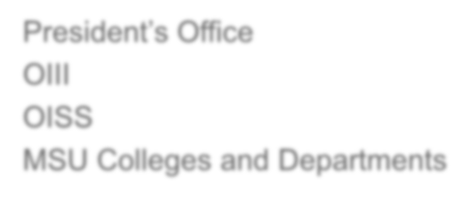






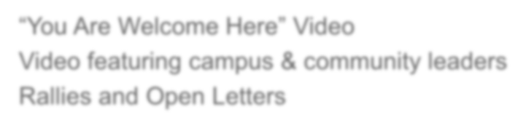


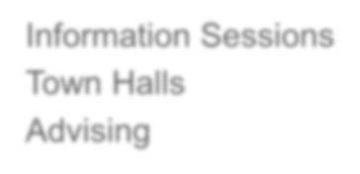

MSU Responses/Statements
President’s Office OIII
OISS
MSU Colleges and Departments
“You Are Welcome Here” Video
Video featuring campus & community leaders Rallies and Open Letters
Information Sessions Town Halls
Advising
“Our students and scholars come from around the world to become Spartans, and then return to the world to make it better.”
MSU President Lou Anna K. Simon

Slide 8

Town Halls & Info Sessions
February 1: Addressed the EO signed January 27th in terms of what it meant, how it affected students/scholars, and what support resources/services were available; Streamed live on the internet and audio portion was available on the OISS webpage. ~ Attendance 200.
March 16: Addressed EO signed March 6th in terms of university responses to student questions about how their academics would be supported. ~Attendance 30.
OISS Immigration Sessions
February 7-10: Four sessions to answer questions from international students/scholars about EO immigration issues.
OISS/MSP/Olin Psychiatry Emotional Support sessions
February 3 & 6: Dr. Farha Abbasi, Clinical Psychiatrist, Olin Health Center
“Hear Us” Support rally (Persian Student Association)
February 8: Sponsored by MSP; featured OISS Director.

Slide 9

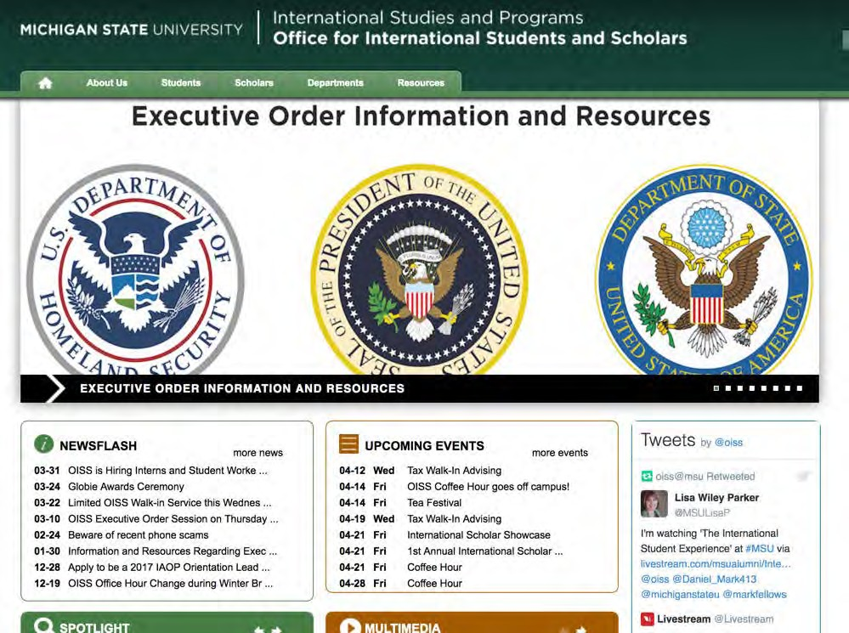
Contact Info: Immigration Issues
oiss.isp.msu.edu
Portal for MSU information
about EOs relative to travel bans.
First point of contact
Features:
  E.O. updates
  FAQ’s
  Campus and community resources
  Additional points of contacts
517-353-1720 oiss@msu.edu

Slide 10
Contact Info: Academic Issues
Undergraduate Students Assistant Dean Debra Dotterer dotterer@msu.edu
(517) 353-3243
Graduate Students
Associate Dean Tony Nunez nunez@grd.msu.edu
(517) 353-3220

Slide 11

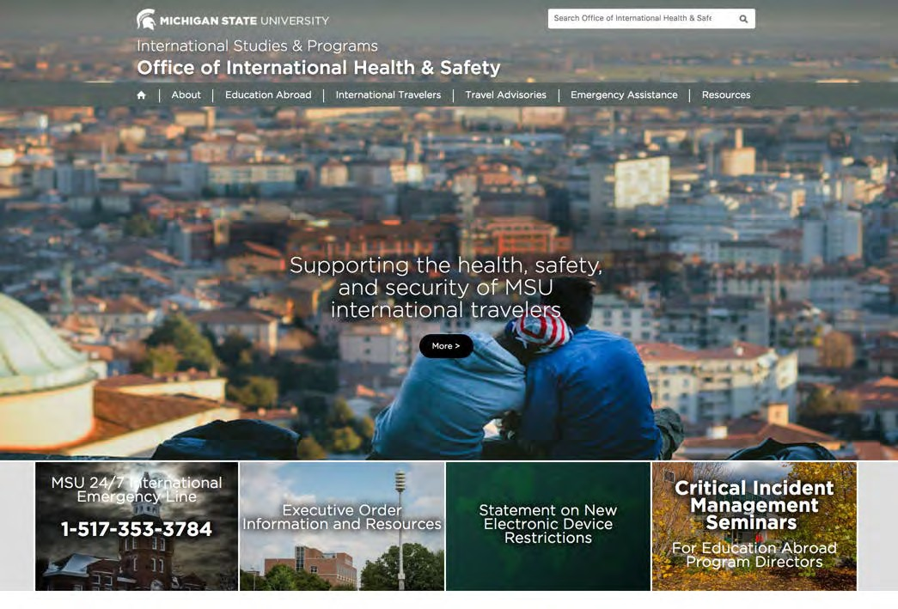
Contact Info: Health and Safety
Office for International Health and Safety
oihs@msu.edu
24/7 Emergency Line
+1-517-353-3784
oihs.isp.msu.edu

Slide 12





Additional Resources
List of local Immigration Attorneys
Talking Points to Dean/Dir/Chair, Advisors, and Counselors
OISS
Information Sheet if Detained
OIHS 24/7
Emergency Hotline
RSAC
Procedures for Students Abroad

Slide 13




Support Units
Counseling Center, Olin Health Center, or Student Affairs and Services for Student Support
The MSU College of Law Immigration Law Clinic
Office for Inclusion and Intercultural Initiatives
Employee Assistance Program for Faculty and Staff

Slide 14

Student Concerns
Clarifications on who is affected and how
Immigration rights and responsibilities
What documents to carry
Changes in status
General
University support
Ability to continue programs
Anxiety affecting academic productivity
Academic
Health & Safety
Emotional toll
Personal safety, harassment

Slide 15
Principles of Support
Values Statement
Michigan State University is committed to our institutional values: quality, inclusiveness, and connectivity. We embrace building a vibrant, intellectual community that offers and respects a broad range of ideas and perspectives. As an intentional global university, we value the diversity and richness that international students, faculty, and staff contribute to the university and to the community.
Students from countries around the world play an invaluable role in MSU’s classrooms, labs, and community as we work to solve problems and change lives locally, nationally, and globally.
While U.S. immigration policies evolve, MSU remains committed to providing students from impacted countries the opportunity to receive a quality educational experience

Slide 16
Principles of Support
MSU will work with impacted students to:
Provide timely updates and answer questions about the implications of shifting immigration laws, policies, and practices
Continue to accept and admit students from impacted countries
Defer admission of accepted students whose arrival is delayed
Explore opportunities for students who have made significant progress toward their degrees, but are unable to return to campus, to complete studies and be awarded an MSU degree

Slide 17
Principles of Support
MSU will work with impacted students to:
Help students identify alternative funding sources for students who are unable to return to campus, or to leave campus, and who lose access to financial support because of immigration related travel restrictions
Provide high quality individualized academic advising to all students who find themselves facing difficulty related to immigration or travel complications, through a central point person in the Graduate School and the Office of the Associate Provost for Undergraduate Education
Advise and assist graduating students who are pursuing practical training to complement their education
Evaluate and prioritize assistance, acknowledging the importance of keeping families together

Slide 18

Thank You

