Slide 1
Faculty Recruitment, Hiring, Promotion, Tenure and Retention
Teresa K. Woodruff
Provost and Executive Vice President for Academic Affairs
Jabbar R. Bennett
Vice President and Chief Diversity Officer
Suzanne Lang
Associate Provost and Vice-President for Faculty and Academic Staff Affairs

Slide 2
Thinking About Decanal & Faculty Hires
Disciplinary depth
Institutional vision
There’s a cohesive link between each step:
Recruitment
Hiring
Promotion
Tenure
Retention

Slide 3
Incorporating DEI
To reach our strategic goals, we need to:
See the connection between recruitment, hiring, promotion, tenure, and retention of a diverse faculty.
Understand where we are and how to reach our goals through our search priorities, hiring, and support of faculty.
Support of faculty is based clear expectations and an understanding of how to reach those expectations.
Inclusion and equity are foundational to retention.

Slide 4
Recruitment & Hiring
Improving the diversity of the candidate pool depends on the networks and partnerships we have and those that we build.
How we compose the position description so that minorities see themselves as having the specified qualifications is required.
Where and how we advertise the position – we have to change our view that “if we build it, they will come”.
Show case the supportive programs and offices to help every faculty member be a success.

Slide 5
Overview of the Search Process
Preparing for a Successful Search
Resources for Search Committees
Describing the Position and Determining Candidate Qualifications Recruitment Process
Selection Process
Source: MSU Academic Hiring Manual, and Faculty Search Toolkit

Slide 6
What we Think About When we Begin a Search
Establishing a diverse search committee
Ensuring committee members understand the purpose and general process of the search, and their responsibilities
The need to comply with MSU requirements, and federal and state laws
Designating an “affirmative action advocate”

Slide 7
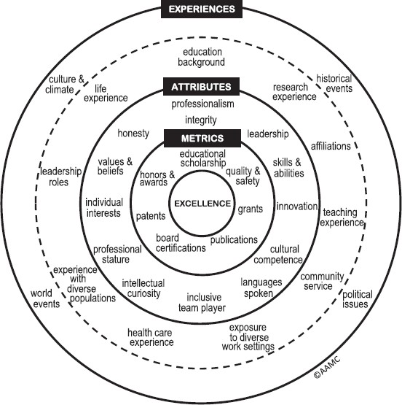
Embracing a Holistic Review: The E-A-M Model
The Experiences-Attributes-Metrics (E- A-M Model) is designed to create a qualified and richly diverse interview and selection pool with a focus on EXCELLENCE
Experiences – Culture and Climate, Historical Events, Political Issues, World Events, Educational Background, Research Experience, Affiliations, Teaching Experience, Community Service, Exposure to Diverse Work Settings
Reproduced with permission from Roadmap to Excellence: Key Concepts for Evaluating the Impact of Medical School Holistic Admissions (AAMC, 2013)

Slide 8
Embracing a Holistic Review: The E-A-M Model
The E-A-M Model is designed to create a qualified and richly diverse interview and selection pool with a focus on EXCELLENCE
Attributes – Professional Integrity, Leadership, Skills and Abilities, Innovation, Cultural Competence, Languages Spoken, Inclusive Team Player
Metrics – Educational Scholarship, Grants, Publications, Patents, Honors and Awards
Reproduced with permission from Roadmap to Excellence: Key Concepts for Evaluating the Impact of Medical School Holistic Admissions (AAMC, 2013)

Slide 9
Advancing Inclusive Excellence at MSU
1855 Professorship Initiative
Reimagining the land grant mission for the future
Organization of relevant knowledge - driving responsive, research, teaching engagement
Signal to influence all other land grant institutions
Funded Categories
Social and Environmental Justice
Minority Politics, Urban Journalism, Law and Democracy
Diversity and Data Science
Cultural Leadership and Practice
One Health

Slide 10
1855 Professorship Initiative
Competitive Review
76 impressive proposals
13 professorships – represented by 9 primary colleges and 16 unique collaborative units
Primary College Recipients
College of Agriculture & Natural Resources (CANR)
College of Natural Sciences (CNS)
College of Veterinary Medicine (CVM)
Residential College in the Arts & Humanities (RCAH)
College of Law (COL)
College of Social Science (CSS)
College of Communication Arts & Sciences (CAS)
College of Engineering (COE)
College of Arts & Letters (CAL)

Slide 11
Faculty & Academic Staff Through the Lens of an Employee Life Cycle
1
2
3
4
5
6
7
8
Attract
Being an appealing, inclusive employer
Recruit
Enabling all talent to apply
Onboard
Ensuring all talent is understood and given tools/support for success
Learning and Development
All talent represented and included
Reward, Recognition, & Benefits
All talent needs are recognized & rewarded
Progression & Performance
Consistent and clear feedback
Retention
Talent that wants to stay
Separation
Learn from exits
STRATEGY: Strategic workforce plan designed to deliver institutional strategy

Slide 12
Strategic Plans Underpinning Faculty & Academic Staff Employment Activities
By investing in mentoring as well as professional, career and leadership development, we can make MSU a workplace of choice that supports an innovative, creative and diverse faculty and staff.
Strategic planning:
MSU 2030
Diversity, Equity & Inclusion
Relationship Violence & Sexual Misconduct Plan

Slide 13
Composition of Faculty & Academic Staff: 2001/2011/2021 By Race & Ethnicity as % of Total Population
90%
80%
70%
60%
50%
40%
30%
20%
10%
0%
Total Faculty/Academic Staff (Headcount) by Year
2001 | 4,537
2011 | 4,925
2021 | 5,660
3725, 82%
2001 2011
3727, 76%
4031, 71%
723, 15%
437, 10%
283, 6%
868, 15%
294, 5%
157, 3%
30, 1%30, 1%
241, 5%
381, 7%
10, 0.2%
104, 2%
0
46, 0.8%
0
0 0
35, 1%
White
Black
Asian
Hispanic
Haw/PI
Multiracial
Am Ind/AL
 |  |  |  |  |  |  | Nat
2001 | 82% | 5% | 10% | 2% | 0% | 0% | 1%
2011 | 76% | 6% | 15% | 3% | 0% | 0% | 1%
2021 | 71% | 7% | 15% | 5% | 0.2% | 0.8% | 1%

Slide 14
Success of MSU’s Faculty and Academic Staff is our Unit’s Primary Goal
The promotion and tenure/continuing processes are a reflection of a faculty/academic staff member's entire academic career at MSU
Review toward progress is conducted annually
The recognition that comes from being promoted through the academic ranks should be available to all whose performance warrants it

Slide 15
Reappointment, Promotion, and Tenure
The quality of MSU is sustained through the dedicated and creative work of the faculty.
Key Resource: Faculty Guide for Reappointment, Promotion & Tenure
MSU hires outstanding people and has strong expectations
MSU provides significant support because we want you to succeed
As an example, in tenure reviews, our track record over the last 20 years:
2/3 of cohort attained tenure
At final review stage, 90%+ receive tenure

Slide 16
Retention Promotes the Health and Success of MSU
A top priority area
Assessed using turnover rates of employee departure (includes resignations, layoffs, terminations, retirements, and even deaths)
Exit interviews and discussions

Slide 17
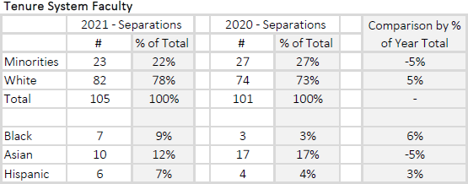
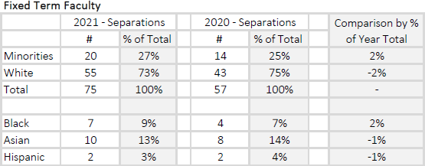
Separation* Numbers
Need to create a more robust stay interview/exit interview program
*Non-retirement separations

Slide 18
Support for Faculty and Academic Staff
Faculty & Academic Staff Development: https://ofasd.msu.edu/
The Office of Faculty and Academic Staff Development (formerly the Academic Advancement Network) works with all faculty, academic staff, and academic administrators at Michigan State University as they join the university, establish professional trajectories, and move through various stages of review, promotion, and growth.
Thriving in the Tenure System I – for pre-tenure faculty February 2nd 8:30-12:00 Thriving as an Academic Specialist February 9th 8:30-12:00
Thriving as a Fixed Term Faculty February 16th 8:30-12:00
Thriving in the Tenure System II for Associate faculty February 23rd 8:30-12:00

Slide 19
Questions

