Slide 1
Report for Faculty Senate
UCC

Slide 2
Bylaws for the Committee
4.5.1. The members of the University Committee on Curriculum (UCC) shall include a faculty member from each college. UCC shall also have five undergraduate student members, of whom one must be a member of ASMSU, and two graduate student members. The Provost shall be a member with voice, but no vote. The Provost shall also name an executive secretary to serve ex officio without vote. The University Registrar shall serve ex officio without vote. 4.5.1.1. The UCC will report to the Faculty Senate. UCC may seek advice from the University Council before reporting to the Faculty Senate on a particular matter and will do so if The Steering Committee so requests. 4.5.2. The chairperson of the UCC will serve on The Steering Committee and thus on the University Council and the Faculty Senate. 4.5.3. The UCC shall exercise the faculty’s delegated authority to review and approve or reject all changes in undergraduate curricula and degree requirements recommended by the University Committee on Undergraduate Education, and to review and approve or reject changes in graduate and graduate-professional curricula and degree requirements recommended by the University Committee on Graduate Studies. The UCC shall not reject a recommendation from either the University Committee on Undergraduate Education or the University Committee on Graduate Studies without providing a rationale for the rejection and consulting with the appropriate committee. In addition, the UCC shall exercise the faculty’s delegated authority to review and approve or reject all undergraduate and graduate courses proposed by academic units. 4.5.4. The UCC shall advise the Provost on criteria for the establishment and deletion of courses and curricula.

Slide 3
Committee Structure
The committee has 3 subcommittees that meet monthly to cover the curriculum that has gone through the College governance system and is looking for University approval.
Sub A considers requests from the Science Colleges
Sub B considers request from the Social Sciences and Law Colleges
Sub C considers request from the Arts and Business Colleges
Full Committee votes on recommendations from the Sub committees. They can also provide feedback on matters that are directed from Steering committee
The report is then presented at Faculty Senate

Slide 4
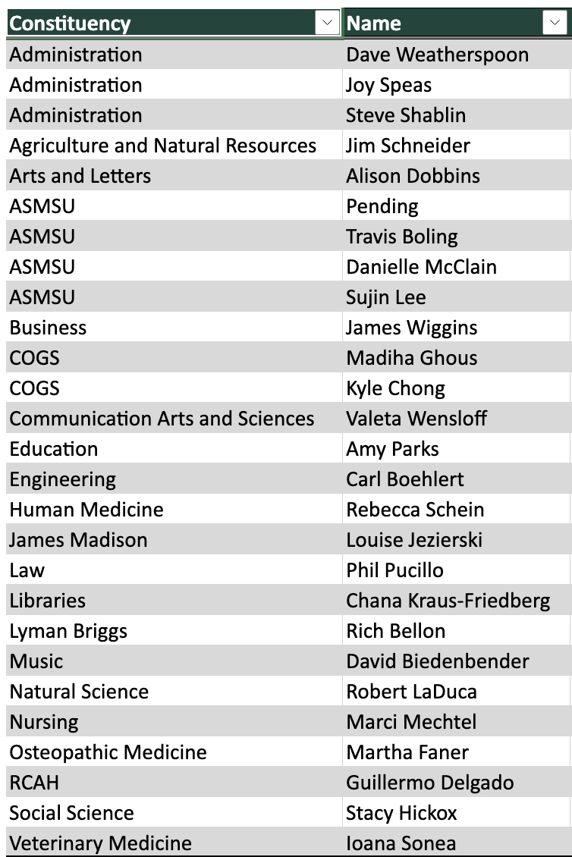
2021-2022 Membership

Slide 5
Work to date
The committee has approved the following:
Programs
Courses
Program discontinuations and moratoriums
UCC
Approved the recommendation for the creation of Undergraduate Certificates
Total Discontinuations=4
Total Moratoriums=7
New =13
Changes = 138
New = 165
Changes= 305
Deletions= 41

