Slide 2
Campus-wide RVSM climate surveys
Students, faculty, and staff
Measure prevalence, help-seeking, climate
Reliable and valid measures
Repeat assessments to measure change

Slide 4
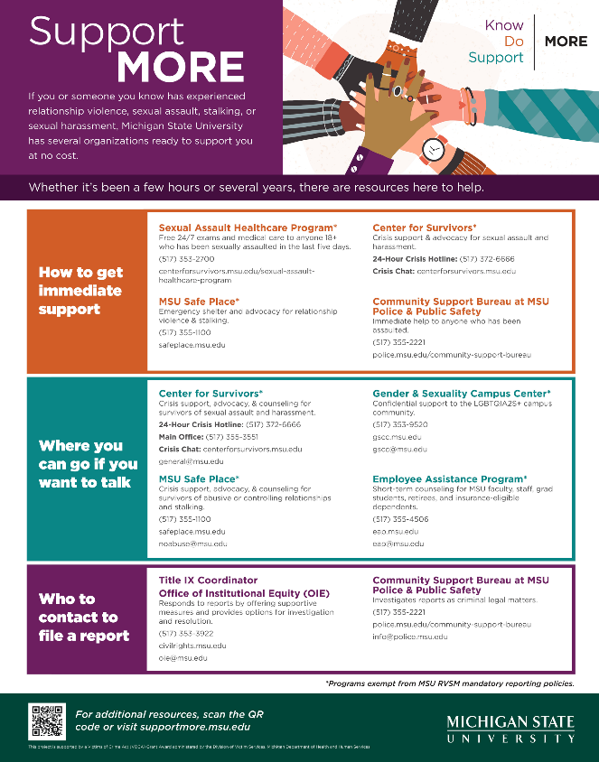
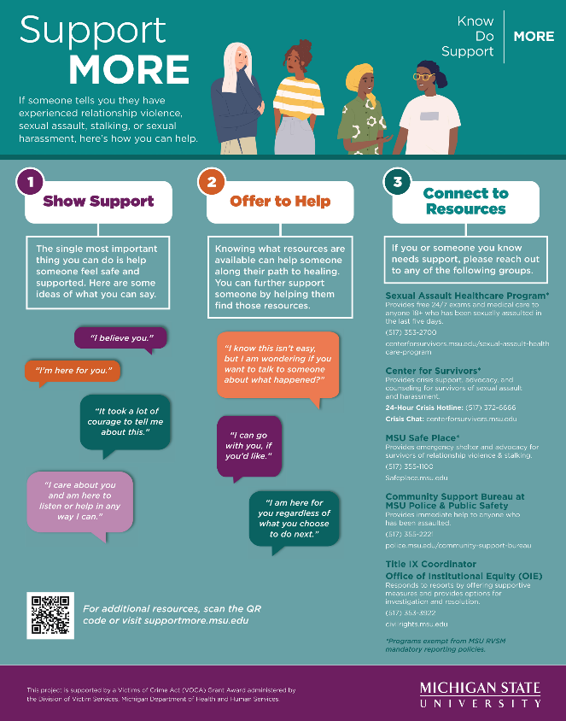

Slide 6
HISTORY
Spring 2019
Know More 2019
Conducted
Questions focused on
AY 2018-2019

Slide 7
HISTORY
Spring 2019
Spring 2021
Know More 2019
Conducted
Questions focused on
AY 2018-2019
RVSM Strategic Plan
Released
Planned another
Know More Survey
Delayed due to COVID

Slide 8
HISTORY
Spring 2019
Spring 2021
Spring 2022
Know More 2019
Conducted
Questions focused on
AY 2018-2019
RVSM Strategic Plan
Released
Planned another
Know More Survey
Delayed due to COVID
Know More 2022 Conducted
March 16 – May 16, 2022
Questions focused on AY 2021-2022
Fall 2021: 81% UG classes had in person component
Spring 2022: 89% UG classes had in person component

Slide 9
CONTEXT
We CAN compare 2019 to 2022 results to measure progress
We CANNOT compare ALL 2019 measures to 2022 measures because there were some changes to the 2022 survey

Slide 10
CONTEXT
We CAN compare 2019 to 2022 results to measure progress
We CANNOT compare ALL 2019 measures to 2022 measures because there were some changes to the 2022 survey
We SHOULD assume COVID mitigation measures in AY 2021-2022 affected the results
We DO NOT know and CANNOT feasibly estimate that impact

Slide 11
OVERVIEW
1
REVIEW SURVEY CONTENT AND CHANGES FROM 2019
2
SUMMARIZE SURVEY METHODS AND RESPONSE RATE
3
HIGHLIGHT KEY FINDINGS FOR STUDENTS, FACULTY, STAFF
4
DISCUSS NEXT STEPS AND ANSWER QUESTIONS

Slide 12
1
2022 SURVEY CONTENT
Incidence & Prevalence of RVSM
RVSM Resources
Campus Climate
(Connectedness, Leadership, RVSM Climate)
Workplace Incivility
Workplace Incivility
Campus Climate
Notes:
LARGELY CONSISTENT WITH 2019 SURVEY SO CAN MAKE COMPARISONS OVER TIME
That said, needed to make some changes to address known problems and omissions (e.g., student workplace incivility)
AND, made purposeful changes to make survey more inclusive

Slide 13
1
2022 SURVEY CONTENT: CHANGES
2019 Know More @MSU Survey
How do you currently describe yourself? You describe yourself as a…
Man
Woman
Transgender man
Transgender woman
Non-binary or genderqueer
You describe yourself some other way (please specify: __________)
You prefer not to answer
2022 Know More @MSU Survey
Do you currently identify as transgender, genderqueer, or nonbinary?
Yes
No
Prefer not to answer
How do you currently describe yourself? Please select all that apply.
Woman
Man
Cisgender
Transgender
Non-binary
Genderqueer
Agender
Genderfluid
Two-spirit
Intersex
You describe yourself some other way (please specify: ______________)
You prefer not to answer

Slide 14
1
2022 SURVEY CONTENT: CHANGES
2019 Know More @MSU Survey
How do you currently describe yourself? You describe yourself as a…
Man
Woman
Transgender man
Transgender woman
Non-binary or genderqueer
You describe yourself some other way (please specify: __________)
You prefer not to answer
2022 Know More @MSU Survey
Do you currently identify as transgender, genderqueer, or nonbinary?
Yes
No
Prefer not to answer
How do you currently describe yourself? Please select all that apply.
Woman
Man
Cisgender
Transgender
Non-binary
Genderqueer
Agender
Genderfluid
Two-spirit
Intersex
You describe yourself some other way (please specify: ______________)
You prefer not to answer

Slide 15
1
2022 SURVEY CONTENT: CHANGES
2019 Know More @MSU Survey
ANALYSIS GROUPS
Women (including trans women)
Men (including trans men)
Nonbinary
2022 Know More @MSU Survey
ANALYSIS GROUPS
Cisgender Women
Cisgender Men
Transgender and/or Nonbinary

Slide 16
2
2022 SURVEY METHODS
Pages 3, 4
IRB review by RTI and MSU (RTI is IRB of record)
Surveys sent to entire population via online platform (anonymous)
Students: 7,298 participated (8 – 24% response rate)
Faculty & Staff: 3,695 participated (5 – 25% response rate)
TOTAL: 10,993 ( 15,073 in 2019)
↓
Notes:
If you exclude “non-pay employees,” the faculty/staff response rate range becomes 19-29%
Random sample UG received $20 incentive to ensure sufficient sample size
Non response bias: student (UG upper class and AA less likely; grad more than prof); faculty/staff (years of service more)

Slide 17
3
FINDINGS
Incidence & Prevalence of RVSM
RVSM Resources
Campus Climate
(Connectedness, Leadership, RVSM Climate)
Workplace Incivility
Workplace Incivility
Campus Climate

Slide 18
3
FINDINGS
Incidence & Prevalence of RVSM

Slide 19
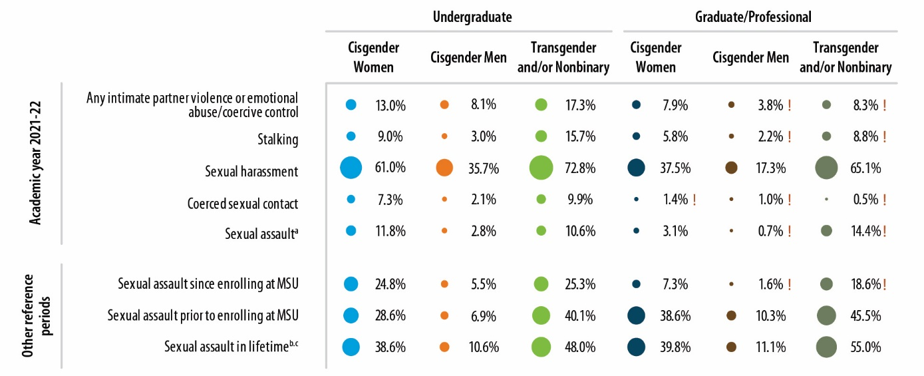
3
FINDINGS
Pages ES-3, 16
Incidence & Prevalence of RVSM
Notes:
Coerced sexual contact: TOUCH and/or PENETRATION by coercion (lies, rumors, end relationship, promise, pressure after initially said no)
Sexual assault: umbrella term that includes sexual battery (unwanted, nonconsensual TOUCH) and rape (unwanted, nonconsensual PENETRATION)

Slide 20
3
FINDINGS
Pages ES-3, 16
Incidence & Prevalence of RVSM
Cannot compare to 2019 data
Notes:
In interest of time, focus on UG only today
IN AY 21-22
NOTE: since coming to MSU, signif decrease in SA

Slide 21
3
FINDINGS
Pages 18-28
Incidence & Prevalence of RVSM
REPORT PROVIDES BREAKDOWNS BY
Year in School Athletics
Race/Ethnicity Greek Life
Sexual Orientation International
Gender Identity Disability
Notes:
HIGHER: LGBTQIA+, disability
NOTE: here, trans and NB are separate
RACE/ETHNICITY: it depends on type (STALKING higher among AA & Latinx students; SA higher among white, Latinx, multiracial)

Slide 22
3
FINDINGS
Pages ES-4, 46
Incidence & Prevalence of RVSM
STUDENT
Any Work-Related
Sexual Assault
(< .5%

Slide 23
3
FINDINGS
Pages ES-4, 46, 75
Incidence & Prevalence of RVSM
STUDENT
Cannot compare to 2019 data

Slide 24
3
FINDINGS
Page 48
Incidence & Prevalence of RVSM
STUDENT
REPORT PROVIDES BREAKDOWNS BY
Years of Service Sexual Orientation
Rank Gender Identity
Race/Ethnicity Disability
Any Work-Related
Sexual Assault
Notes:
HIGHER: LGBTQIA+, disability

Slide 25
3
FINDINGS
RVSM Resources
Notes:
A LOT OF DATA in report—a lot of detail for our service programs and OIE; today, just going to highlight one small slice

Slide 26
3
FINDINGS
Pages ES-2, 17, 39, 59
RVSM Resources
For Faculty and Staff Who Experienced Workplace Sexual Harassment
29.5% to 50.5% told NO ONE
When Faculty and Staff Do Tell Someone, They Are Most Likely to Tell
A work colleague and/or a friend/family member
Faculty and Staff Choose Not To Report/Seek Formal Help Because They
(1) Did not believe the incident was serious enough to report
(2) Did not feel they needed help
(3) Believed they would be treated poorly
(4) Were concerned about the impact (of reporting) on their job/career
(5) Were concerned about possible retaliation

Slide 27
3
FINDINGS
Workplace Incivility

Slide 28
3
FINDINGS
Page 52
Workplace Incivility

Slide 29
3
FINDINGS
Page 52
Workplace Incivility
Cannot compare
to 2019 data
Notes:
HIGHER: LGBTQIA+, disability
FACULTY: cisgender women: White, Latinx, multiracial
FACULTY: cisgender men: Black, Latinx men
STAFF: cisgender women: White, Latinx, multiracial
STAFF: cisgender men: White
RACE/ETHNICITY: white, Latinx, multiracial;

Slide 30
3
FINDINGS
Campus Climate

Slide 31
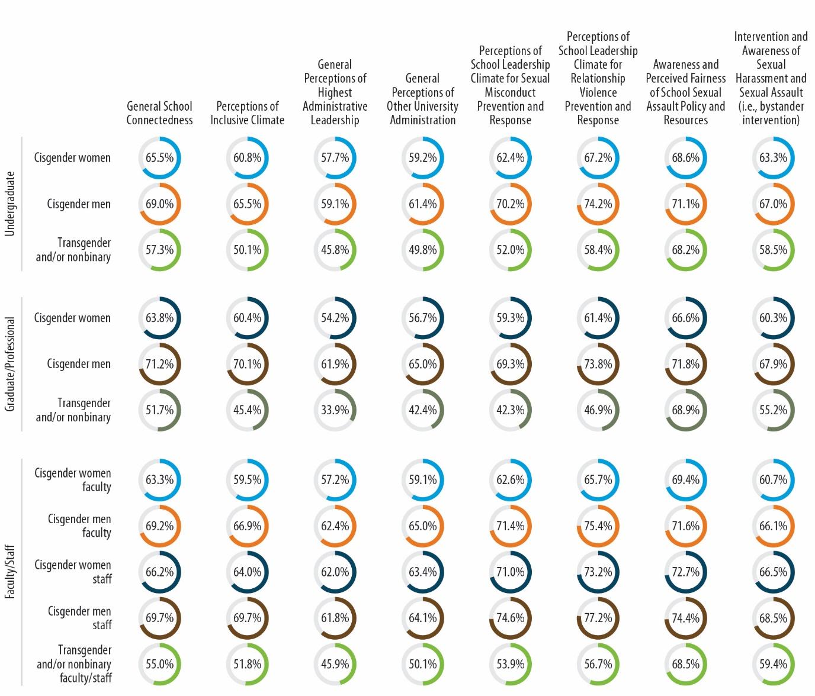
3
FINDINGS
Pages ES-6, 58
Campus Climate
Notes:
So here’s the omnibus graphic (totally un-readable!) Again, for time, focus only on a few

Slide 32
3
FINDINGS
Pages ES-6, 58, 79, 80
Campus Climate
Or No
Change
Or No
Change
Or No
Change
Notes:
Looking at just some of the measures (dropped bystander—new measure)

Slide 33
3
FINDINGS
Pages ES-6, 58, 79, 80
Campus Climate
Across All Measures, Transgender & Nonbinary Respondents Rate Climate Lower

Slide 34
4
NEXT STEPS
Full ADA-Accessible Report Available Online (supportmore.msu.edu)
RVSM Workgroup Campus-Wide Discussion Hours
Scheduling Additional Meetings (Faculty Senate, ASMSU, COGS, more)
RVSM Advisors Available for Campus/Unit Consultation & Presentations

Slide 35
QUESTIONS

