Slide 1
Fixed Term Promotion Project Jamie Alan, Associate Professor, UCFA Chair Jennie Schaeffer, FASA Director

Slide 2
Initial Charge
Faculty request through Academic Governance
FASA -Assuring all colleges have a visible process in place
Collaborative approach with FASA and UCFA
Notes:
Jamie

Slide 3
Understanding the Challenges
Most Colleges had defined processes but both administrators and faculty were often unclear on how to effectively operationalize them.
We collected these questions & ideas from faculty and the Council of Faculty Affairs Deans
Determined that committee work would be necessary.
Notes:
Jamie

Slide 4
Committee Work
Core Work Team:
Jamie Alan, Marilyn Amey, Kate Birdsall, Sonja Fritsche, Jennie Schaeffer
Large Committee:
20+ members representing various colleges and position types and UNTF.
Subcommittees were formed to address key points of confusion
Notes:
Jamie

Slide 5
What’s New
Timeline: parallel to the Academic Specialist timeline, with packets submitted to HR in May.
1
Form on Progress & Excellence for Fixed Term Faculty
2
Guidelines
3
Notes:
Jennie

Slide 6
Considerations
Increased Clarity for Faculty & Unit/College
Underlying principles
Maintain flexibility within colleges
"The fixed term promotion process offers a structured pathway for career advancement, allowing all faculty to develop and receive recognition for their contributions while ensuring that MSU remains responsive to changing needs of individual colleges."
Fixed Term Promotion Guidelines
Notes:
Jennie

Slide 7
Highlights of the Guidelines
University Level Standards for Promotion
Instructor to Sr. Instructor
Assistant to Associate Professor
Associate to Full Professor
Tips for Dossier Preparation
Considerations for External Letters
Notes:
Jennie

Slide 8
Highlights of the Guidelines
Committee Formation
Key points to guide units in being thoughtful and purposeful about who makes up the review committee to ensuring a fair and equitable process
Mentoring
Mentoring has not been robust for most fixed-term faculty. Suggestions & considerations are noted for strengthening this area.
Notes:
Jamie

Slide 9
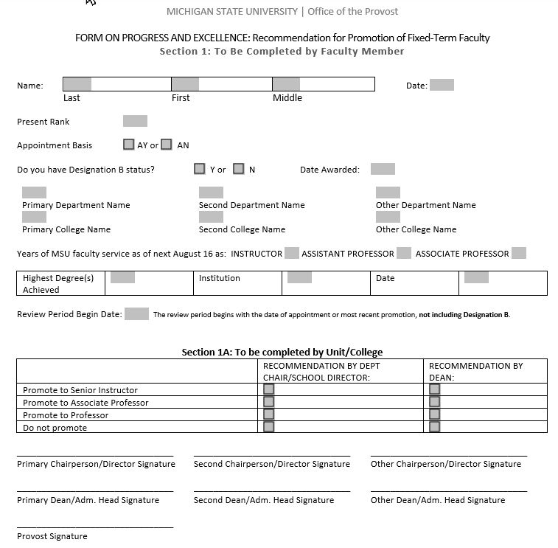
The New Form
Notes:
Jennie

Slide 10
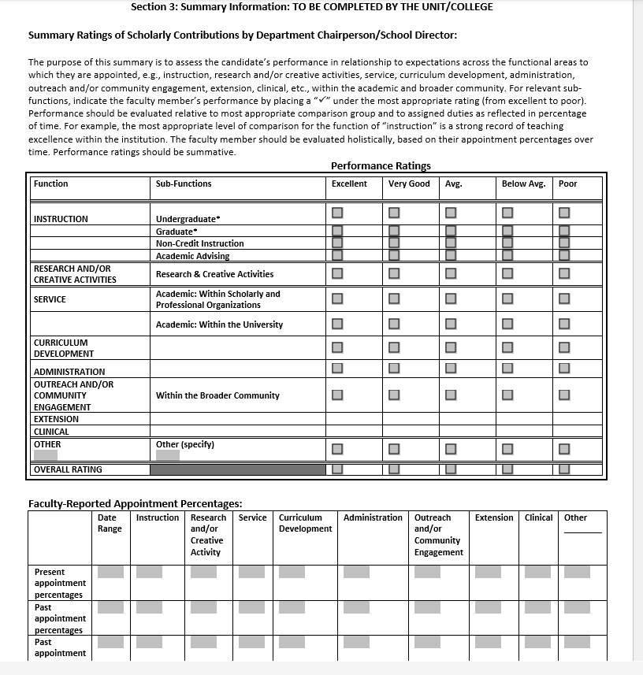
The New Form
Notes:
Jamie
Note that they will now be able to document their percentages over time to help assure a more accurate evaluation of actual work done

Slide 11
Questions?

