Slide 1
VIPP Mission and Activities
Xinyu Wu, October 11, 2022

Slide 2
Mission
Provide transformative learning experience to international professionals & organizations by connecting people, knowledge, cultures and ideas

Slide 3



Actionable Priorities
Offer diverse high quality professional training
program
Provide 360-degree Support and services
Stakeholders
Engage with stakeholders through effective communication
Build high performing team

Slide 4
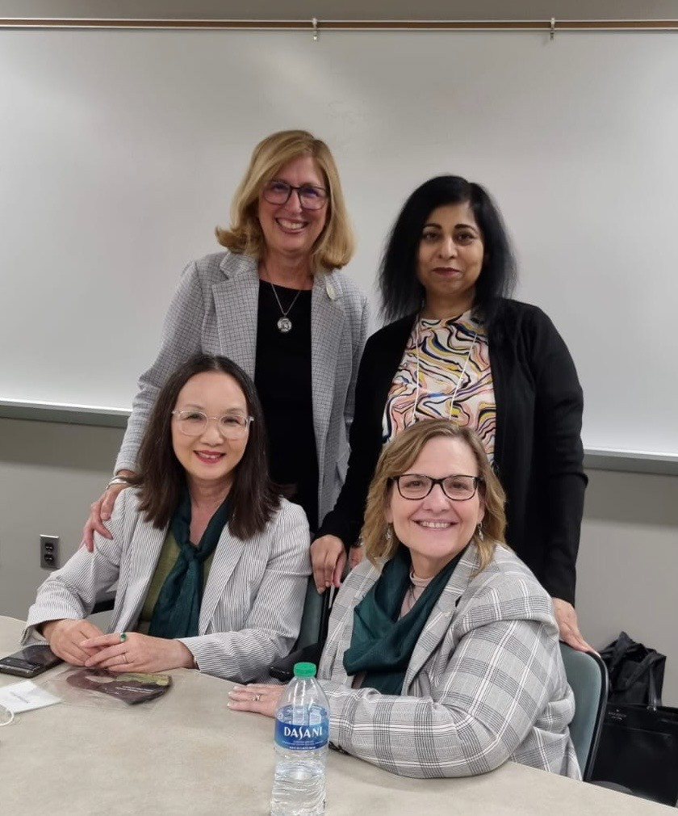
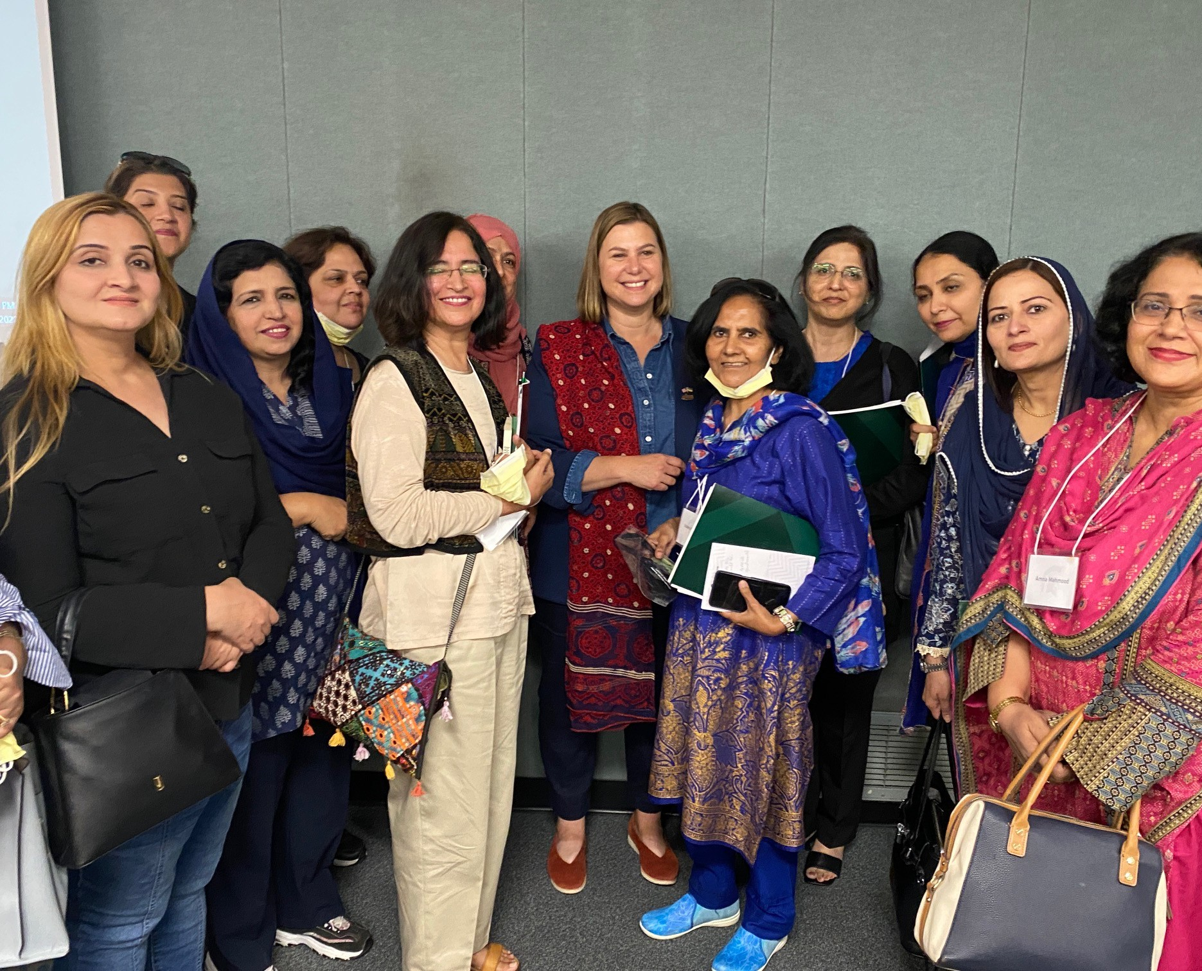
Diverse Program
USG program – DoS & USDA
AAP, Asia Hub, CERES, GenCen & Muslin Studies, BROAD, CAL, CANR, CEDU, CSS, AAN, VPRI …..
Virtual summer/winter school for university students
BROAD and ComArts
Pakistan HE Senior Women Leadership Program
- September 2022

Slide 5
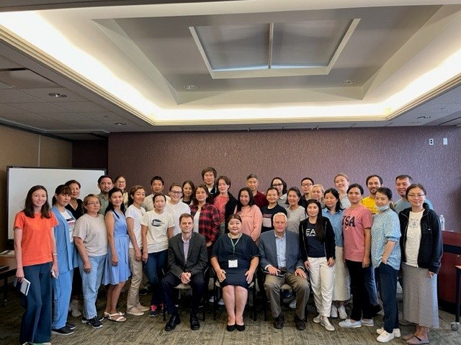
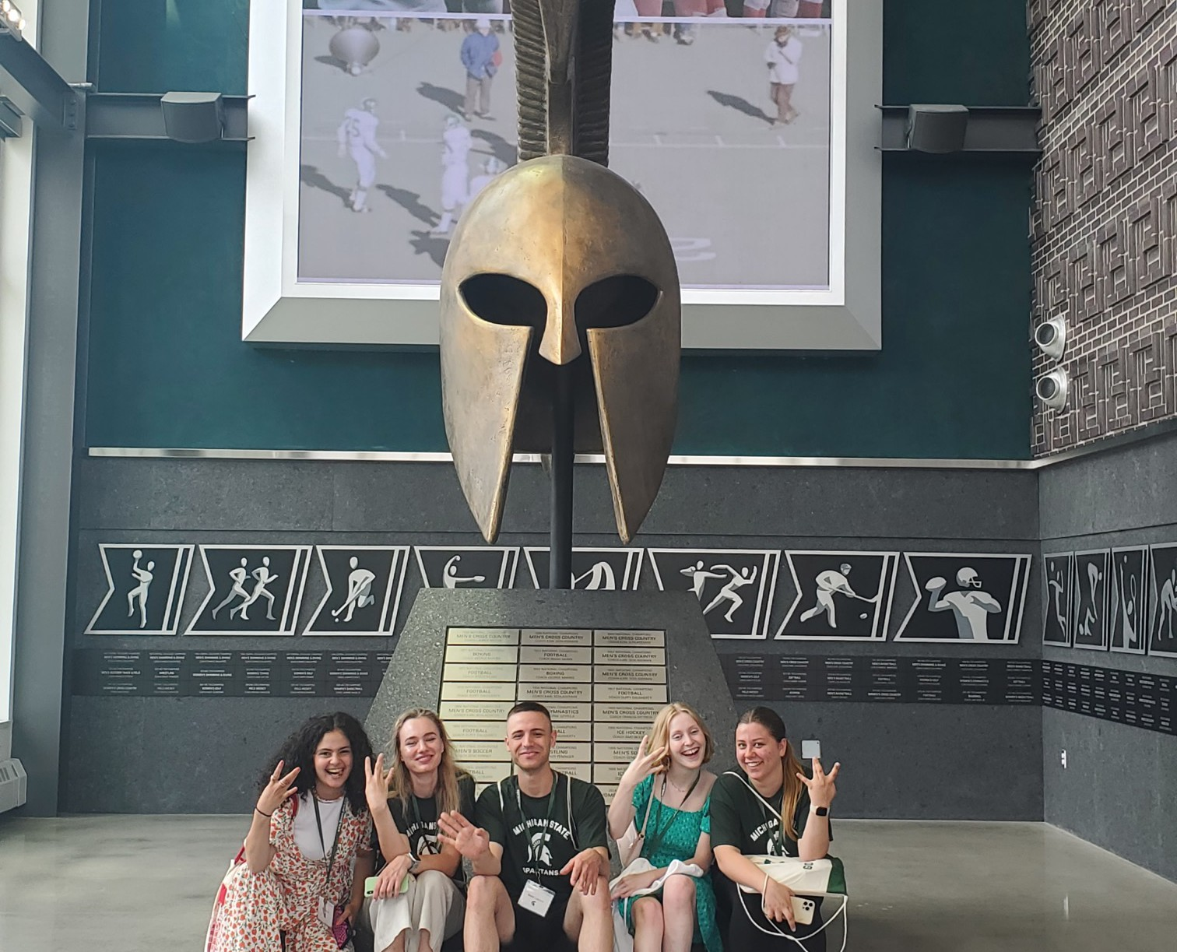
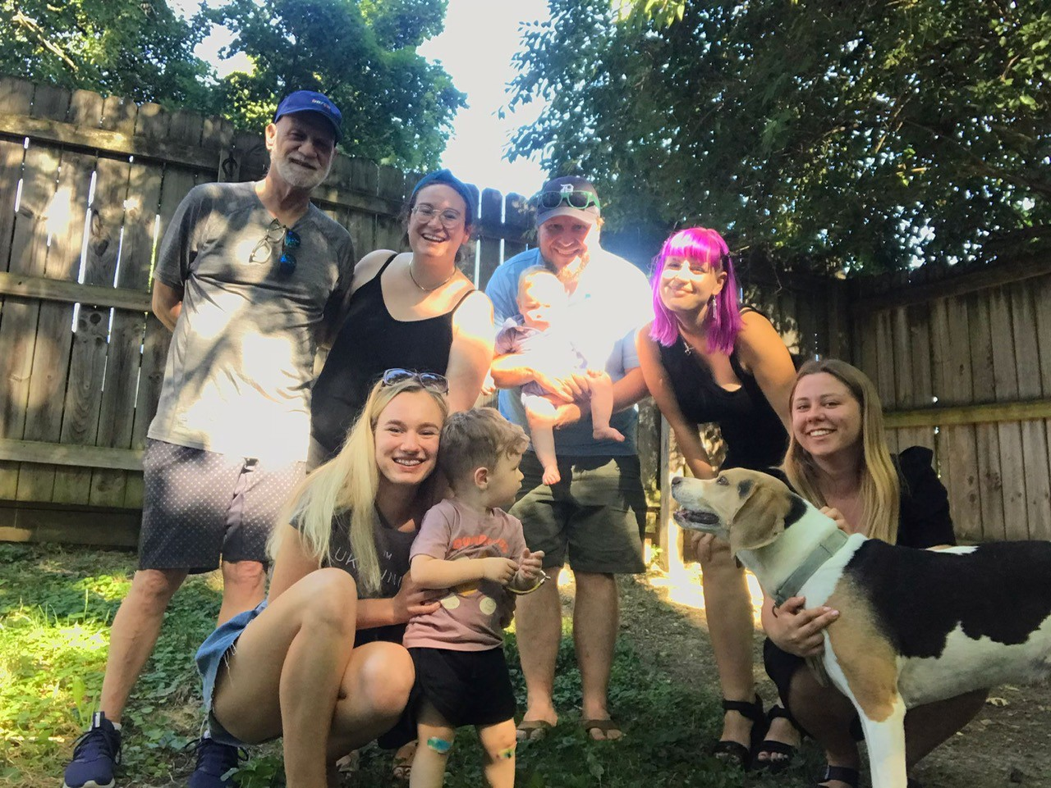

360-Degree Support & Services
Bolashak Presidential Scholarship program
CERES, CEDU & LAW
SUSI Civic Engagement CAL & CSS
5

Slide 6
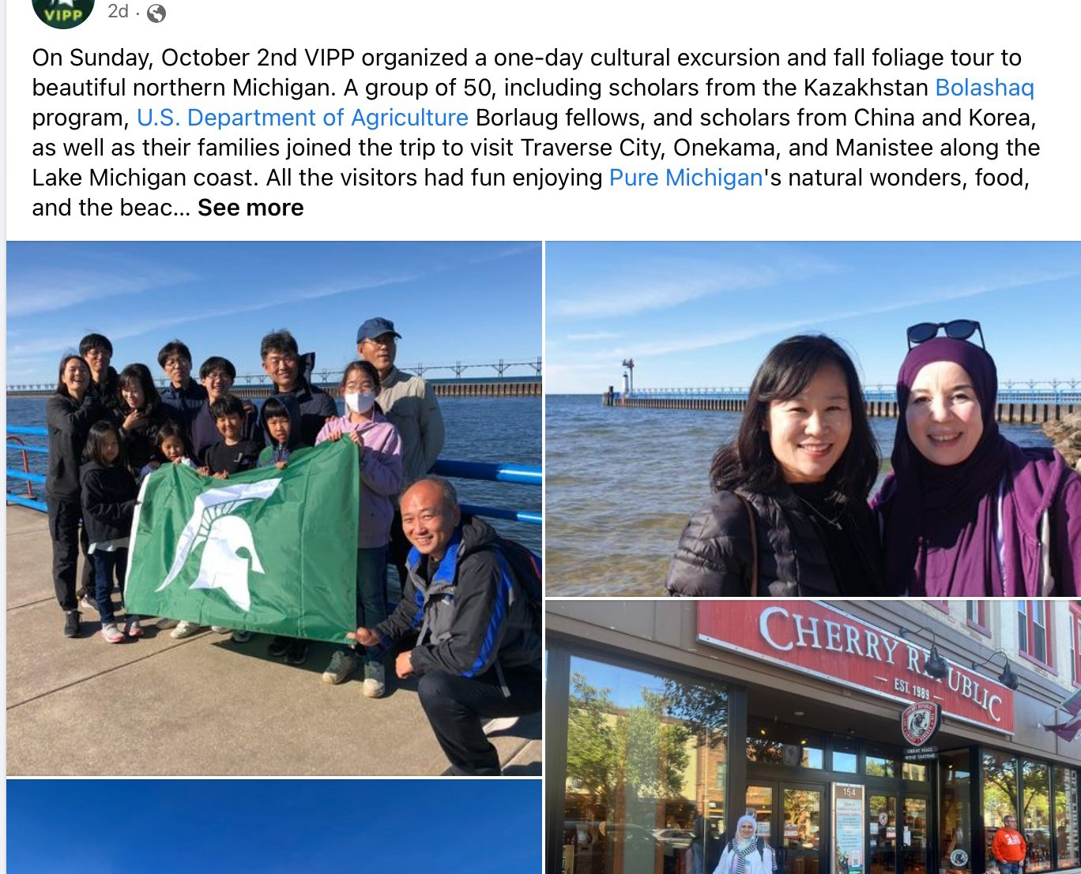
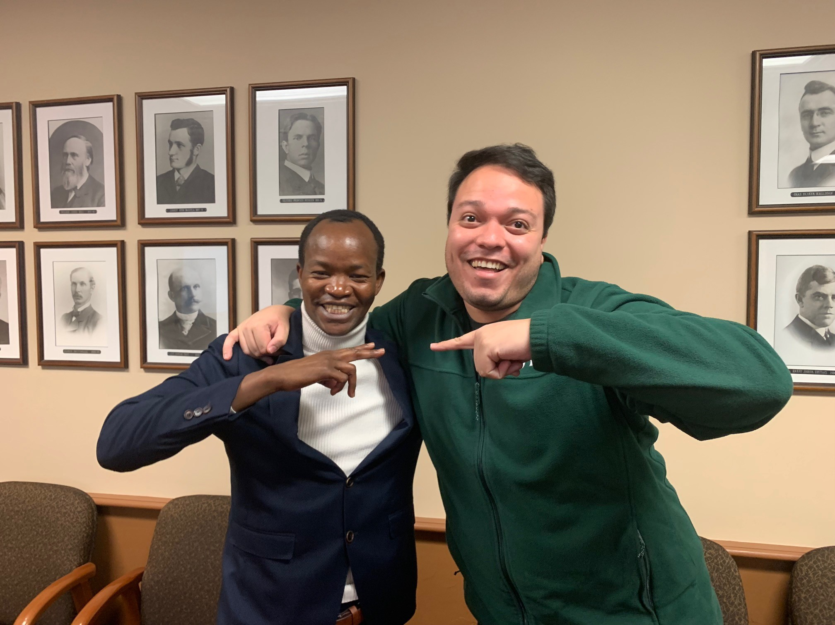
Engagement
30th Anniversary
Branding
Website
Social media
VIPP Endowments
  Afghanistan women development lecture
– CSS, Guo Chen
  Cambodia visiting scholar – CSS, Amanda Flaim
  Palestinian history lecture – ISP, Mohammad Khalil
  Global Korean Award – ISP, Siddharth Chandra
6

Slide 7

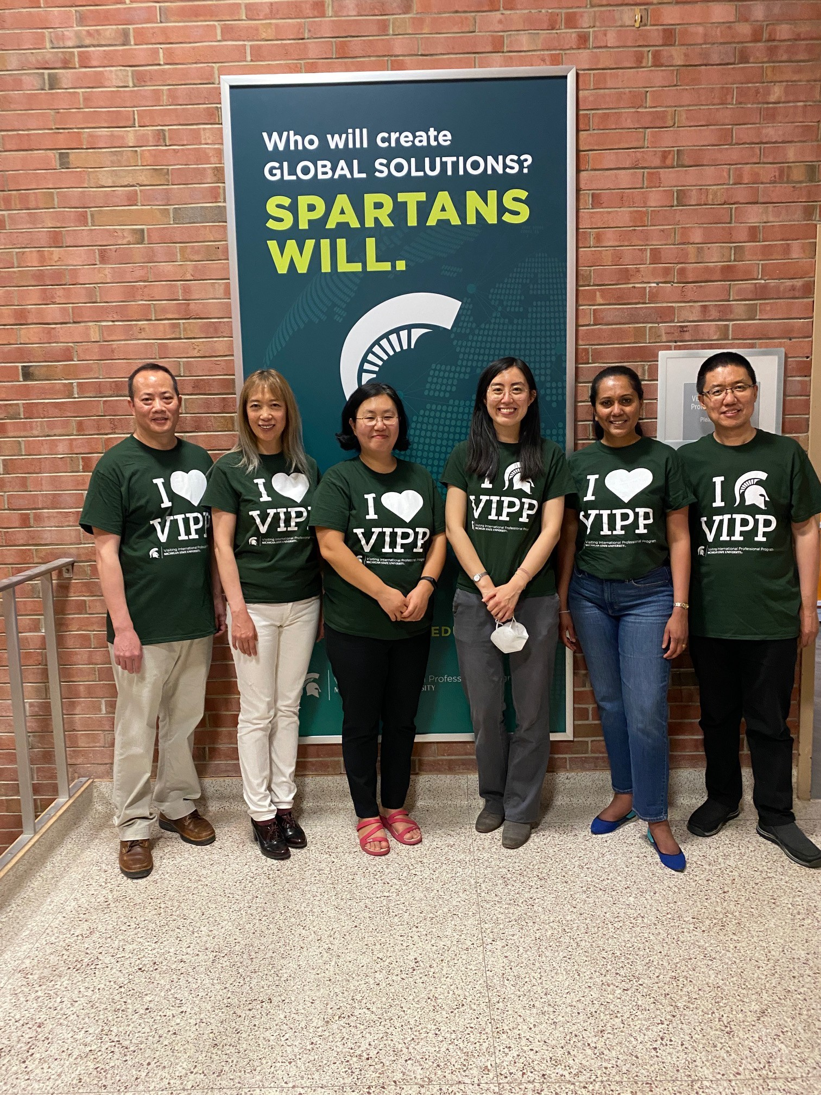
VIPP Strategic Planning
Fall retreats
Facilitated team building SWOT review
Strategic alignment
Conversations with stakeholders
Financial model review
Spring 2023 - Five-year Plan

Slide 8
Thank you!

