Slide 1
GYAN Updates and Reimagining the Office for Education Abroad
ISP Directors Meeting
October 25, 2022

Slide 2
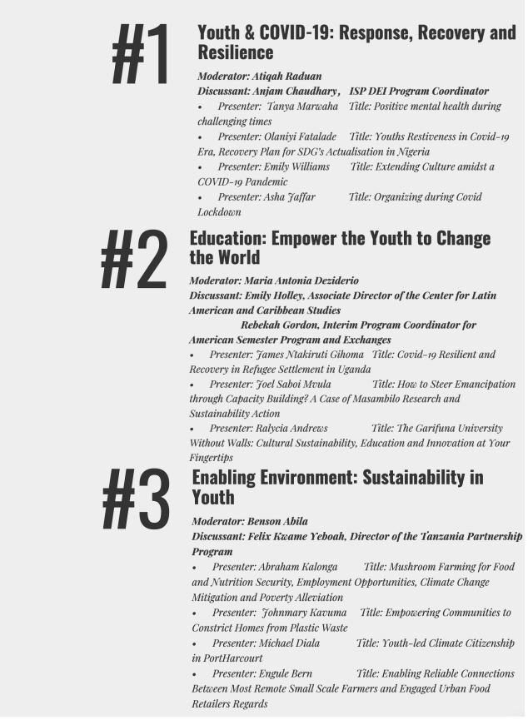
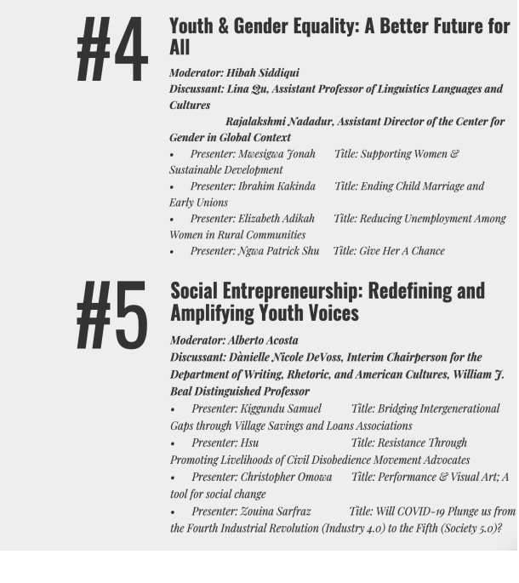
International Youth Day Innovation Collaboratory

Slide 3
Panel 1 Youth & COVID-19: Response, Recovery and Resilience

Slide 4
Panel 2 Education: Empower the Youth to Change the World

Slide 5
Panel 3 Enabling Environment: Sustainability in Youth

Slide 6
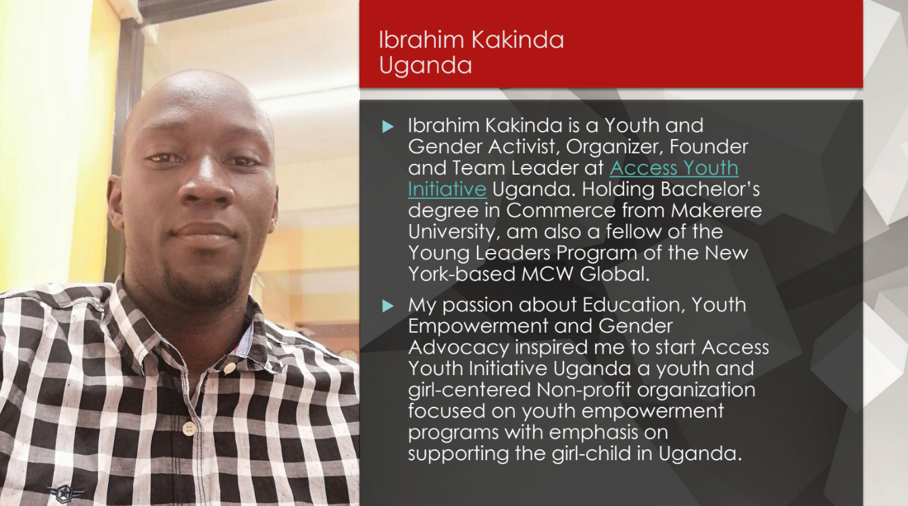
Panel 4 Youth & Gender Equality: A Better Future for All

Slide 7
Panel 5 Social Entrepreneurship: Redefining and Amplifying Youth Voices

Slide 8
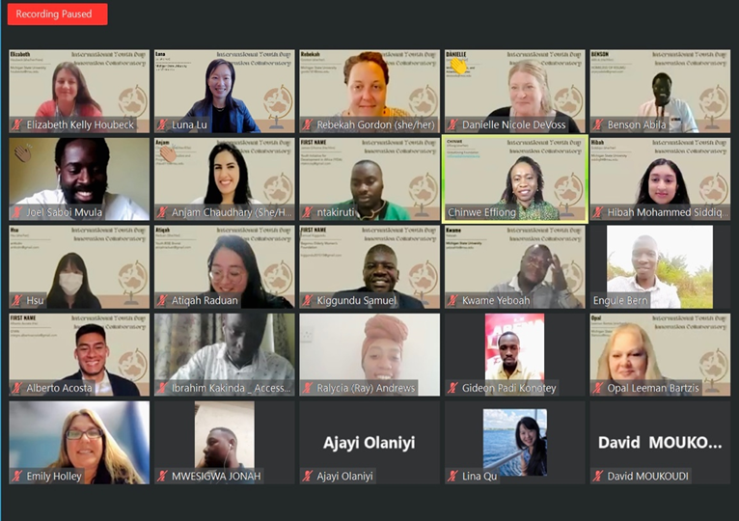
Creating a World for All Ages
Youth Mentoring Program
Facilitating connections
Coaching on presentations
Supporting personal and professional development
Youth Word Collage

Slide 9
GLOBAL VOICES Webinar Series
GYAN launched the Global Voices webinar series to showcase the work that global innovators at MSU and around the globe are doing in relation to the United Nations Sustainable Development Goals. The series serves as a coordinating platform for research and outreach activities, and it connects young innovators with faculty and industry mentors who can help scale their work.
View the Global Voices Webinar episodes on our YouTube channel!
Episode #1 Food Security
Episode #2 Jobs for Youth
Episode #3 Quality Education
Episode #4 Peace and Justice

Slide 10
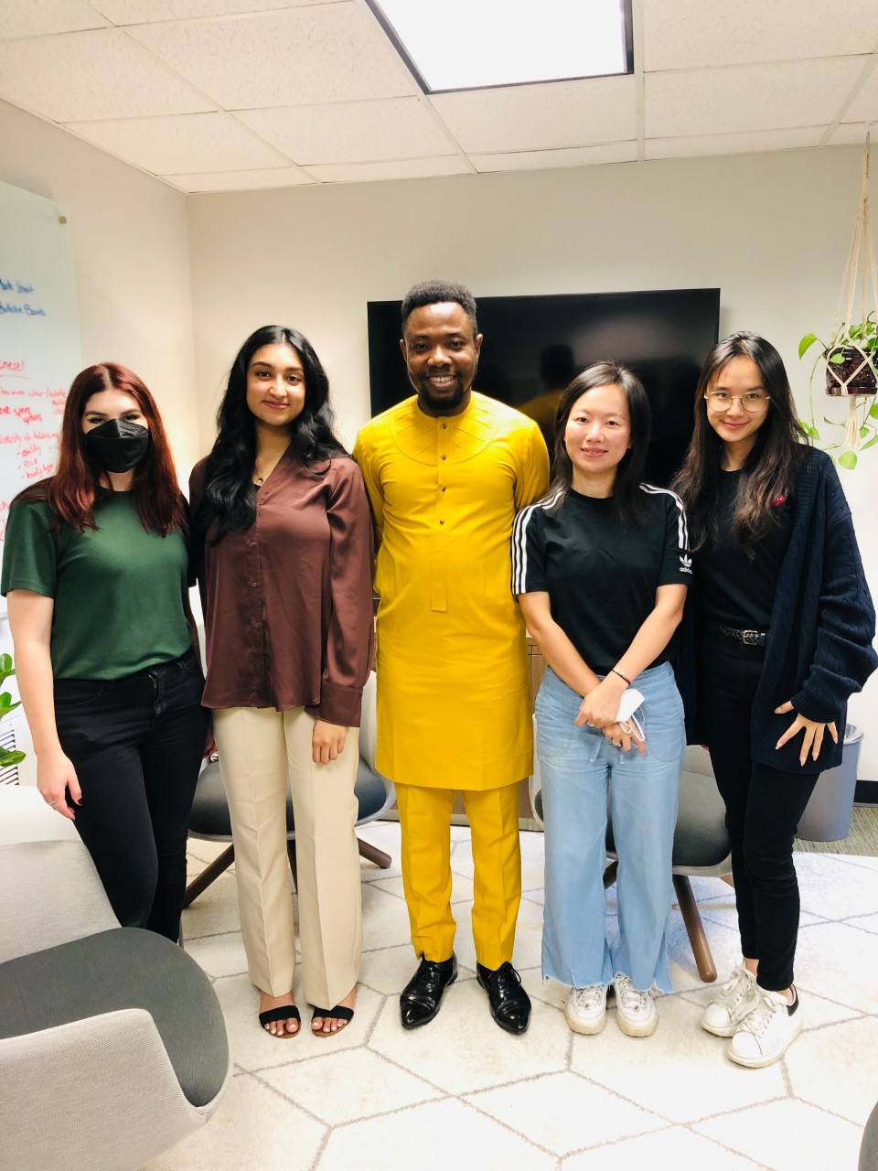
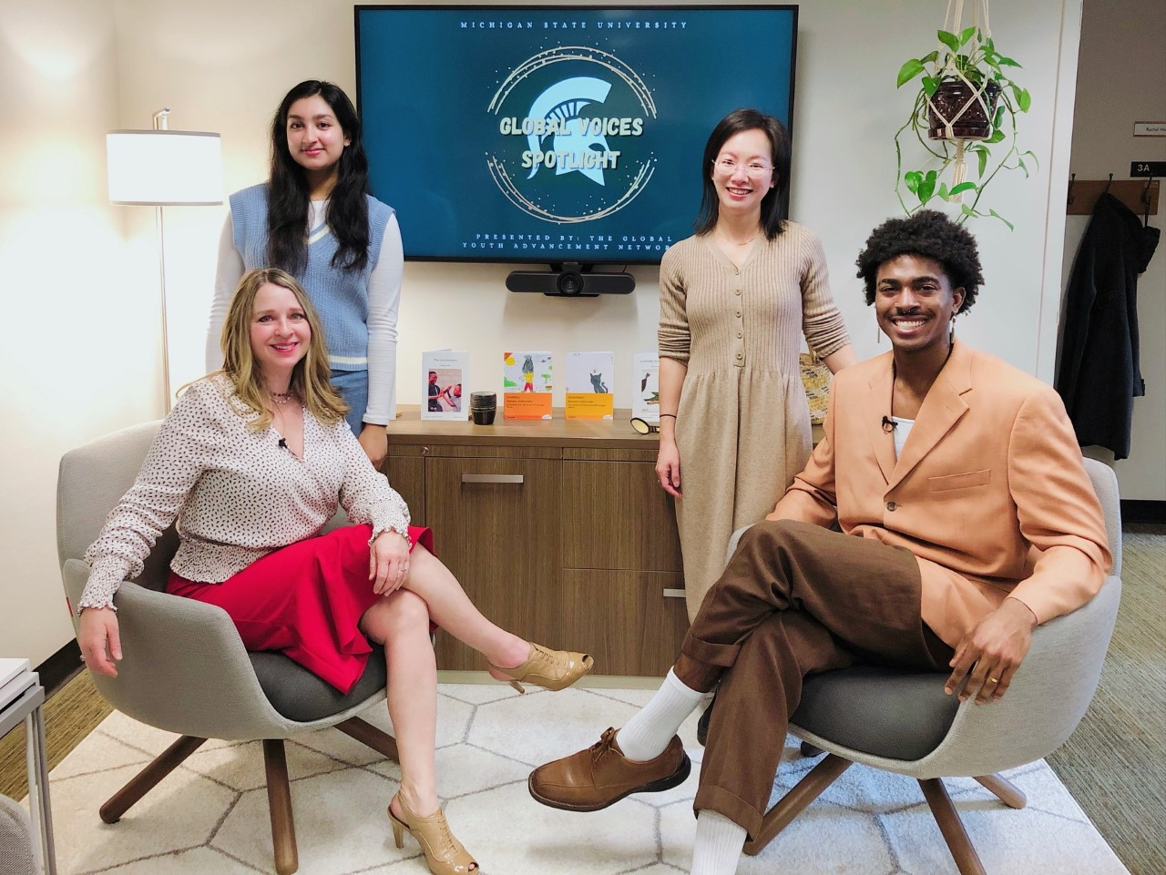
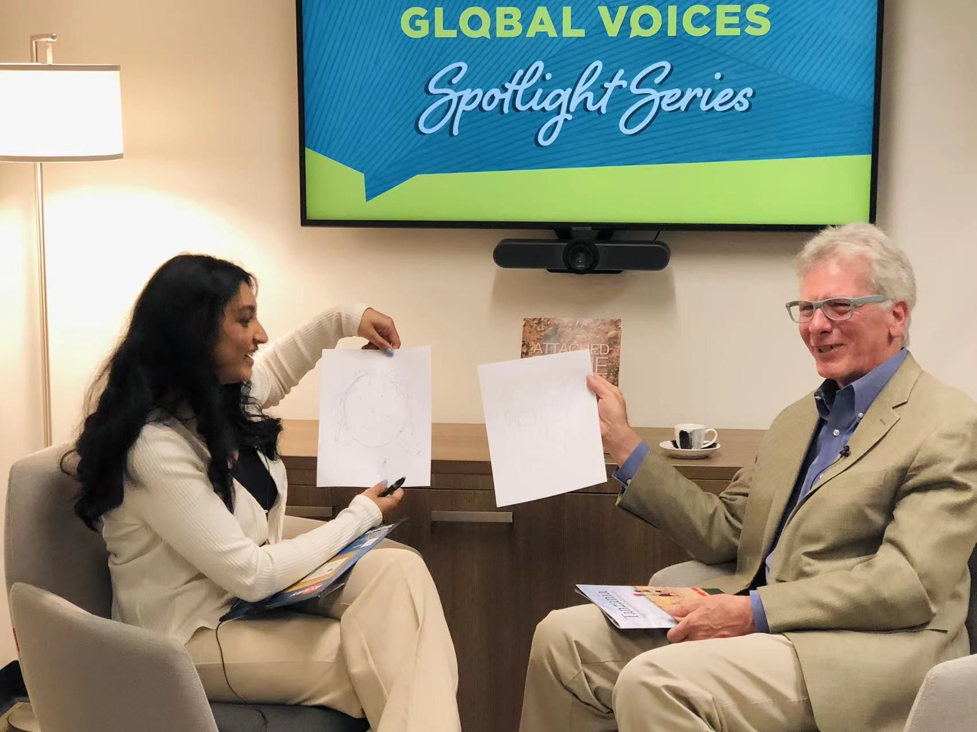
GLOBAL VOICES Spotlight Series
With Dr. Marcy Hessling O'Neil
With Dr. Peter Glendinning
With Chibuzor Agomuoh
This series provides a space for intergenerational conversation between young people and professionals devoted to meaningful global engagement and problem-solving via research and outreach activities related to youth.

Slide 11
Celebrate the benefits of international education and exchange worldwide. November 14 – 18, 2022

Slide 12
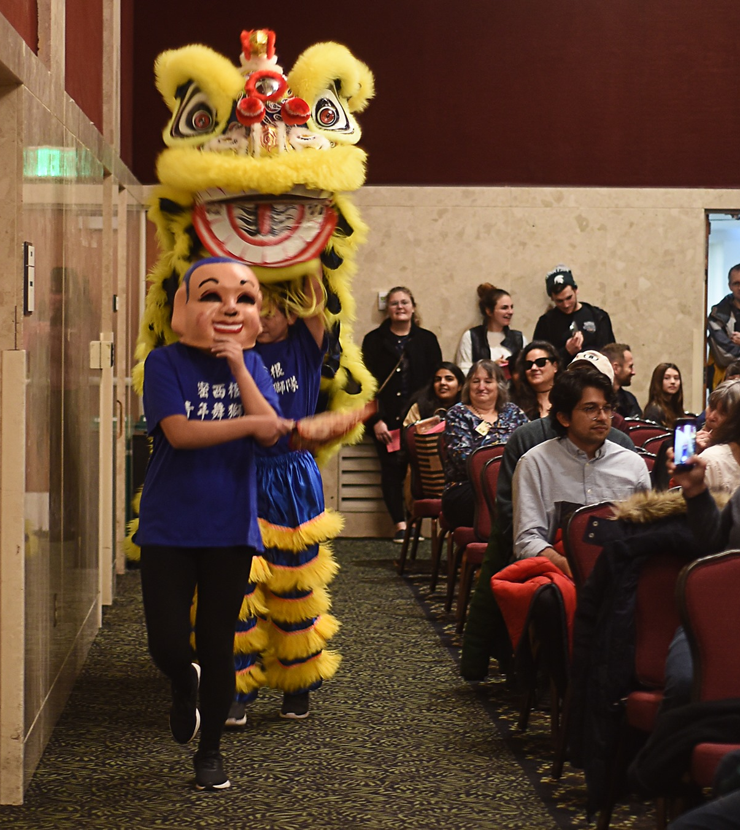
IEW Activities and Goals
2022
Raise awareness about IEW
Promote existing activities
Committee building
2023
Increase engagement outside of ISP
Move some events to IEW week
Pilot programming
2024+
New IEW programming
Robust slate of campus-wide events

Slide 13
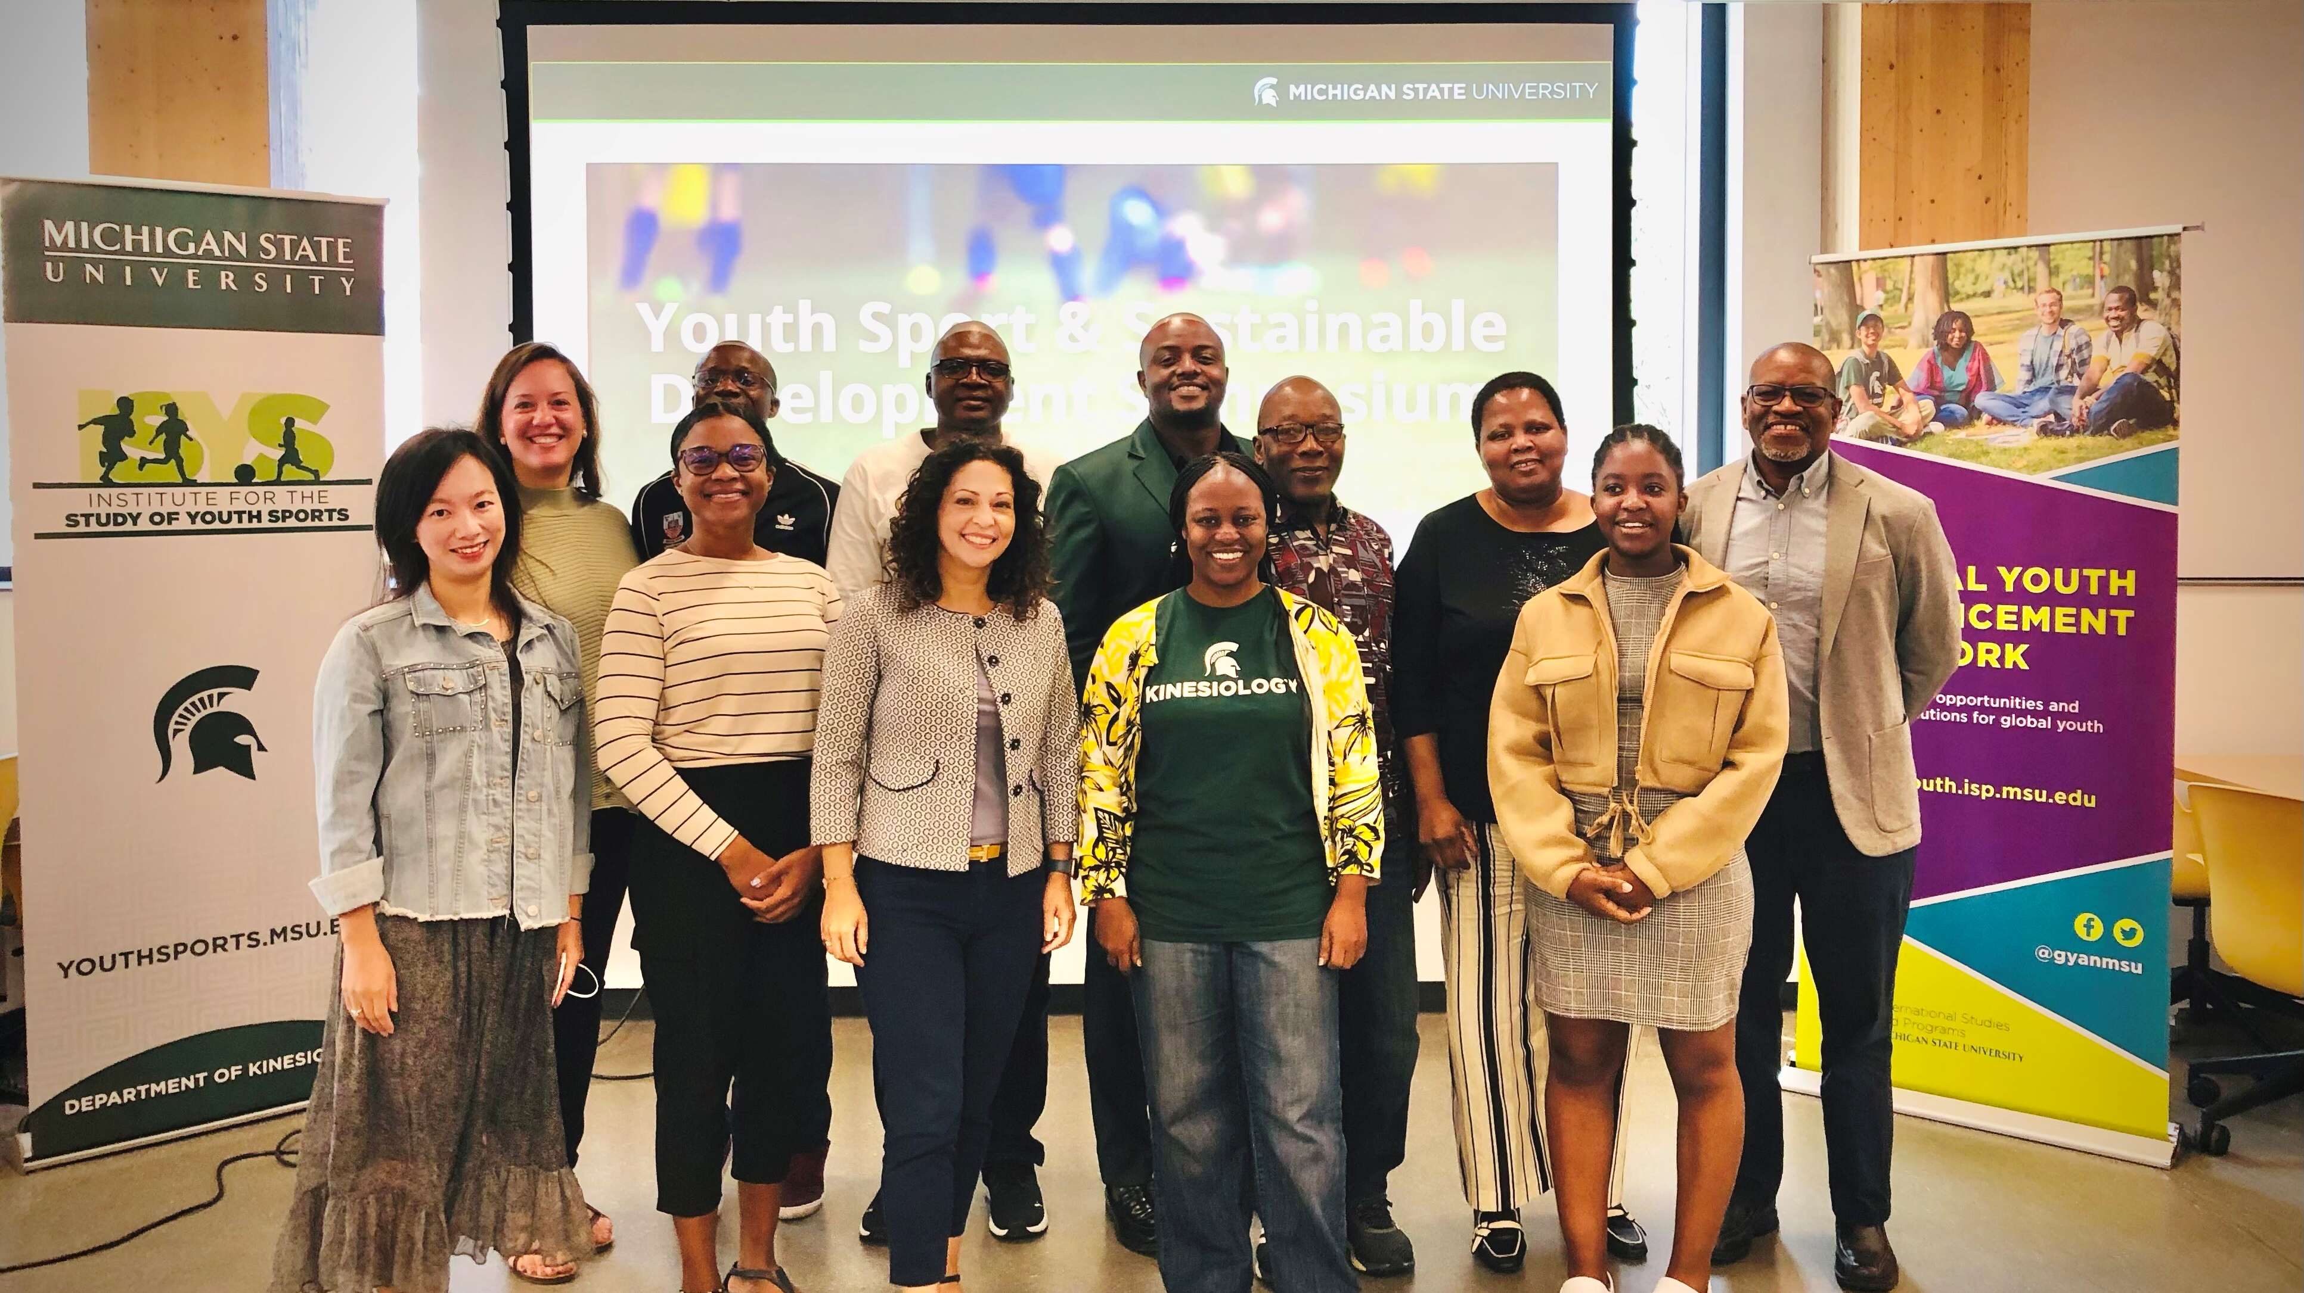
Youth Sport Symposium

Slide 14
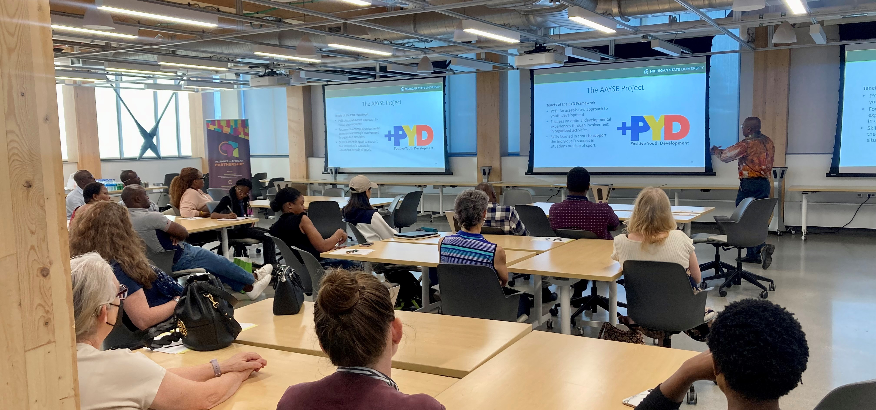
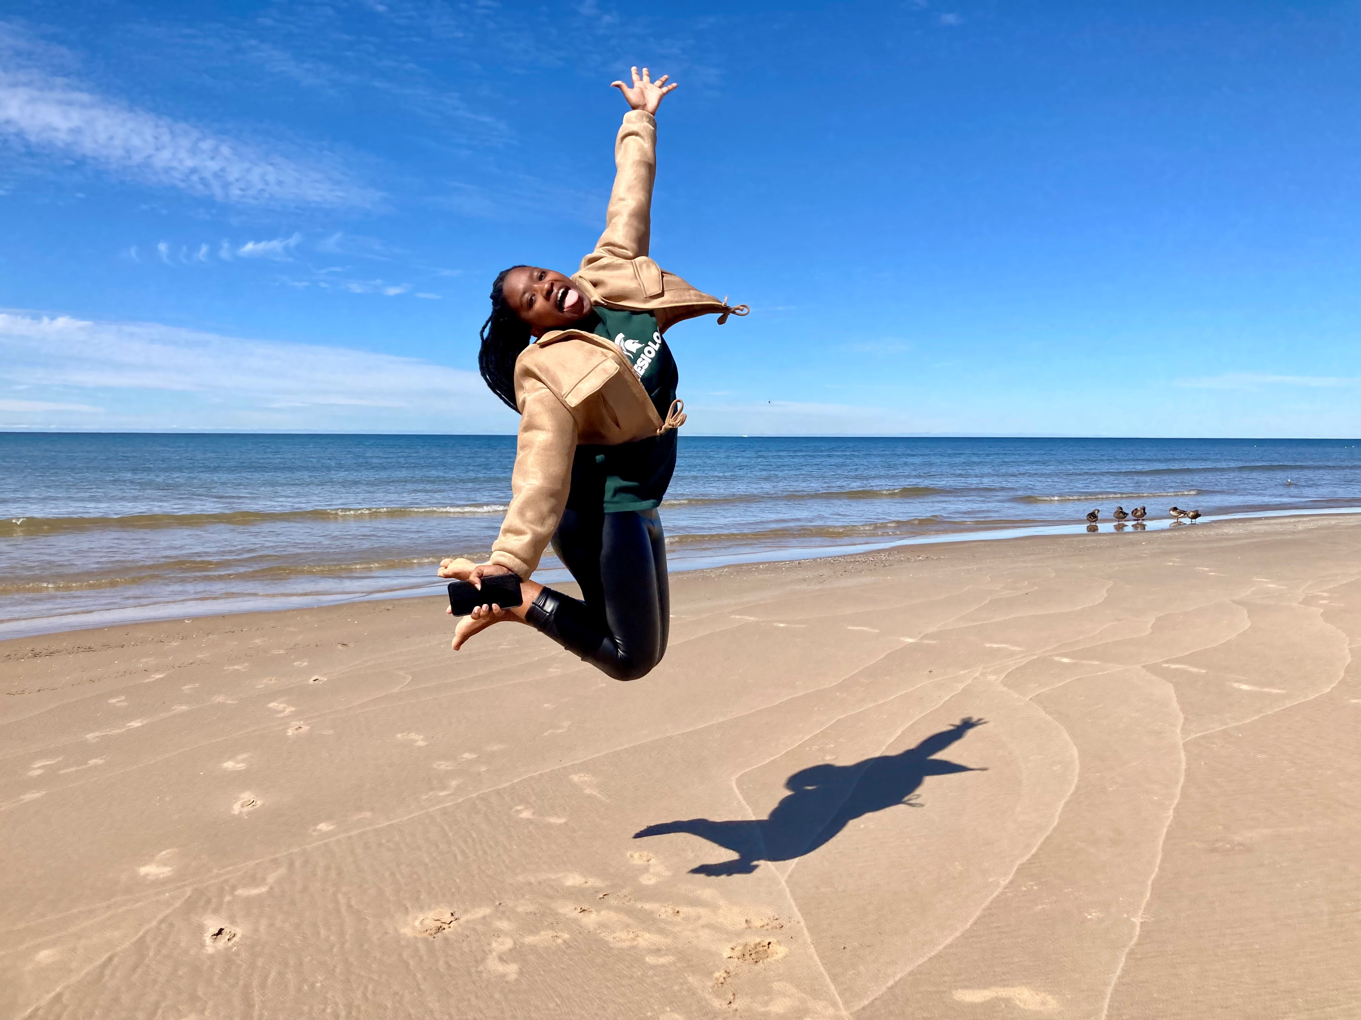
Platform for MSU Faculty-led research​ ​
Program and Admin Support​ ​
Youth Engagement​
​

