Slide 1

Global Safety at MSU
THE OFFICE FOR GLOBAL HEALTH, SAFETY, AND SECURITY
ISP Advisory Consultative Committee (ACC)
February 23,2023
globalsafety.isp.msu.edu
517-884-2174
globalsafety@msu.edu

Slide 2
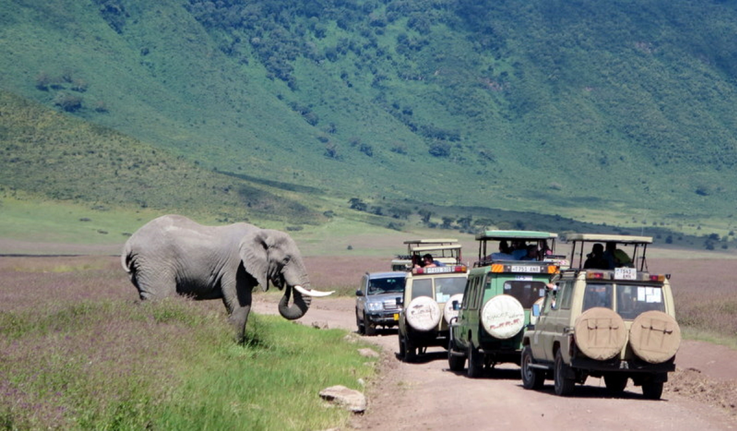
Topic Overview
About Global Safety (Concepts & Office)
Update on International Travel at MSU
International Travel Registration & Waiver Processes
High Risk Destinations
Incident Reporting
Security Strategies
Travel Resources
Questions & Discussion

Slide 3
About Global Safety

Slide 4
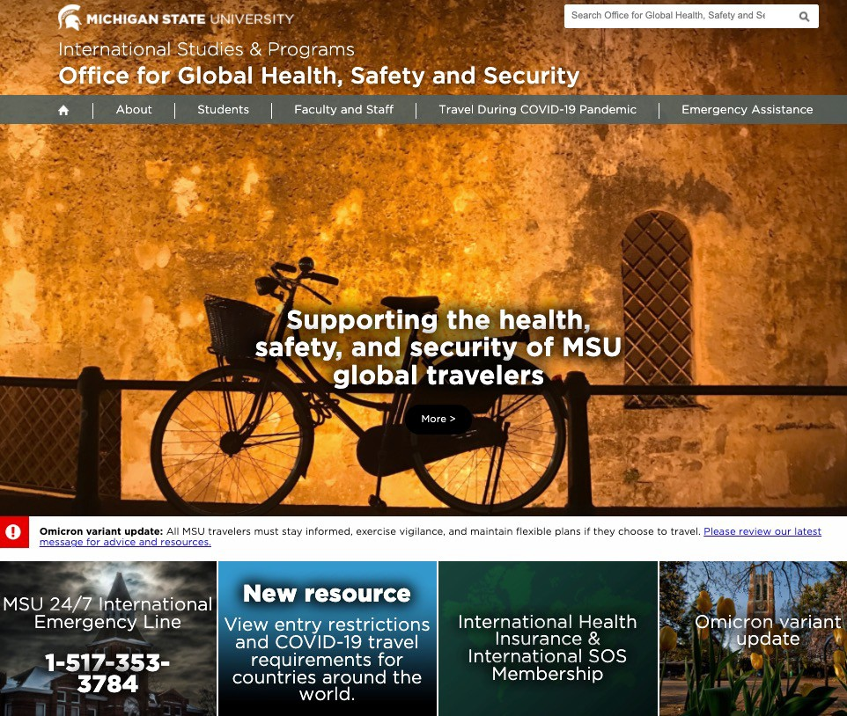
MSU Global Safety
24/7 emergency assistance
Monitor international events and global public health concerns
Develop emergency and crisis management protocols, travel guidelines, and health, safety, and security practices
Assessing risk for MSU international travel and projects
Coordinating international health and evacuation insurance

Slide 5



Global Health, Safety and Security Team
Chris Daniel Director danielc7@msu.edu
Elke Schmidt Senior Coordinator
schmi822@msu.edu
Megan Hauser Tran Coordinator hausertr@msu.edu

Slide 6
Update on International Travel at MSU

Slide 7

Fall 22 and Spring 23 Travel Data
Data pulled from MSU Global Travel Registry (Education Abroad is rolled up separately and not in GTR)
Currently working with IT to ensure accurate data is being pulled from EDW
Comprehensive reporting through EDW would require IT project
ISOS also allows for reporting but there are some duplicates (travel arrangers / personal from Triplink)

Slide 8
Fall 22 and Spring 23 Travel Data: At a Glance
Fall 22
Number of Trips: 626
Number of Travelers: 748
Waivers granted: 20
  FASTR Reviewed Waivers: 0
  RSAC reviewed Waivers: 1
Top 5 Travel Reasons (trips):
  Conference or Meeting Attendance: 413
  Research and Creative Endeavors: 209
  International Capacity Building: 54
  Site Visit: 38
  Recruitment: 31
Spring 23
Number of Trips: 230
Number of Travelers: 325
Waivers granted: 19
  FASTR Reviewed Waivers: 5
  RSAC reviewed Waivers: 2
Top 5 Travel Reasons (trips):
  Conference or Meeting Attendance: 100
  Research and Creative Endeavors: 104
  Site Visit: 27
  International Capacity Building: 25
  Teaching 16

Slide 9
Fall 22 Travel by Location
Top 5 Destinations
Fall 22 Top 5 Destinations
Countries | # of Travelers | # of Trips
Canada | 159 | 36
Germany | 55 | 55
South Africa | 53 | 25
UK | 42 | 32
France | 37 | 32
UK
Germany South Africa
France Canada
0
20 40 60 80 100 120 140 160 180
Trips Travelers
Top 5 Elevated-Risk Destinations
Fall 22 Top 5 Elevated Risk Destinations
Countries | # of Travelers | # of Trips
South Africa | 53 | 25
India | 18 | 17
Nigeria | 17 | 17
Mexico | 17 | 14
Thailand | 12 | 12
Thailand
Mexico Nigeria
India South Africa
0
10
20 30
Trips Travelers
40
50
60

Slide 10
Spring 23 Travel by Location
Top 5 Destinations
Spring 23 Top 5 Destinations
Countries | # of Travelers | # of Trips
South Africa | 22 | 16
India | 15 | 14
Bangladesh | 10 | 4
Tanzania | 9 | 6
Egypt | 7 | 5
India Germany Malawi Canada
South…
0
5
10 15
Trips Travelers
20
25
Top 5 Elevated-Risk Destinations
Countries | # of Travelers | # of Trips
South Africa | 53 | 25
India | 18 | 17
Nigeria | 17 | 17
Mexico | 17 | 14
Thailand | 12 | 12
Spring 23 Top 5 Elevated-Risk Destinations
Egypt Tanzania Bangladesh
India South Africa
0
5
10
Travelers
15
20
25
Trips

Slide 11
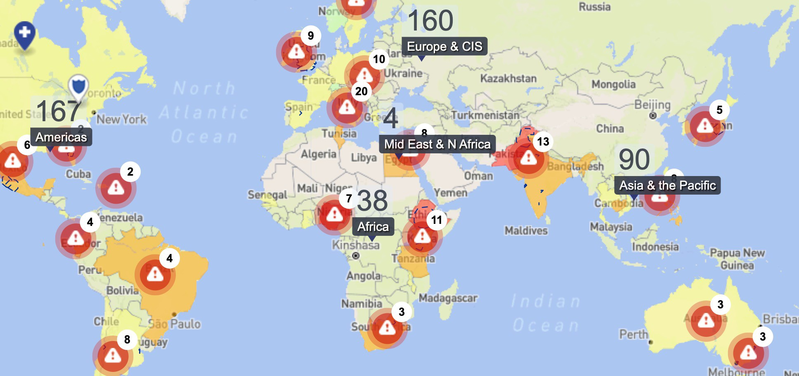
High-Risk Travel Update
Fall 22 Extreme-Risk Travel Waiver:
  Burkina Faso: Student, RSAC reviewed
Spring 23 Extreme-Risk Travel Waivers:
  Garissa, Kenya: Faculty, FASTR reviewed
  Michoacan state, Mexico: Faculty, FASTR reviewed
  Afar region, Ethiopia: Faculty, FASTR reviewed
  Aregquipa, Peru, Faculty, FASTR reviewed
Recent Travel concerns:
  Peru: Civil unrest
  China: COVID-19 resurgence
  Kenya, Nigeria and Tanzania: Possible terrorist attacks – USG alerts
  Turkey: Earthquake and security

Slide 12

Fall 22 and Spring 23 EA Travel Data
Fall 22: 8/31/22-12/17/22
121 students
Spring 23: 1/9/23-3/10/23
649 students
Includes Spring Break (448 students)
Spring has historically higher numbers than Fall; Spring Break significantly shifts the numbers

Slide 13
5-Year Data Analysis and Incident Reporting

Slide 14

























AY 17-18
AY 20-21
Total Percentage of Incidents
by Type
Security 11%
Conduct 9%
Health 35%
Safety 8%
PCeornsdouncatl 0%
Person•al Presentation for FASTR Oct me
8%
Logistical
eting
Legal 0%
Logistics 12%
5%
Legal
Security 29%
Health 46%
Mental Health
5%
Mental Health 8%
AY 17/18 Through AY 21/22
6%
Behavior
Safety 18%
0%
Conduct 7%
Security 16%
Health | 363
Security | 106
Logistics | 51
Conduct | 45
Mental Health | 37
Safety
27
Safety 4%
Mental Health 5%
Logistics 8%
Legal
2%
Personal 3%
Personal
19
Legal
12
Behavior
4
Health 55%
Total
664

Slide 15





AY17/18-AY21/22 by Severity
I-Potential 259 incidents |  | II-Isolated 371 incidents
 | III-Critical 29 incidents
IV-Major 5 incidents |  | Unknown 3 incidents
Unknown 0%
III - Critical 4%
IV - Major 1%
I - Potential 39%
II - Isolated 56%
Total Reported Incidents: 664

Slide 16
AY17/18 - AY21/22 Incident Type by Program
AY17/18 - AY21/22 Incident Severity by Program
Unknown
Unknown
Non-EA
Behavior Conduct Health Legal Logistics
Mental Health Personal
Safety Security
Non-EA
Non-credit
Non-credit
I - Potential II - Isolated III - Critical Unknown IV - Major
JCMU
JCMU
EA
EA
Credit
Credit
Both
Both
All travelers
All travelers
0
100
200
300
400
500
600
0
100
200
300
400
500
600
Grand Total | All Travelers | Both | Credit | EA | JCMU | Non- credit | Non-EA | Unknown | Grand Total
#Incidents | 2 | 4 | 19 | 482 | 25 | 6 | 120 | 6 | 664
% | .3% | .6% | 2.9% | 72.5% | 3.8% | 9% | 18.1% | .9% | 100%

Slide 17
Critical Incidents
Critical Incidents as Proportion of Total AY17/18 through AY21/22
16%
14%
12%
10%
8%
6%
4%
2%
0%
Year | % of incidents | Total Incidents | Critical Incidents
AY17/18 | 7% | 136 | 9
AY18/19 | 3% | 258 | 7
AY19/20 | 14% | 77 | 11
AY20/21 | 6% | 17 | 1
AY21/22 | 3% | 175 | 5
Total | 5% | 664 | 33
AY17/18
AY18/19
AY19/20
AY20/21
AY21/22

Slide 18
International Travel Registration and Waiver Process

Slide 19
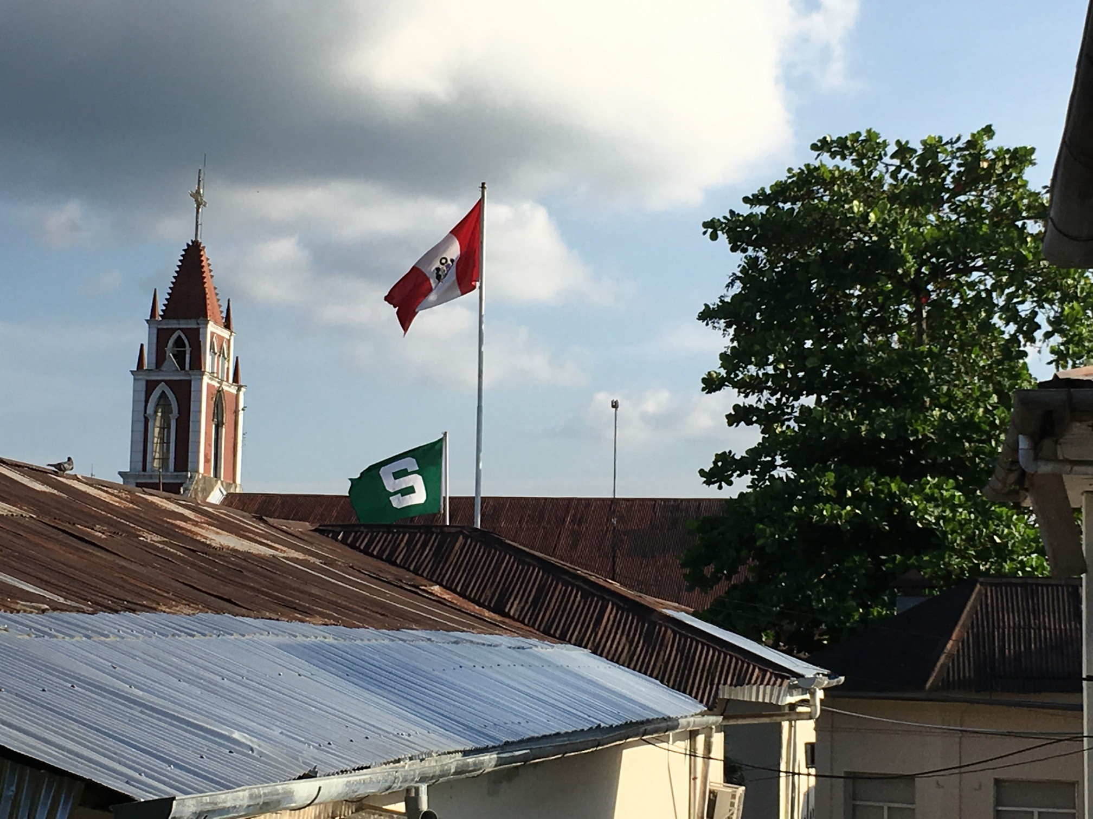
Who is an MSU Sponsored Traveler?
Affiliated with MSU during travel
Under MSU’s Duty of Care
Common examples:
  Education Abroad participant
  Connected to employment at MSU
  Connected to enrollment at MSU
  Funded by MSU
More information at globalsafety.msu.edu/sponsored-travel

Slide 20
Domestic Travel Policies
Returned to pre-pandemic policies
  Leadership of the unit approves travel
  No Domestic Travel Waiver required
  Follow travel authorization process in Concur
Specialized support to Domestic Study Away
Programs (students and faculty); currently refining
Minimum health and safety measures
  List of minimum health and safety measures available at
globalsafety.msu.edu/coviddomestic

Slide 21
International Travel Policies – Student Travel
Education Abroad students
  Faculty-led programs
  3rd –party provider programs
  Direct-enroll programs
  Exchange programs
These programs have a separate review process.
Non-Education Abroad students
  Ex. research, internship, conference travel
Partner vetting on the frontend is done whenever possible

Slide 22
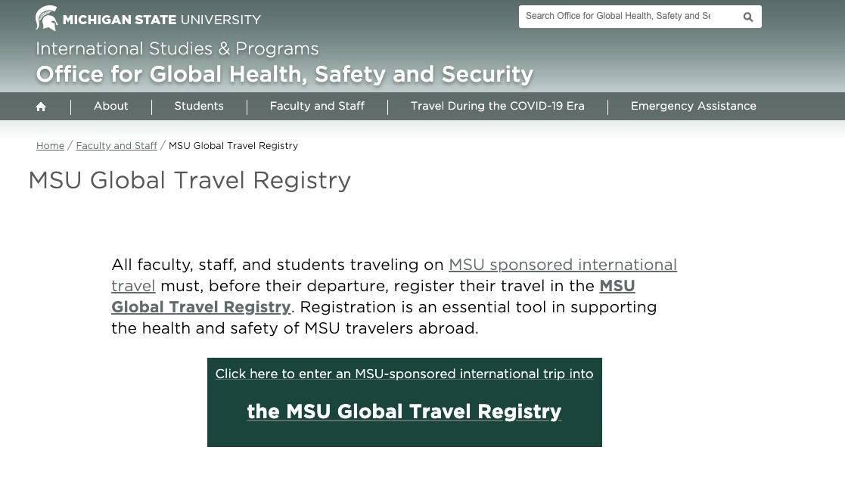
International Travel Policies - Overview
All MSU-sponsored
international travelers must register in the Global Travel
Register (GTR)
EA participants automatically
added into ViaTRM and ported
into ISOS Travel Tracker (API)
Allow at least 3 weeks for review
Additional review required for
high-risk destinations
Travel Waiver Request may be required

Slide 23
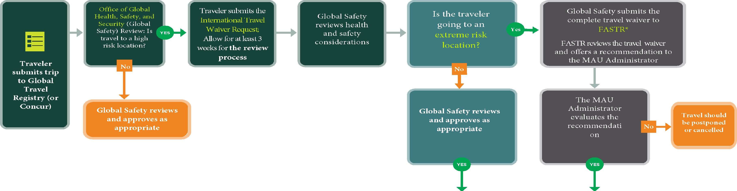


TRAVEL REVIEW PROCESS FOR MSU SPONSORED TRAVELERS
Please use -
the | following | flowchart | when | making | 1nternat1onal | travel | plans. | Questions | can | be | directed | to
Proposed Travel Has Been Approved
Proposed Travel Has Been Approved
The traveler will receive an email from Global Safety.
The traveler may complete necessary travel arrangen"l.ents, including registration in the GTR (travelregistry.msu.edu) or Concur, if applicable
The traveler will receive an e1nail fron1 FASTR and the MAU Administrator. The traveler may complete necessary travel arrangements, including registration in the GTR (travelregistry.msu.edu) or Concur, if applicable.
•Non-Education Abroad (EA) student travel follows the same travel waiver submission process and may be subject to review by RSAC rather than FASTR. RSAC will then offer a recommendation to the provost for final approval.
For EA travel, please reach out to the Office for Education Abroad.
For more information visit: globalsafety.isp.msu.edu
Updated 1.31.23

Slide 24
Submitting Travel Requests: Overview of Steps
Register travel in the Global Travel Registry (GTR)
Complete Concur request as applicable Global Safety Reviews travel
If high risk location: additional review by Global Safety initiated
Depending on review, Waiver Request may be required
a. Traveler then completes waiver
Extreme Destinations reviewed by FASTR / Separate Student process within RSAC where registration is dependent on EA status
Final Steps

Slide 25
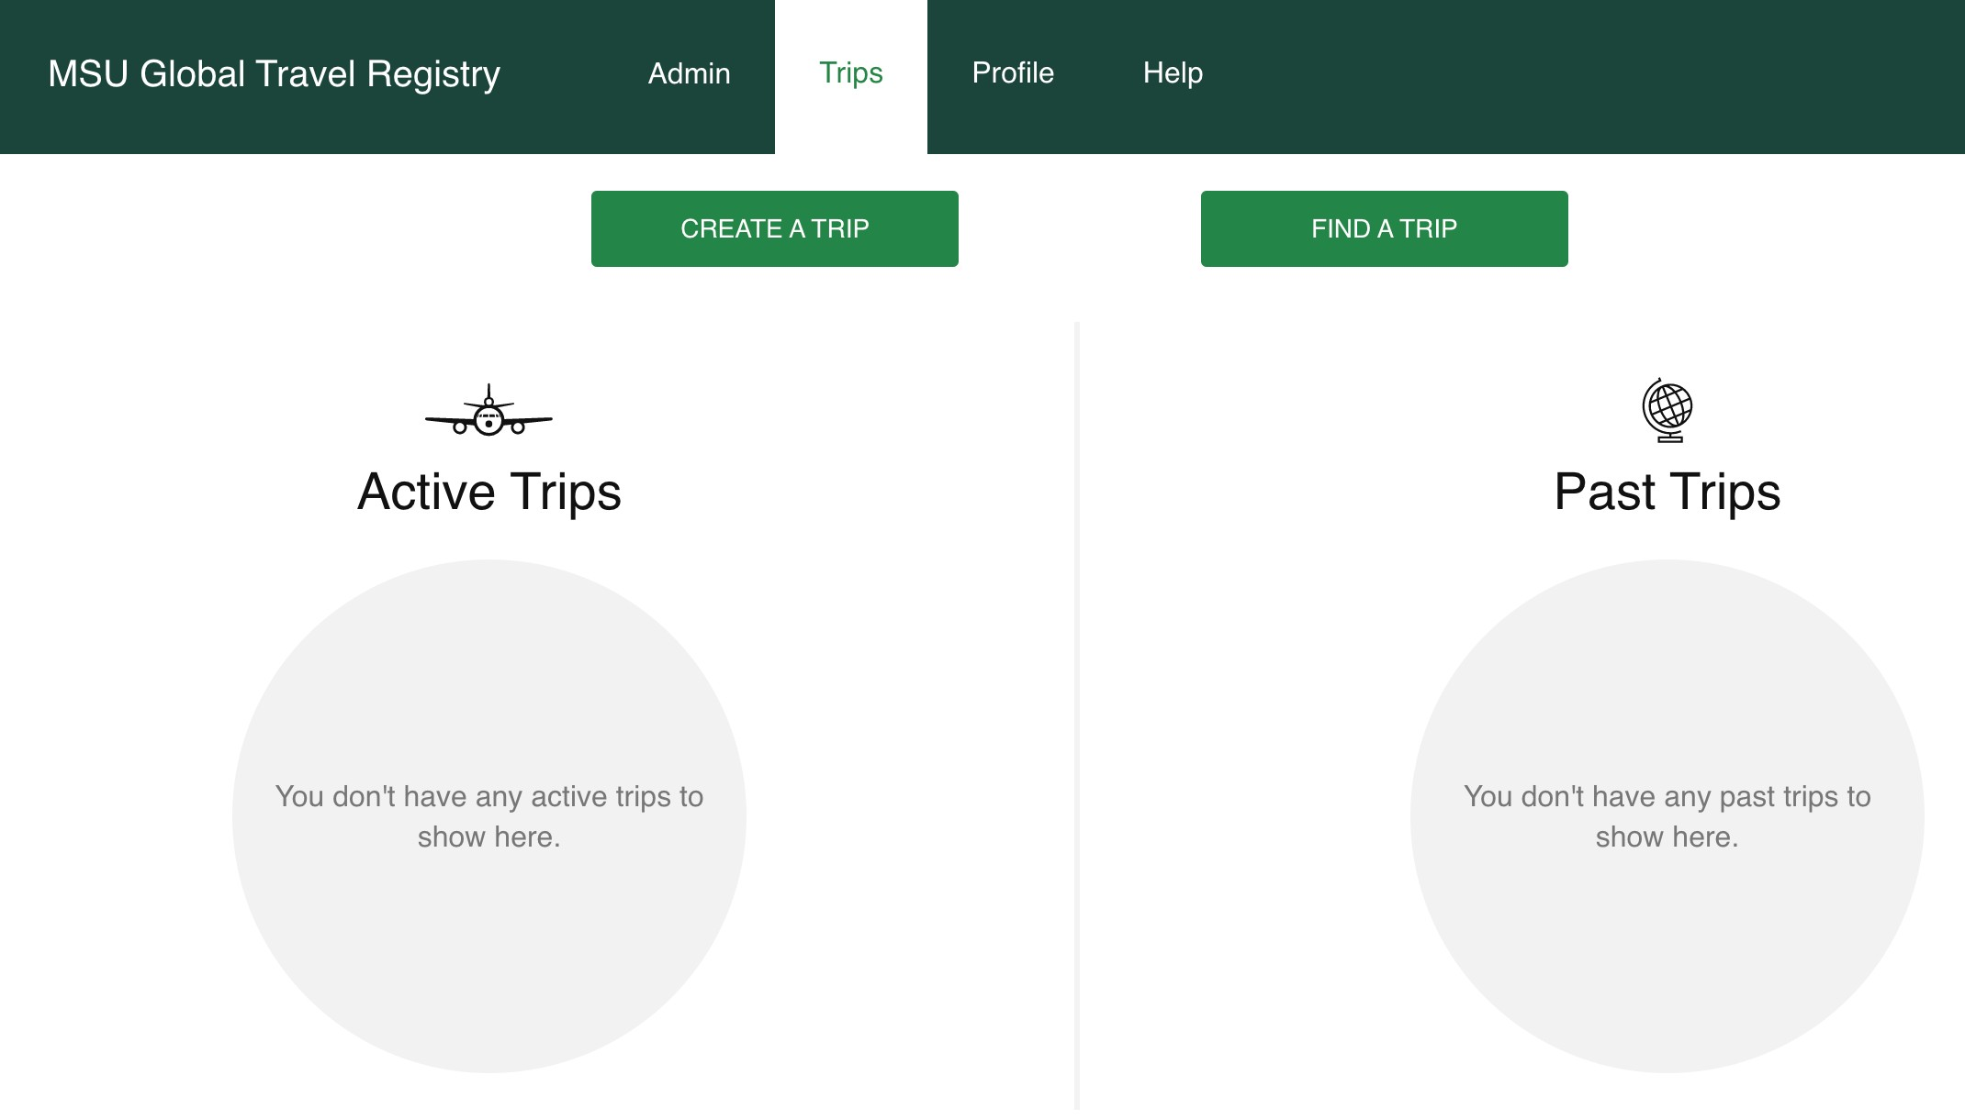
Step 1: Register in GTR
Includes itinerary and traveler info
Each trip registered separately
  EX: Travel to Japan in March for a conference requires separate registration than travel to Egypt in August for another conference
Step 2. Submit Concur request as Applicable
Concur request resources on Travel@State website

Slide 26
High Risk Destinations

Slide 27
Step 3: High-Risk Destination Travel Review
Global Safety will review travel
  Our office will reach out to traveler/ travel arranger or admin to clarify travel details to determine the correct type and level of review needed
Approved depending on travel details
  Travel may be approved at this stage by Global Safety or
  A waiver may be requested
27

Slide 28
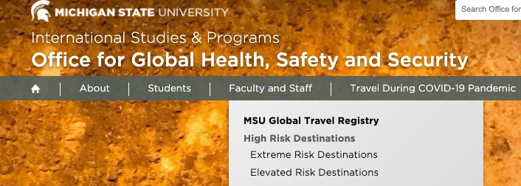
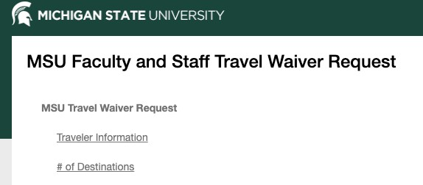
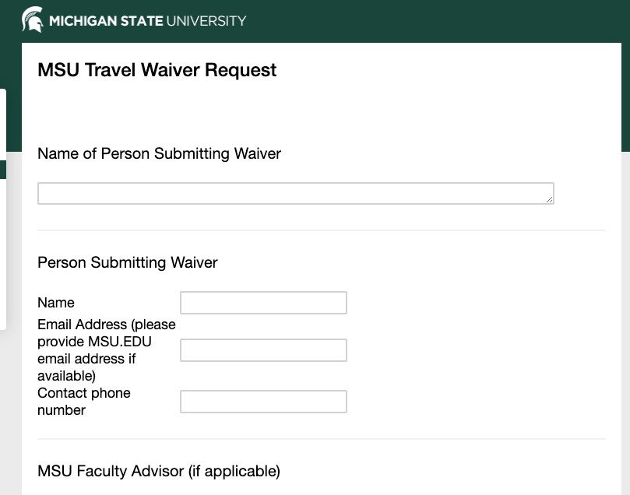
Step 4: Submit a waiver
Additional review for extreme and elevated risk destinations.
  Waiver Request must be submitted
  High-Risk Country List available on Global Safety website
Submit requests at least 3 weeks in advance
  allows for adequate time to review travel and move through approval process
globalsafety.msu.edu/staff-high-risk

Slide 29
Step 5: FASTR or RSAC (if student) Review for Extreme Risk Locations
Waiver request may be escalated to FASTR or RSAC committee review
  Global Safety will reach out to traveler/support admin if any further information is required
Once decision is made, traveler/support admin will be notified
  Recommendation by FASTR with final approval by Dean or Unit Head
  Recommendation by RSAC to Provost
29

Slide 30
International travel approval
Notification from the Office for Global Health, Safety, and Security or
Recommendation by FASTR / RSAC with final approval by Dean or Unit Head / Provost
Step 6: Final Steps
After approval
Traveler signs Acknowledgment of Risk form
Travel is registered in the GTR
Any pending requests in Concur and GTR registration will be approved
30

Slide 31
Security strategies to mitigate risk

Slide 32

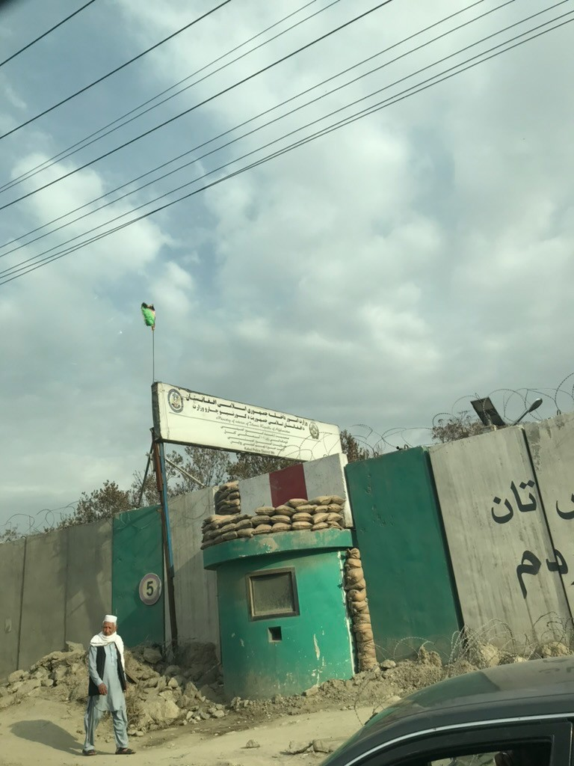
Security Strategies
ACCEPTANCE
Legal, economic or political sanctions. Possible counter-violence
Reduce or remove threats by winning hearts and minds
Devices/procedures used to reduce vulnerability
DETERRENCE
PROTECTION

Slide 33
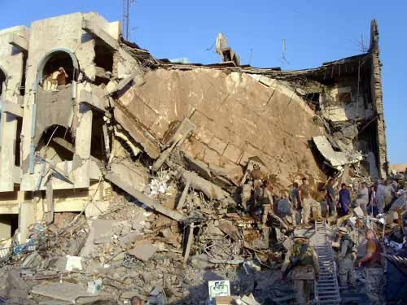
UN Security Risk Management (SRM)
SRM Methodology – Originally developed June 2004; iterated since
Prior to SRM, the UN used “Threat
Assessments” to determine levels of threat and identify Security Phases;
In SRM, Threat Assessment is one of
step of a multifaceted process with more focus on Risk Management.
SRM process produces a Security Risk Assessment (SRA) – which is a tool that can be undertaken at multiple levels: country or city level, individual building level, road mission, etc.
August 2003: UN HQ Baghdad, Iraq

Slide 34
Components of the SRM
Responds to the Duty of Care Looks at RISK by identifying by Threats, Vulnerability & Risk
Proactively assessing &
including Security and Safety
Security = risks to human
managing risks
Minimizing the risk of harm to
resources, assets, and
students, faculty and staff
operations as a result of intentional violence
traveling internationally through
the implementation of
comprehensive security policies
and procedures.
Safety = risks associated with
accidental hazards such as
Promoting readiness to respond
natural disasters, health risks,
to a crisis through up-to-date
and vehicle accidents
analyses

Slide 35
Components of the SRA
FACTORS | DESCRIPTION | TALLY | TOTAL
Types of Incident: | Carjacking Burglary Theft Abduction | X X X X X X X X X | 8 4 4 2
Time of Day: | Late afternoon Night | X X X | 2 4
Number of Perpetrators: | >1 3 4 5 | X X X X / | 2 4 2 1
Weapons Used: | ‘Armed’ Gun Iron bar | X X / / | 4 1 1
Location: | At/outside residence Office Parked on roadside Road block | X X / / / X | 5 1 1 2
Type of car: | Sedan 4WD (note parts removed from several cars) | X X / / X X | 5 1 4
Other factors of note: | Vehicle followed Entering Compounds | X / X X | 3 4
Threat Assessment: Information
is collected on current safety and
security threats in the operating
environment
Vulnerability Assessment:
Information about threats is analyzed through the lens of the
University’s identity, footprint and program profile to understand
how if may be more or less vulnerable to the various threats
Risk Assessment: A risk rating for
each type of threat is assigned
based on the analysis of how
likely a given security incident
could occur and how severe the impact

Slide 36
SRA Format
 |  |  | Risk |  | Vulnerability
Program Assessment | Threat | Impact | Likeli- hood | Risk (UnMit) | Weaknesses | Strengths | Mitigation Measures | Risk (Mit)
36

Slide 37
SRA Risk Matrix – Tanzania Example
Impact
Negligbile 1
No serious injuries, Minimal loss or damage to assets, No delays to programs
Minor 2
Minor Injuries, some loss or damage to assets, some program delays
Moderate 3 Non-threating injury, loss or
damage to assets, program disruptions
Severe 4 Serious injury, major disruption of assets,
severe program disruptions
Critical 5
Death or severe injury, total loss of
assets, loss of programs
RISK
Likelihood
Imminent 5
Low
Medium
High
Extreme
Extreme
Very Likely 4
Low
Medium
High
High
Extreme
Likely 3
Neglibile
Low
Medium
High
High
Possible 2
Neglibile
Low
Low
Medium
Medium
Unlikely 1
Nil
Neglible
Neglible
Low
Low
Unmitigated Risk Mitigated Risk

Slide 38
Travel Resources

Slide 39

Travel Health Insurance
International health insurance through International SOS (ISOS) and Chubb
  All MSU-sponsored international travelers are eligible!
  Must register in the Global Travel Registry
  ISOS has doctors on-call and can assist with arranging medical care
globalsafety.msu.edu/isos
39

Slide 40
International SOS
Comprehensive support for MSU travelers.
  24/7 phone line for urgent and non-urgent medical and security advice during pre-departure planning or while traveling: 1-215-942-8478.
  26 Global Assistance Centers and a network of vetted medical, dental, security, and transport service providers internationally.
  Robust medical and security evacuation.
  Mental health and emotional support services.
  Web portal and free phone app to sign up for alerts, research your destinations, or contact ISOS via chat.
globalsafety.msu.edu/isos
40

Slide 41
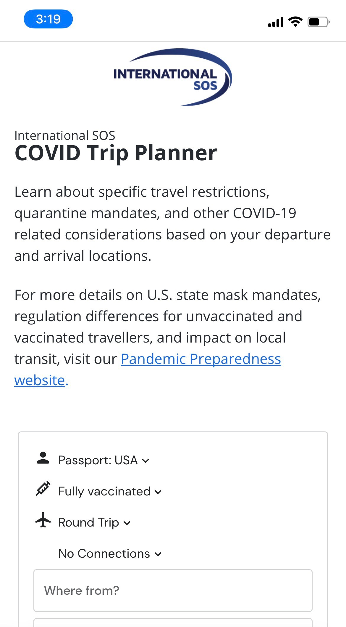
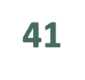
New ISOS app
Search “International SOS” in the Apple or Google Play Store
MSU membership #11BCAS798617
Recently revamped! Includes:
  Country entry requirements guide (powered by Sherpa)
  Pre-travel checklists
  Destination guide
  Alerts while traveling
  Check-in feature
  Direct access to call/chat with ISOS

Slide 42
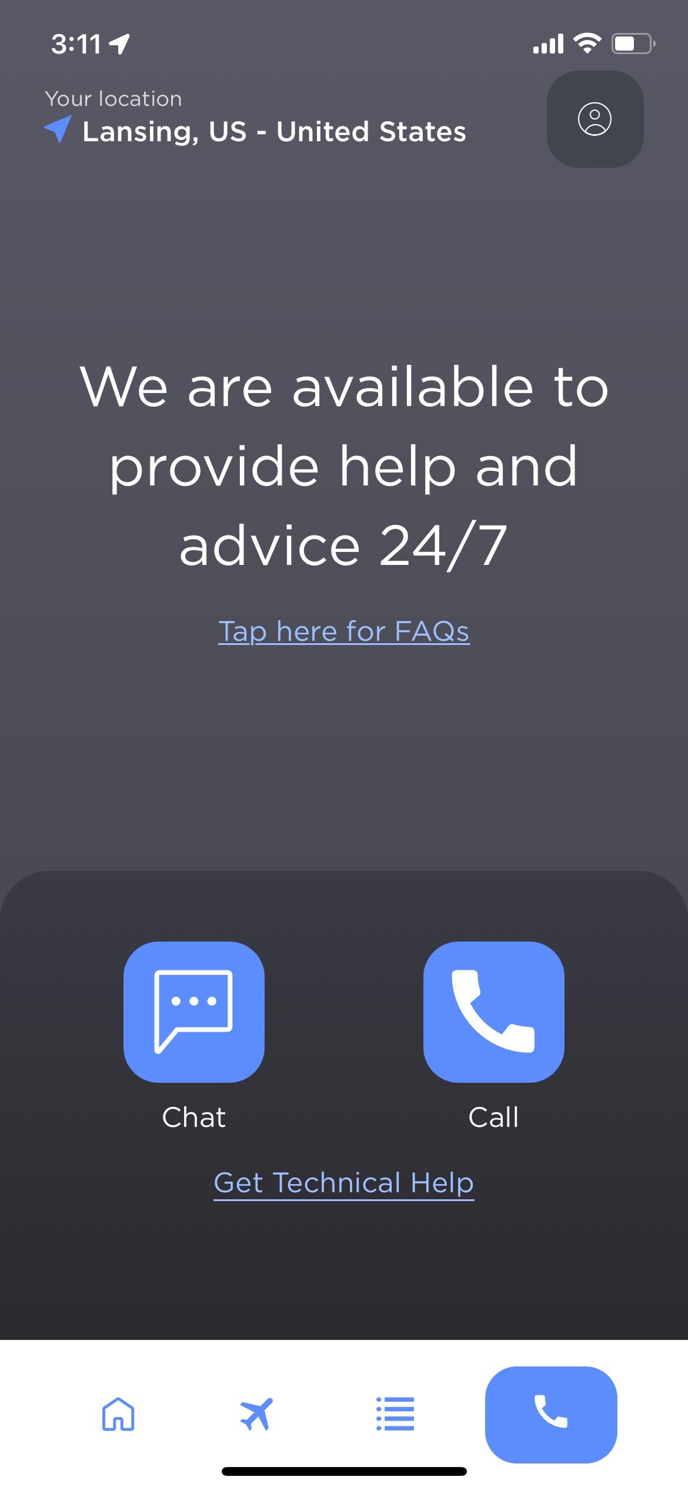
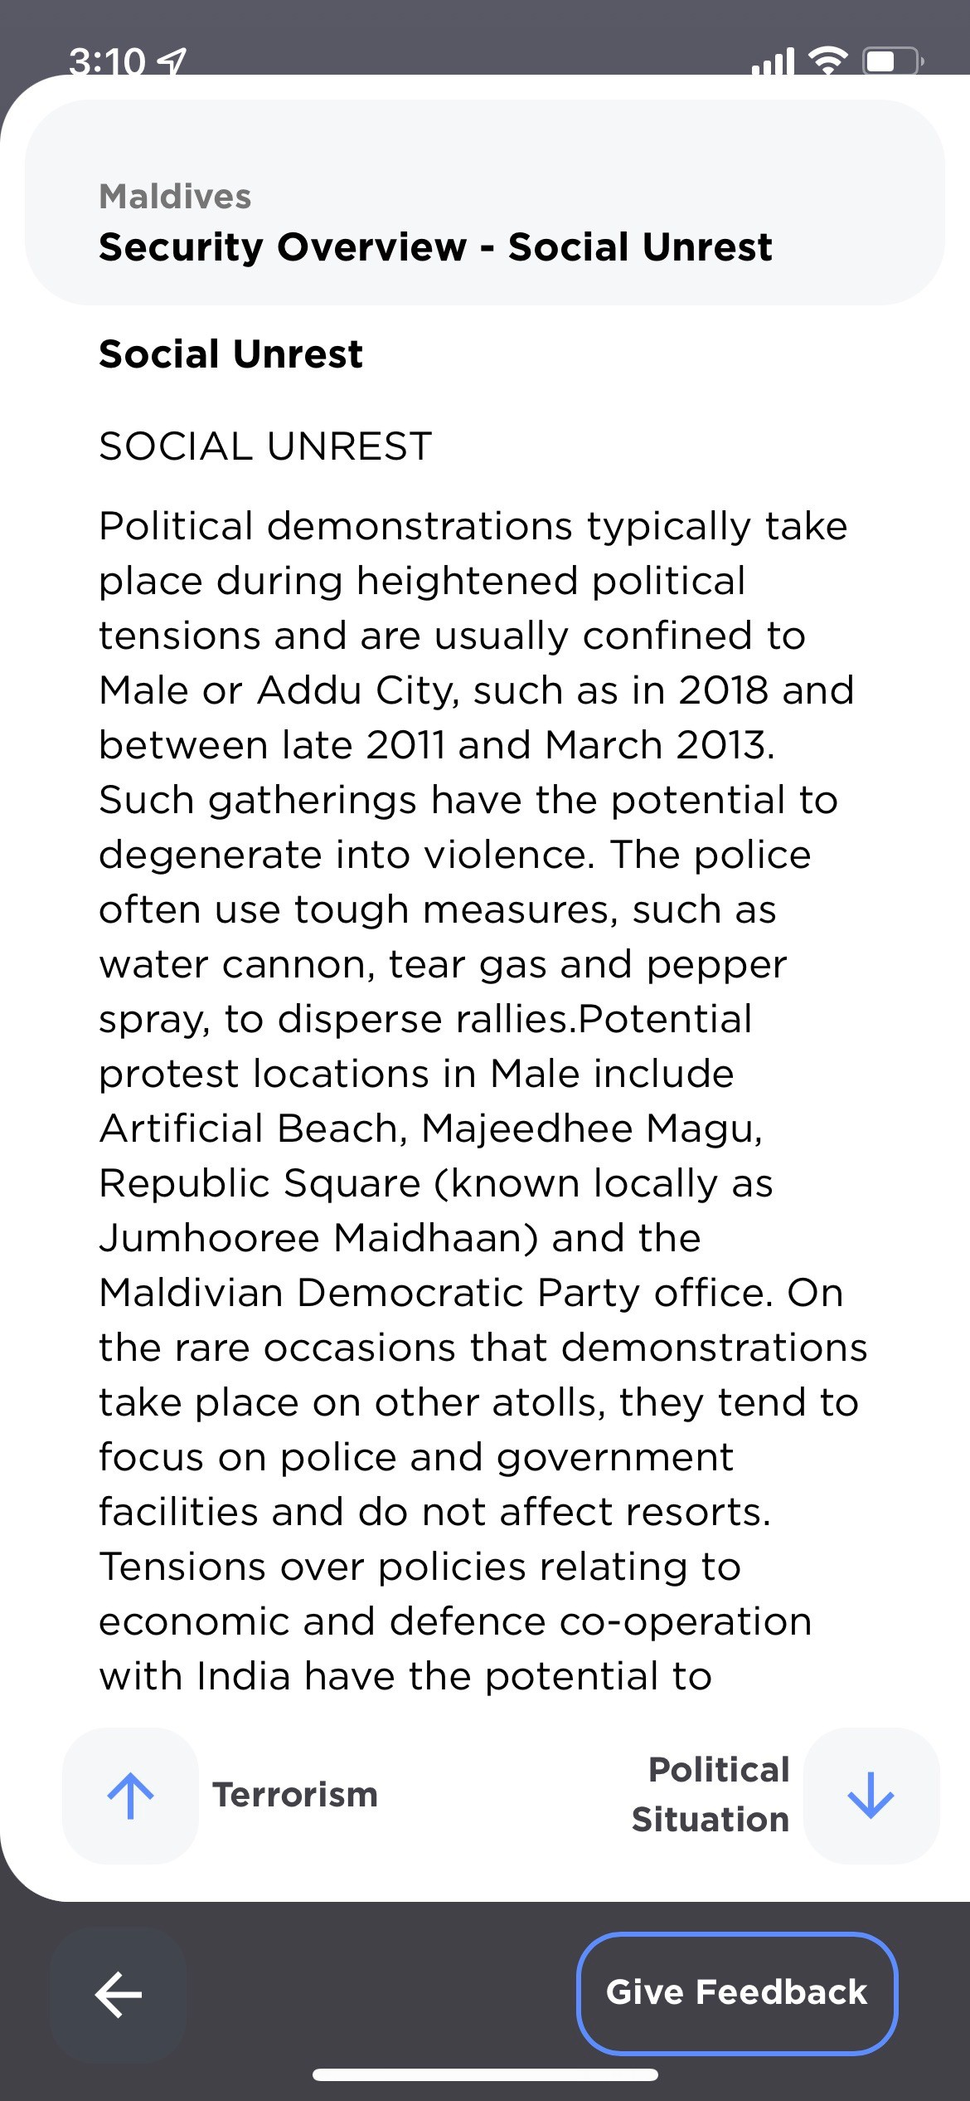
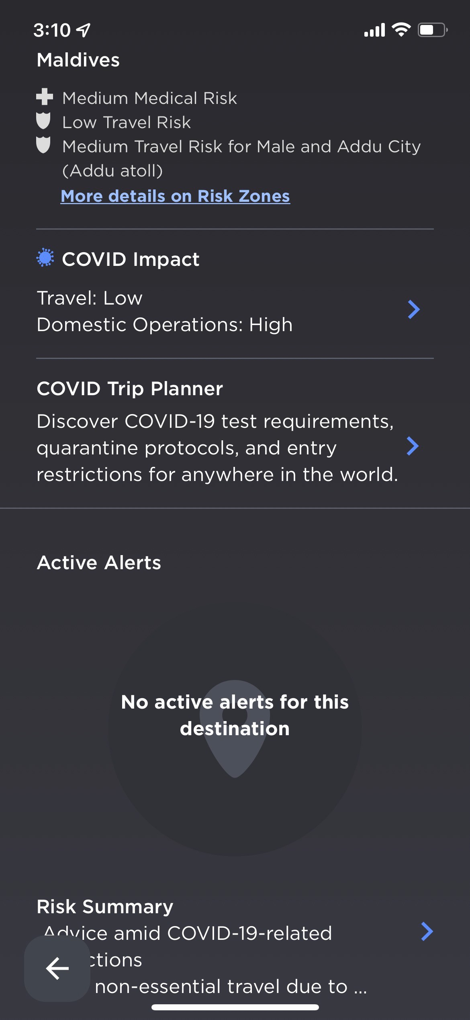
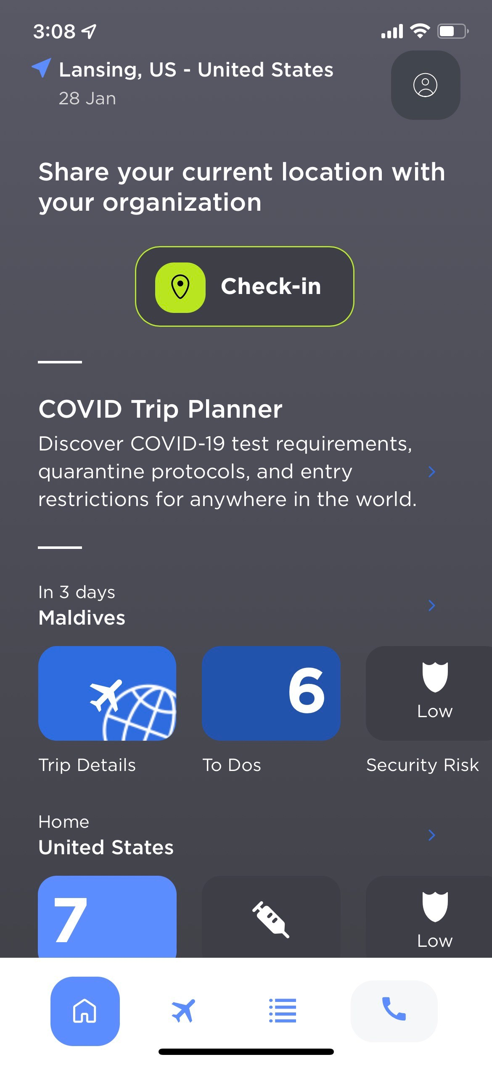
42

Slide 43
Insurance Information
MSU Health Insurance information available on Global Safety Website
  Coverage details, exclusions, link to full policy, etc.
  Contact Global Safety for proof of insurance letters
CFAR/IFAR Trip cancellation insurance-not offered by MSU
  Not required to participate in MSU sponsored travel
  Purchased independently
  Offers protection against trip cancellation and/or interruption
  More information found on website
43

Slide 44
24/7 Emergency Assistance
International SOS Scholastic Assistance Line
+1-215-942-8478
Medical Assistance Security Assistance Pre-trip Advice
MSU International Emergency Assistance Line
+1-517-353-3784
Further Assistance and Support from MSU
44

Slide 45
Questions & Discussion
Office for Global Health, Safety, and Security
globalsafety.isp.msu.edu 517-884-2174 globalsafety@msu.edu
45

