Slide 1
Role of the University Committee on Undergraduate Education
Secretary for Academic Governance Tyler Silvestri
September 29, 2022

Slide 2
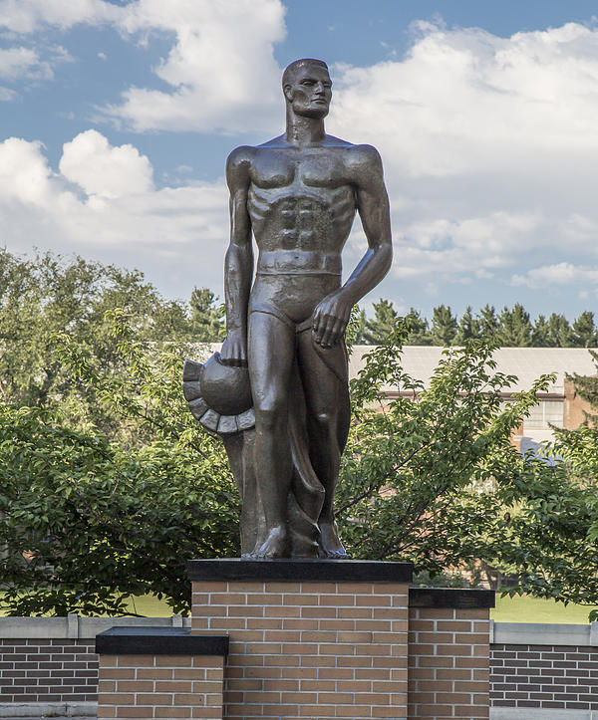
“It is important to specify the manner and process by which the faculty and students develop and communicate their views to the President and the Board. These Bylaws for Academic Governance are designed to provide an effective system for the participation of faculty and students in the development of policy on academic matters.”
Preamble of Bylaws for Academic Governance

Slide 3
The Steering Committee
Faculty Senate
Standing Committees
University Council
Associated Students of Michigan State University
Council of Graduate Students
Advisory-Consultative Committees
Standing Committees
Athletic Council
Faculty Healthcare Council
Ad-Hoc Committees

Slide 4
MSU Academic Governance System
University Council
Faculty Senate
University Committee on Academic Governance
University Committee on the Libraries
University Committee on Curriculum
University Committee on Undergraduate Education
University Committee on International Studies & Programs*
University Committee on Faculty Affairs
University Committee on Graduate Studies
University Committee on Honors Programs*
University Committee on Faculty Tenure
University Committee on Student Affairs
University Committee on Military Education*

Slide 5
Modes of Participation
Defined in Bylaws for Academic Governance
Mode | Whose Opinion Is Sought | Authority
Consultation | The individuals on the body | The administrator
Advisory | The body itself | The administrator
Shared Responsibility | The body itself | The next-highest administrator, if agreement cannot be reached
Delegated Authority | The body itself | The body (except in exceptional circumstances)

Slide 6
University Committee on Undergraduate Education
Role | Mode
Grading policy for undergraduate students | Delegated Authority
Use of grades and GPAs for undergraduate admissions and for advancement in/graduation program from undergraduate academic programs | Delegated authority
Review all changes in undergraduate academic programs and recommend approval/rejection to UCC | Advisory
Establishment, moratorium, discontinuance, or merger of undergraduate academic programs | Shared responsibility with Dean of Undergraduate Studies to consult with the Provost
Policies pertaining to curriculum revision, methods of instruction, evaluation of instruction, and advising/counseling for undergraduate students | Shared responsibility with Dean of Undergraduate Studies to consult with the Provost
Policy pertaining to admissions and retention, financial aid, and the use and distribution of educational and research resources for undergraduates | Shared responsibility with Dean of Undergraduate Studies to consult with the Provost
Work with Dean of Undergraduate Studies and the Provost and make recommendations to the University Council on all other matters of academic policy affecting undergraduate students | Advise and Consult

Slide 7
NEW Request – Requires Funding
CHANGE Request – May Require Funding
Dean/Provost Conversation during College Planning and Budget process
1. Initiation of Program Concept by Department/Dean
1. Department
1. Department
2. Dean/Provost Consultation
2. College
2. College
3. Department
3. University Curriculum & Catalog, Office of the Provost
4. College
3. University Curriculum & Catalog, Office of the Provost
Provost Consultation with Dean (including Office of Planning and Budgets Analysis)
5. University Curriculum & Catalog, Office of the Provost
4. University Committee on Curriculum
Subcommittee A, B, or C
Provost Determination
6. Provost Consultation (including budget analysis)
UCUE advice
UCGS advice
TEC consultation
After consultation with the Dean and the Office of Planning and Budgets, the Provost will make a determination about the forwarding of the program request to the University Committee on Curriculum for approval of its curriculum and degree requirements.
UCUE advice
UCGS advice
TEC consultation
5. UCC Full Committee
4. University Committee on Curriculum
Subcommittee A, B, or C
Provost Determination
Upon receipt of consultative commentary, the Provost will determine if the program request will be forwarded to the University Committee on Curriculum for approval of its curriculum and degree requirements.
6. Faculty Senate
Statewide Academic Program Review (name changes only)
UCUE advice
UCGS advice
TEC consultation
7. University Committee on Curriculum
Subcommittee A, B, or C
5. UCC Full Committee
8. UCC Full Committee
6. Faculty Senate
9. Faculty Senate
Statewide Academic Program Review (name changes only)
10. Statewide Academic Program Review

