Slide 1
Sustainable & Just Investing Policies and Practices at MSU
Ad Hoc USIWG (University Sustainable Investment Working Group)
Rex LaMore, Ph.D., Karen Kelly-Blake, Ph.D., Stephen Gasteyer, Ph.D., Emma Gilbert, Joseph Allen, Marianna Coelho Uchoa, Michelle Hoexum, Daniel Ahlquist, Ph.D., Dave Ewoldson, Ph.D., John Melcher, Cody Evans, Alice Puchalsky, and Eli Folts
January 31, 2023
Notes:
Welcome

Slide 2
An Impetus for Change
The overarching beliefs that have guided the Ad Hoc USIWG through this mission are relatively straightforward:
As a public institution, it is our obligation to seek the highest degree of stewardship and accountability in managing our investments.
It is fundamental to transparently demonstrate MSU's community values in the way that the Common Investment Fund (CIF), our institutional endowment, is managed and invested.
MSU's ability to advance specific Environmental, Social, and Governance (ESG) goals from its Strategic and DEI Plans should be directly reflected in investment policy and practice.

Slide 3
A Chronology of Our Efforts
In November 2021, a group of faculty, students, and concerned outside partners, who came to be the Ad Hoc University Sustainable Investment Working Group (USIWG), presented its first resolution to the University Council regarding sustainable and just investing at MSU.
The resolution called upon the Board of Trustees to create a ten (10) person task force, which would include members of the Board of Trustees and faculty and students across MSU, to investigate the alignment between the Board's Endowment Investment policies and practices with the goals and values adopted in the university's 2021 Strategic and DEI Plans.
The resolution passed through the University Council with significant support.
Approximately 80 percent of the council voted to pass the resolution.
However, the Board of Trustees decided not to take action upon the resolution.
Notes:
Overview/Background of the USIWG
Report (say “hope you all had the chance to read our report prior to coming here”)

Slide 4
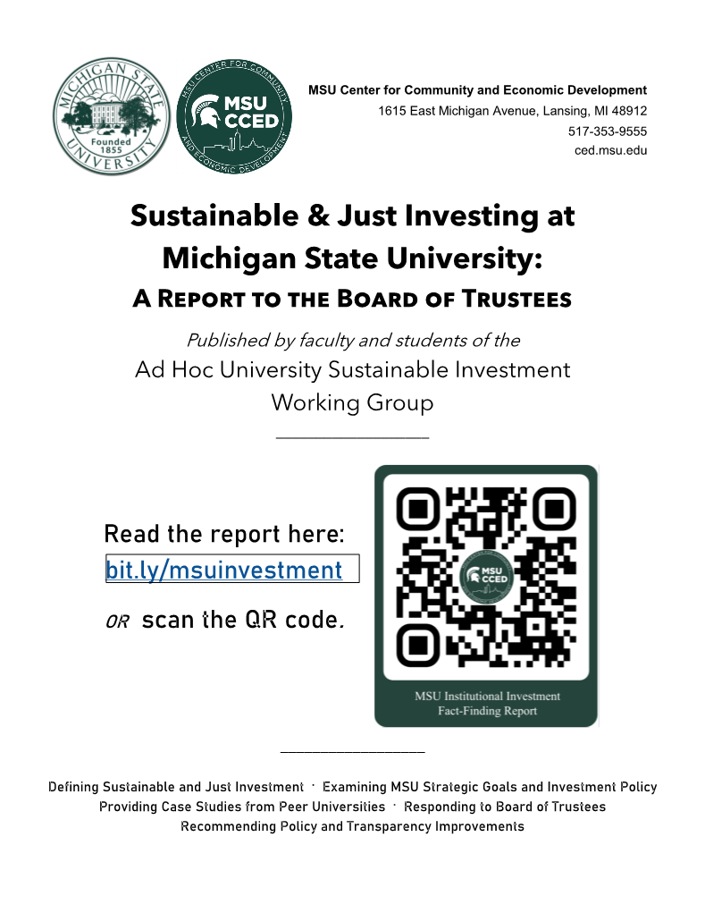
Our Continuing Efforts
Recognizing the importance of the topic, and in spite of the BOT’s failure to act, the Ad Hoc USIWG undertook a fact-finding investigation to more fully understand the policies and practices that the MSU Board of Trustees are employing to guide the University’s investment portfolio and to recommend how we might align our investment practices with our stated values as expressed in our recently adopted Strategic and DEI plans.
In April of 2022, on Earth Day, the working group presented to the Board a fact-finding survey that was completed by the MSU Board of Trustees’ designated representative in June.
The responses to that survey and additional research of the Working Group resulted in the publication of a fact-finding report over the summer of 2022.
Notes:
Overview/Background of the USIWG
Report (say “hope you all had the chance to read our report prior to coming here”)

Slide 5
Ongoing USIWG Efforts
In 2022:
We worked on our report and recommendations for the MSU BOT;
We presented our report to the BOT at their first meeting of the 2022-2023 academic year on September 9th;
We presented to several student and faculty organizations in order to spread the word and make connections around the issue of sustainable & just investing at MSU; and
The USIWG with the guidance of a resolution sub-commit crafted a resolution, for consideration for the University Council (UC) and other stakeholders.

Slide 6
Overview of Resolution being Presented to the UC for Consideration
Three Actions are called for in the proposed resolution:
That the MSU Board of Trustees develop and adopt a social conscience framework in its investment policy statement to be transmitted and employed by the investment firms that manage MSU’s endowment; and,
That the MSU Board of Trustees expand the network of investment firms that it uses for managing MSU’s endowment to ensure a competitive approach to supporting the social conscience framework; and,
That where reasonable, the Board of Trustees make Budget & Finance Committee meetings and Investment Advisory Subcommittee (IAS) meetings open to the public in order to demonstrate the Board’s commitment to transparency in all its deliberations.

Slide 7
Thank you! If you have any questions, feel free to reach out to Dr. Rex LaMore (lamore@msu.edu).

