Slide 1
University Council March 26, 2024
Laura Rugless (she/her)
Vice President and Title IX Coordinator
Office for Civil Rights and Title IX
Education and Compliance

Slide 2
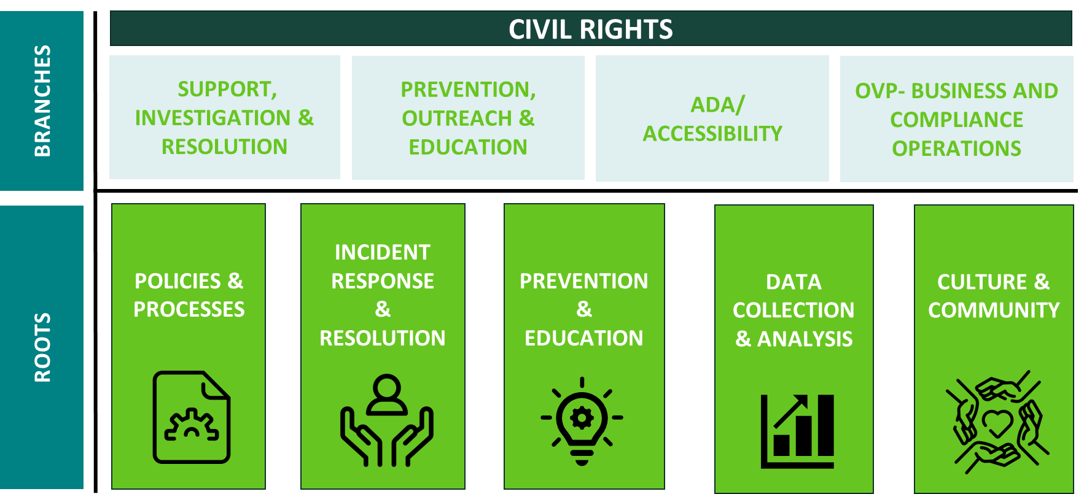
OCR Framework

Slide 3
OCR Strategic Priorities
Develop
Develop the structure and resources of OCR to meet the evolving needs of MSU and the university community.
Improve
Improve campus safety and culture through robust prevention, support and response.
Enhance
Enhance MSU’s civil rights profile and measure the impact of our efforts relative to higher education nationally.

Slide 4
Key Initiatives – Develop and Improve
SUPPORT AND INTAKE
Policies
Reporting and Case Management System
POE Training
Digital Accessibility

Slide 5
Redeveloped SIT approach provides 360 person-centered support and guidance sooner
Support and Intake combined to provide a streamlined experience at the onset of receiving OCR services.
A new step in the process, Options Meetings, is designed to inform parties about resources, supportive measures, party rights, and OIE processes before meeting with an investigator if they choose.
The timely response in outreach, approximately 2.5 business days from the initial report, coupled with Option Meetings, will enhance community member’s experience with the OCR support and intake process.

Slide 6
More robust civil rights policies help drive reporting, support and response
New this year – based on existing protocols
Mandatory Reporting for Relationship Violence, Sexual Misconduct and Stalking Policy
Pregnancy, Childbirth and Other Pregnancy Related Conditions for Students and Employees
Currently under revision
Anti-Discrimination Policy
Digital Content and Web Accessibility Policy
Anticipated revision
Disability and Reasonable Accommodation Policy
Relationship Violence and Sexual Misconduct and Title IX Policy (depends upon new Title IX regulations)

Slide 7
New technology will enhance capabilities for tracking and analytics
New case management system has expanded reporting and monitoring ability to increase communication and shorten timelines
Weekly metric inspections to inform operators of volume and develop solutions in real time
Development of suite of analytics will be used to inform prevention efforts and increase transparency

Slide 8
Prevention, Outreach and Education (POE) offerings enhance safety and improve response
Multi-tiered approach for undergraduate students results in learning beyond compliance
Specialized trainings and programs for athletics, fraternity and sorority students and REHS
Online and in-person programming for employees and graduate students creates consistent knowledge across campus
Other learning opportunities such as the POE Annual Summit and requested trainings
Climate and Response Unit work with units across the university in developing strategies to promote healing and culture change
Request a training:
POE.Training@msu.edu

Slide 9
Campuswide digital accessibility collaboration enhances inclusion and access
Raises awareness of digital accessibility by maintaining a Digital Accessibility Liaison as a point of contact in each MSU unit
Empowers faculty and staff through web-based tutorials, free access to training courses, and the Digital Accessibility website
Improves campus culture via regular meetings, dashboards with accessibility metrics, and an annual self-review survey
Provides guidance and support to units needing assistance

Slide 10
Federal/National Level
Increase in U.S. Dept of Education Title VI shared ancestry complaints
Help students
Address hostile environments
Ensure access
Possibility of new Title IX regulations this spring or summer – more to come
AI policies that center equity and civil rights

Slide 11
Thank you! Questions?
Visit: civilrights.msu.edu
Contact Us:
OCR.laurarugless@msu.edu
OCR.eltarohooper@msu.edu
OCR.tracyleahy@msu.edu
POE.kellyschweda@msu.edu

