Slide 1
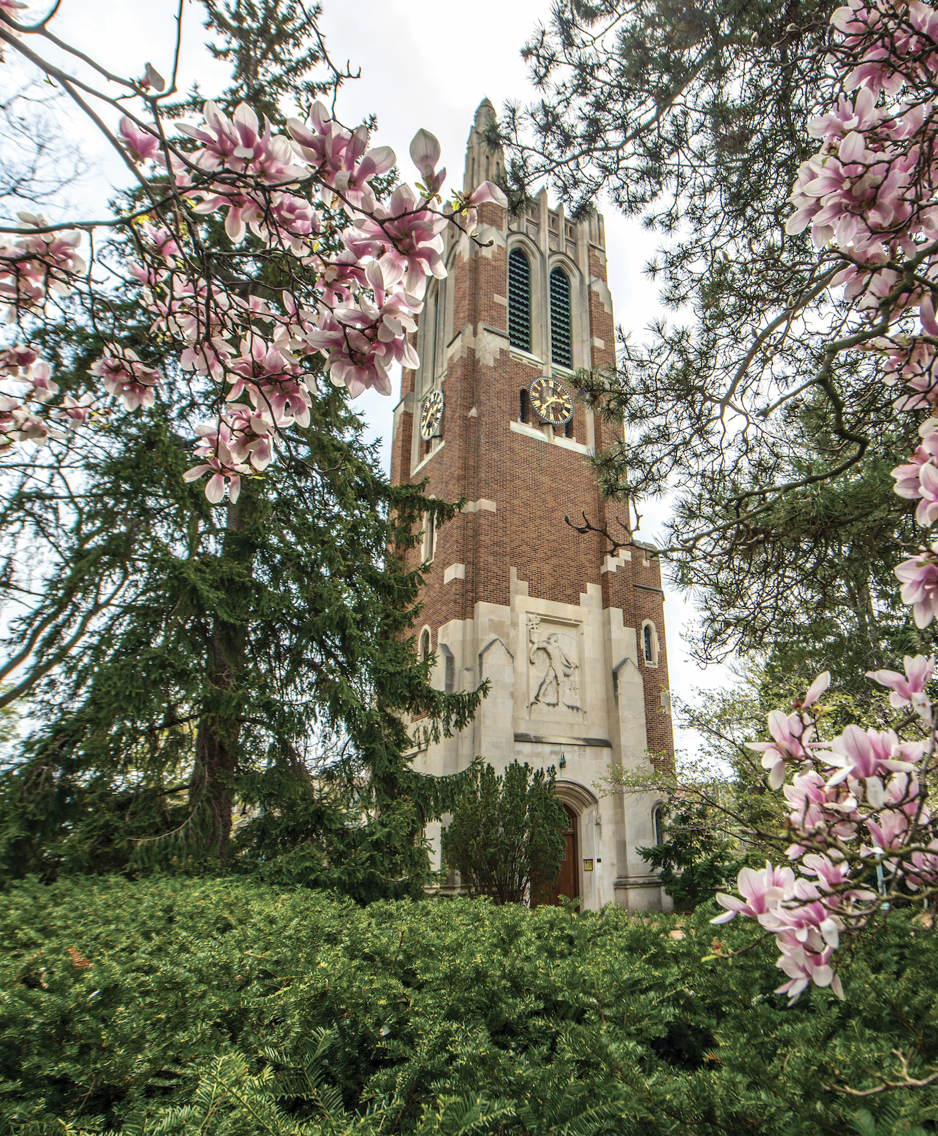
Undergraduate Student Success
Dr. Mark Largent
Vice Provost and Dean of
Undergraduate Education
Dr. Renata Opoczynski
Assistant Provost for
Undergraduate Student Success
Nov. 21, 2024

Slide 2
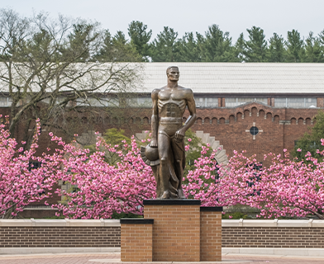
Updates on Undergraduate Student Success Initiatives
First Gen Center
Lansing Cohort Program
Advising Initiative
Transfer Student Success
Coordinated Retention Support

Slide 3
First Gen Center
Leads: Undergrad Ed. (Dr. Christina Bridges and Dr. Heather Shea)
Expand first-generation student support programs with designated space to help foster sense of belonging. Allows for innovative programs and provides centralized support to students in one physical location.
Current Progress on Existing Initiatives:
Since 2021, MSU designated as First Gen Forward Network Member
FLI (First-Generation Leadership & Innovation) Vanderploeg Scholars and TRIO Student Support Services both explicitly name first-gen students in mission/purpose
Next Steps:
Fall: Build committee membership
Spring: Explore higher ed landscape, learn from peers, literature, and research; MSU SWOT analysis; review existing MSU data and assessments; propose structure
Assess and determine physical location
Notes:
Aims to expand our first-generation student support programs with the potential for designated space on MSU’s campus to hep foster a sense of belonging. The First Gen Center should allow for innovative programs and provide centralized student support services to students in one location.
Leads: Undergrad Education - Dr. Christina Bridges and Dr. Heather Shea
Goal: Identify opportunities looking at best practices and research-based approaches while being mindful of MSU’s culture, needs and opportunities
Current Progress on Existing First-Gen Initiatives:
Since 2021, MSU designated as First Gen Forward Network Member through NASPA.
This work involves committing to certain First Gen focused initiatives and setting institutional goals each year (related to policies and practices, not retention or graduation metrics).
There could be alignment with expansion of the Vanderplough-funded First Generation Leadership and Innovation (FLI) program. Proposal and ideas for this are underway with Sarah Ward (director of FLI).
MSU TRIO Student Support Services also explicitly name first-gen students in their mission/purpose. So work is already being done there.
Next Steps:
Fall: Build out committee membership
Spring: Explore the higher education landscape to learn from peers and understand lessons from literature and research; MSU SWOT analysis; review existing MSU first-gen data and assessment; propose structure and needs for First Gen Center at MSU
Assess and determine physical location (Hannah Admin Bldng, Union, Student Services)

Slide 4
Lansing Cohort Program
Leads: Undergrad Ed (Dr. Joy Hannibal and Jared Stratz)
Cohort support program for Lansing residents to attend MSU and meet needs of Lansing.
Summer bridge experience, peer mentors, academic success workshops, tutoring, etc.
Current Progress on Existing Initiatives:
Spartan Lansing Promise Scholars program since 2022
Aligns with and modeled after other place-based cohort programs, like Detroit M.A.D.E.
Next Steps:
Fall: Build workgroup inclusive of Lansing community and MSU
Spring: Identify goals, opportunities, and MSU/Lansing needs; propose structure.
Summer: Recruit first cohort
Notes:
Leads: Dr. Joy Hannibal and Jared Stratz
Overall Goal: Create a “city-based” cohort support program for Lansing residents to attend MSU and meet needs of the Lansing community
Details: Summer bridge experience, peer mentors, academic success workshops, tutoring, etc.
TBD: Could be limited to Lansing or opened to Greater Lansing. Community feedback will help solidify decision.
Current Progress on Existing Initiatives:
Since 2022 have had Spartan Lansing Promise Scholars program.
Original proposal created a few months ago building from current work to support Lansing Promise Students, and the Detroit MADE model.
Lansing Cohort model can closely follow other existing place-based cohort programs such as Detroit M.A.D.E.
Expect it to be similar with recruiting from the local community and providing robust support across all five areas of student success including a summer transition opportunity
Examples - would provide a summer bridge experience, peer mentors, academic success workshops, tutoring, etc.
Our costs would include scholarships for the students, programming costs, and staff salaries.
Next Steps:
Fall: Build membership of the workgroup inclusive of Lansing community and MSU
Spring: Identify goals, opportunities, and needs from MSU and Lansing stakeholders; propose structure and needs for program
Summer: Recruit first cohort

Slide 5
Advising Initiative
Lead: Undergrad Ed (Dr. Ebony Green)
Create a University Advising Team that will serve Exploratory and Exploring Business Preference students
Lead reforms to better support advising across campus
Current Progress on Existing Initiatives:
Advisors Hired and University Advising Structured into Four Interest Areas
Exploring Business Preference Created and Fall 24 Students Welcomed and Advised
Increased Advising Resources in Several Colleges
Initial Identification of Advising Challenges Across Campus Complete
Next Steps:
Assemble and Charge Committees of Subject Matter Experts to Explore Identified Challenges and Offer Recommendations to Appropriate Leaders

Slide 6
Transfer Student Success
Lead: Undergrad Ed (Dr. Portia Watkins)
Improve Credit Evaluation
Expand Envision Green
Make MSU a Transfer Friendly Institution
Current Progress on Existing Initiatives:
Created Transfer Student Success Center (TSSC) in 2021
Created Envision Green Advising Partnership in 2019 and expanded in 2023
Next Steps:
Year 1: Build out workgroups and begin technological improvements for Transfer Credit Evaluation; MOU resigning with LCC; Launch Transfer Advocacy Coalition; Explore Credit for Prior Learning, create a physical location for the TSSC
Year 2: Expand academic mapping; improve transfer communication/websites; expand Envision Green
Notes:
Articulation Agreements
Transfer Guides
Curricular Guide/traditional academic maps: recommend which courses students should take based on their intended transfer destination.
Internal Advising guidance - documented guidance provided directly to academic and faculty advisors and updated regularly

Slide 7
Coordinated Retention Support
Lead: Undergrad Ed (Dr. Christina Bridges and Justin St. Charles)
Coordinating retention outreach across the institution
Expanding retention-based data and analytics
Enhancing retention grant support to students
Current Progress on Existing Initiatives:
Coordinated retention outreach through Strategic Retention team
Enhanced retention data and partnership with Institutional Research
Departure Survey launched this semester
Landscape analysis of all retention grants at MSU
Next Steps:
Current work: Creating a centralized application; coordinated workflow for individualized approval but coordinated outreach and support
Spring: Communication strategy and launch of centralized application
Notes:
https://undergrad.msu.edu/strategy-retention/departure-survey

Slide 8
Question and Comments
Dr. Mark Largent
Vice Provost and Dean of
Undergraduate Education
Dr. Renata Opoczynski
Assistant Provost for Undergraduate
Student Success
Nov. 21, 2024

