Slide 1


Prevention, Outreach and Education Overview
poe.msu.edu

Slide 2




Office for Civil Rights and Title IX Education and Compliance
Office of the Vice President and Title IX Coordinator
Prevention, Outreach & Education (POE)
Investigations, Support & Resolution
Office of
ADA Coordinator
poe.msu.edu
isr.msu.edu
To learn more about the Office for Civil Rights, please visit civilrights.msu.edu

Slide 3


Department Mission & Focus Areas
"Empowering community commitment to end gender-based violence through education, outreach and social change."
Educate the University community
Eliminate gender-based violence
Affect positive social change

Slide 4





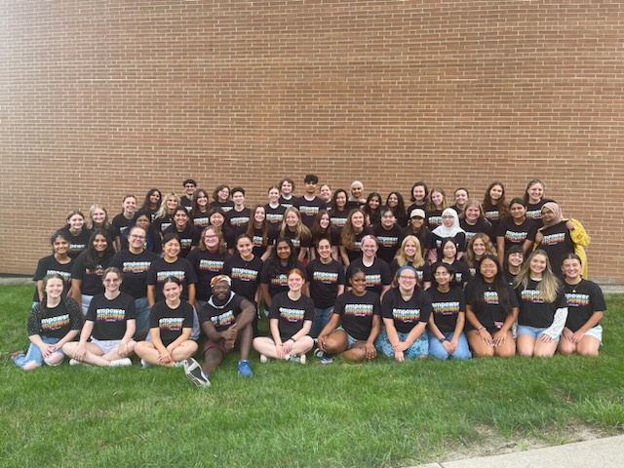
Undergraduate Student Prevention Services
STUDENT
VOICES FOR
PREVENTION
INITIATIVES
PEER
EDUCATION
2023-2024
Peer Educator Team
ONLINE
UNDERGRADUATE
EDUCATION

Slide 5

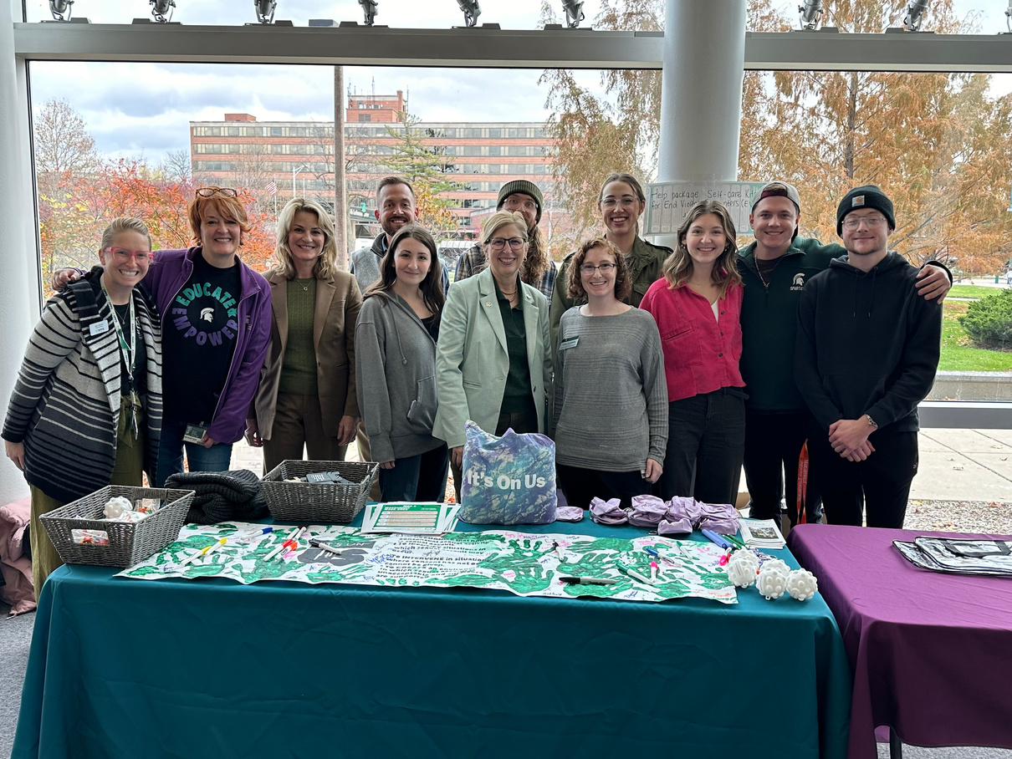
Employee and Graduate Student Prevention Services
MSU
HEALTH CARE
EDUCATION
EQUIPPING
SPARTANS
FOR FIELD
PLACEMENT
FACULTY
& STAFF
SUMMIT
ONLINE
FACULTY & STAFF
EDUCATION
ONLINE
GRADUATE STUDENT
EDUCATION

Slide 6






Climate & Response Unit
Climate & Response
Process
Community
Conversations
Tailored Trainings
Consultation
CLIMATE
ASSESSMENT
TOOLKIT
C&R
3-PART
SERIES

Slide 7

Anti-Discrimination Policy (ADP) Education
Building Campus Partnerships
Presentation Pilots
New Staff

Slide 8



Questions?
POE.MSU.EDU
EMPOWER@MSU.EDU
MSUPOE
MSUPOE

